Slide 1
Empowering ACOs:
Leveraging Quality Management Tools for MIPS and Beyond
Shannon Campbell and Hazel Morrison

Slide 2
  Regulatory Requirements for ACOs
  How to avoid common pitfalls for ACOs
  Using MeasureAble for MIPS and beyond

Slide 3
Regulatory Requirements for ACOs

Slide 4
Poll Question # 1
How actively do you monitor your quality performance throughout the year?
Annually
Quarterly
Monthly
Actively/continuously

Slide 5
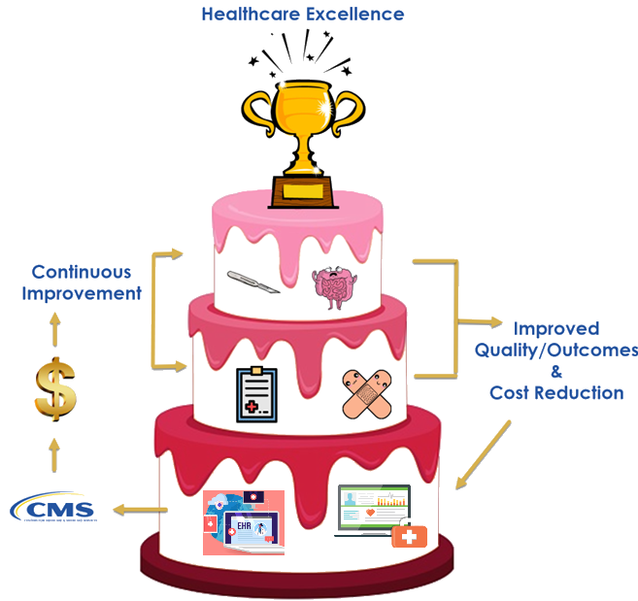
Intent of Quality Payment Program

Slide 6

Intent of Quality Payment Program
Culture of continuous monitoring of performance.
Don't simply engage in the measures during the submission period.
Waste of investment in EHR and data collection.
Risks patient outcomes.
Do monitor performance throughout the calendar year.
Identify and close gaps before submission.
Improve patient care.
Provide control over measure scores and financial incentives.
Why ACOs should embrace a culture that aligns with QPP:
Closure of performance gaps
Improve scores
More agile
Better equipped to adjust to CMS changes
Maximize financial incentives
Data sharing among organizations within the ACO
  Supporting the continuum of care
  Shared accountability for patient care

Slide 7
Poll Question # 2
How actively do you manage performance?
We do not have care gap closure processes. We submit the data to CMS.
We notify member organizations about care gaps.
We identify patterns in care gaps and provide member organizations with insights for improvement.
We actively work with member organizations to improve their processes related to care gaps.
Other

Slide 8
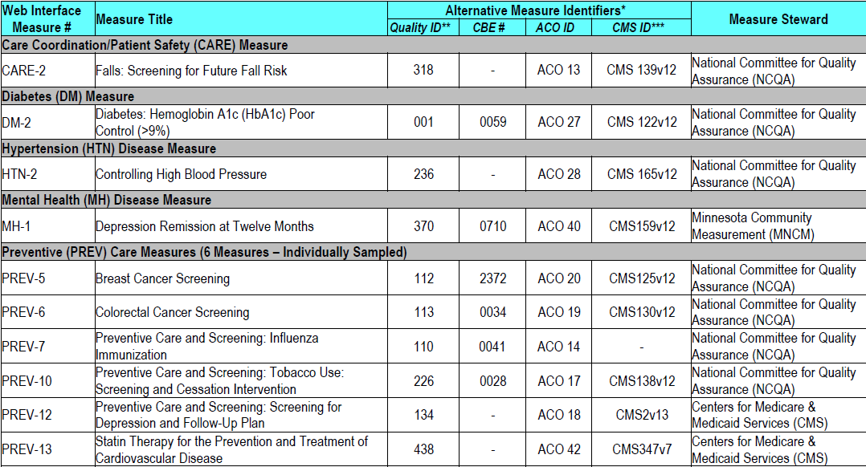
ACO Submission Options
CY2021 PFS Final Rule aligned MSSP with MIPS, shifting MSSP ACOs from quality data submission via CMS Web Interface to Traditional MIPS methods.
(CMS Web Interface will sunset at end of 2024 performance period; unavailable as of 2025 performance period)
Medicare patients

Slide 9
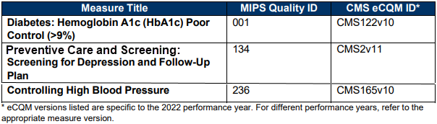
ACO Submission Options
Optional for 2021 through 2024 performance period
  CMS Web Interface will sunset at the end of 2024
Required for 2025 performance period
  CQMs/Medicare CQMs/eCQMs
All patients, regardless of payer.
(Medicare, Medicaid, commercial, self-pay, etc.)

Slide 10
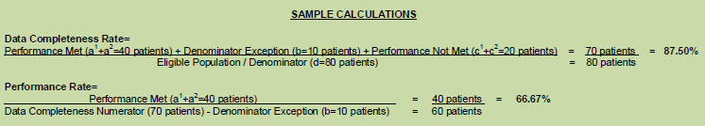
Data Completeness for ACOs
At the measure level

Slide 11
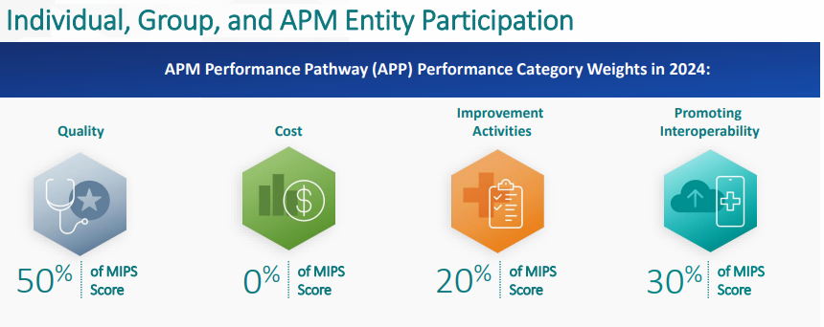
ACO Performance Categories and Weighting
CY2024 PFS Rule change:
2024: Qualified Participants (QPs) and
Partial QPs exempt from PI
2025: QPs and Partial QPs must submit PI
(either at the ACO level or other)
*Categories and weights differ for ACO MIPS eligible clinicians who aren't QPs & may be required to submit MIPS.

Slide 12
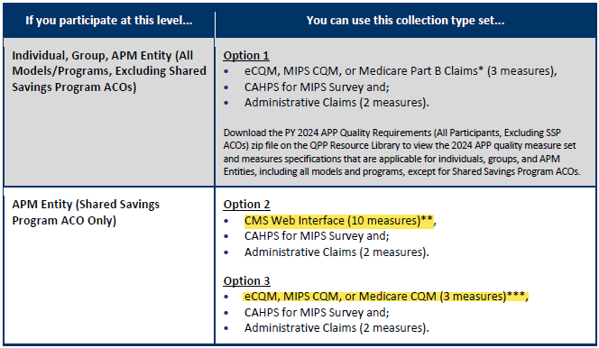
MSSP ACO Performance Categories and Weighting
*Categories and weights differ for ACO MIPS eligible clinicians who aren't QPs & may be required to submit MIPS.

Slide 13
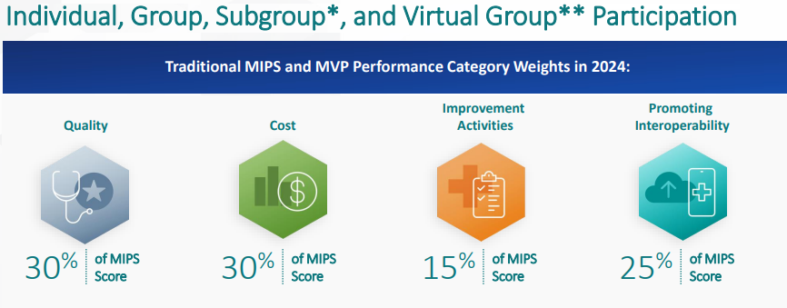
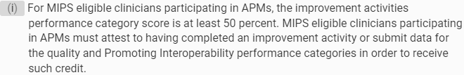
MSSP ACO Participant Performance Categories and Weighting

Slide 14
Common Questions and Concerns

Slide 15
FAQs
What is the intention of data completeness?
CQMs
(and now Medicare CQMs)
2017 performance year: 50%​
2018 performance year: 60%​
2019 performance year: 60%​
2020 performance year: 70%​
2021 performance year: 70%​
2022 performance year: 70%​
2023 performance year: 70%​
2024 performance year: 75%​
2025 performance year: 75%​
2026 performance year: 75%
eCQMs
No data completeness requirement.
The electronic collection method inherently has a data completeness rate of 100%.

Slide 16
FAQs
Does the eCQM/CQM reporting incentive also apply to Medicare CQMs?
No, it does not.
The reporting incentive applies to all payer/all patient reporting.
Medicare CQMs only include Medicare beneficiaries, so they are not eligible for the incentive.

Slide 17
Using MeasureAble for MIPS and Beyond
Notes:
0 min

Slide 18
Poll Question # 3
How familiar are you with the MeasureAble product?
I have never seen a MeasureAble dashboard.
I have seen a demo, but I have never used MeasureAble.
I use MeasureAble to track performance.
I use MeasureAble today to track performance and to submit.

Slide 19




Stepping Up the Value of Measures
Compensation
Improvement
Reduced penalties and increased bonuses based on improvement in your quality scores
Insights
Tools support improvement work to provide better care and increase your quality scores
Regulatory
Analytics help you understand the reasons behind your quality scores
Streamlined workflows to submit data to meet requirements

Slide 20
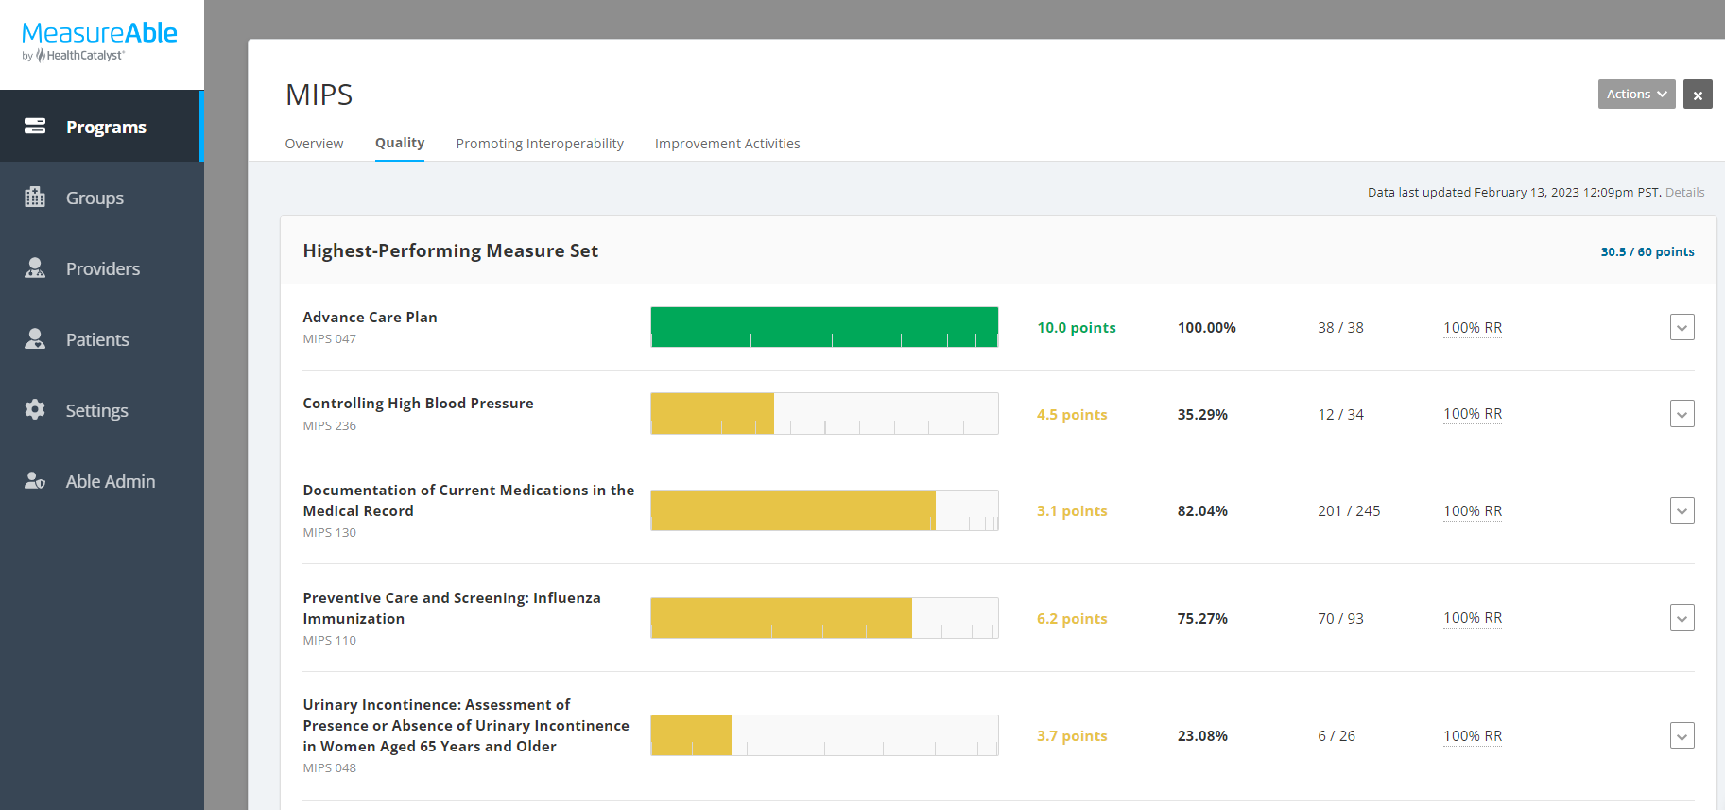
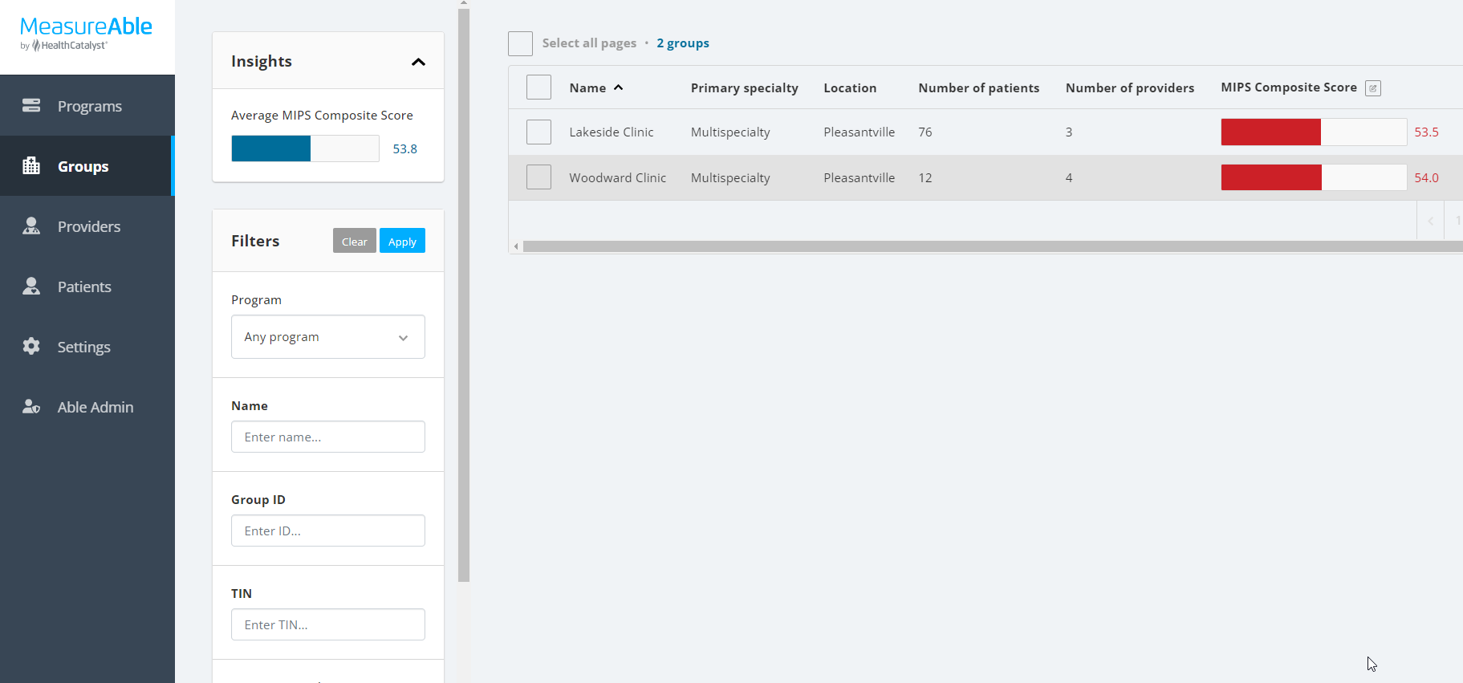
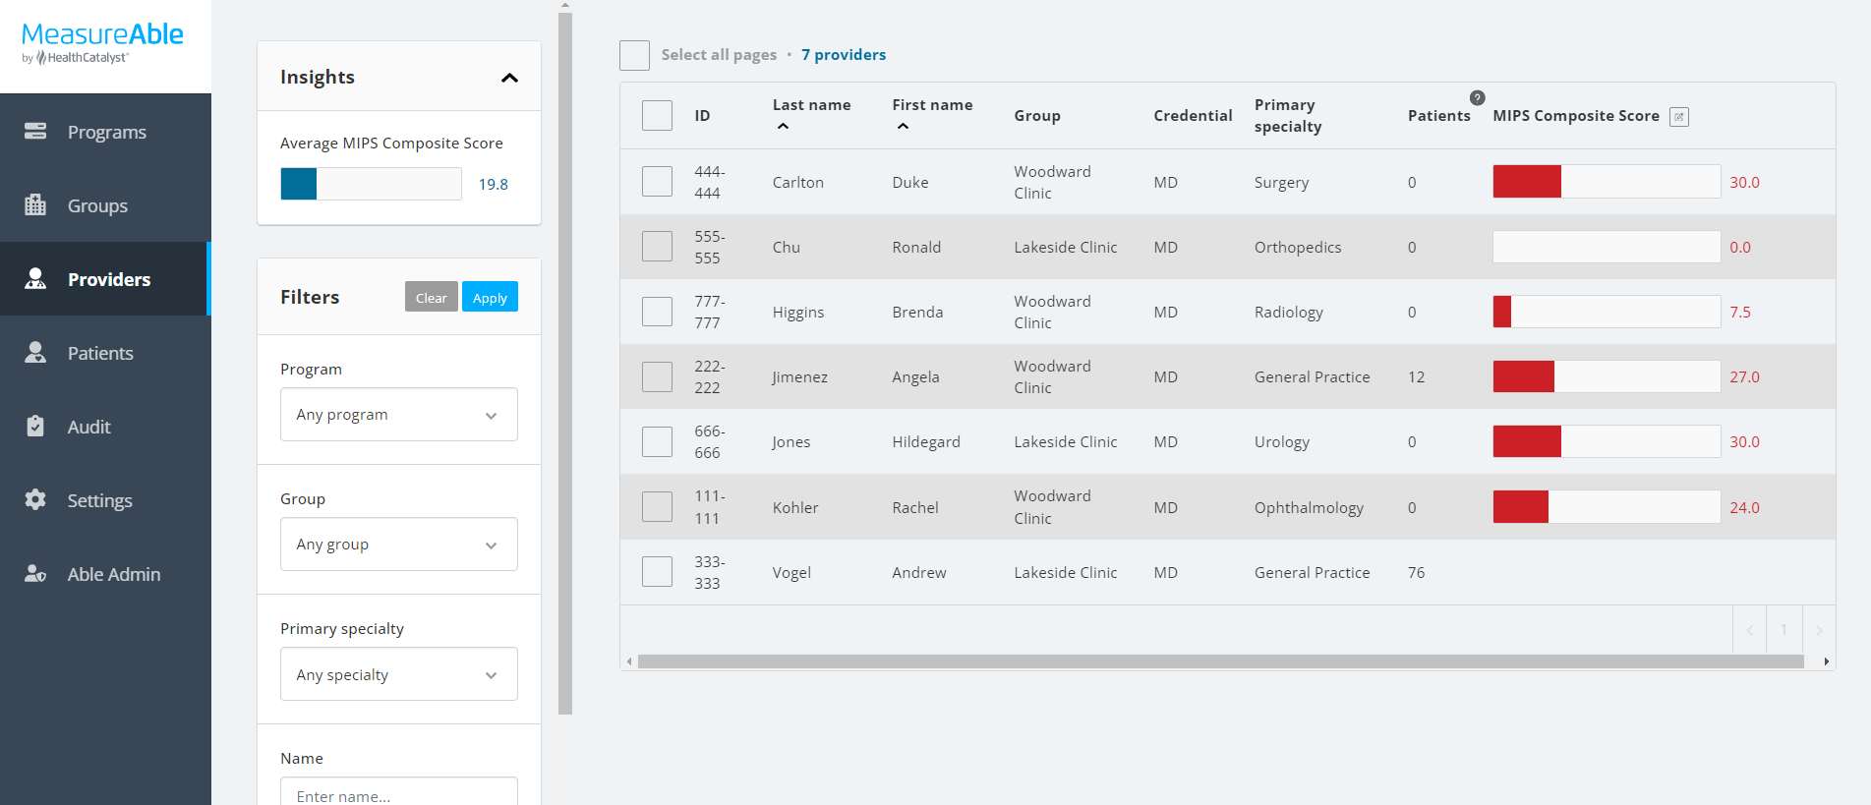
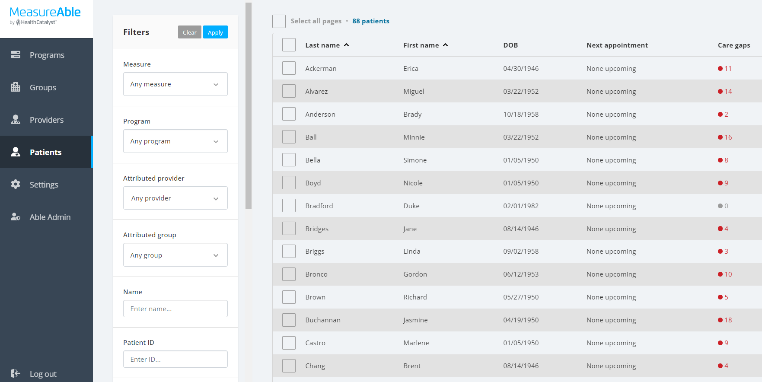
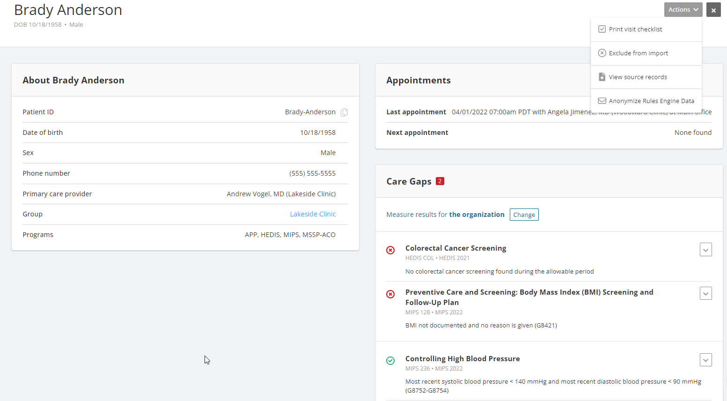
Using MeasureAble to Gain Insights for Improvement
Program Summary
Monitor and manage performance with 5 simple screens
Gain actionable-insights using color-coding to improve and close gaps-in-care
Drill down from summary view to patient level for root-cause analysis
Groups
Providers
Patients
Patient Record

Slide 21
Poll Question # 4
What are your submission plans for Performance Year 2024?
We do not plan to submit at the ACO level.
We plan to submit traditional CQMs.
We plan to submit Medicare CQMs.
We plan to submit eCQMs.
We plan to submit via the CMS web interface.

Slide 22
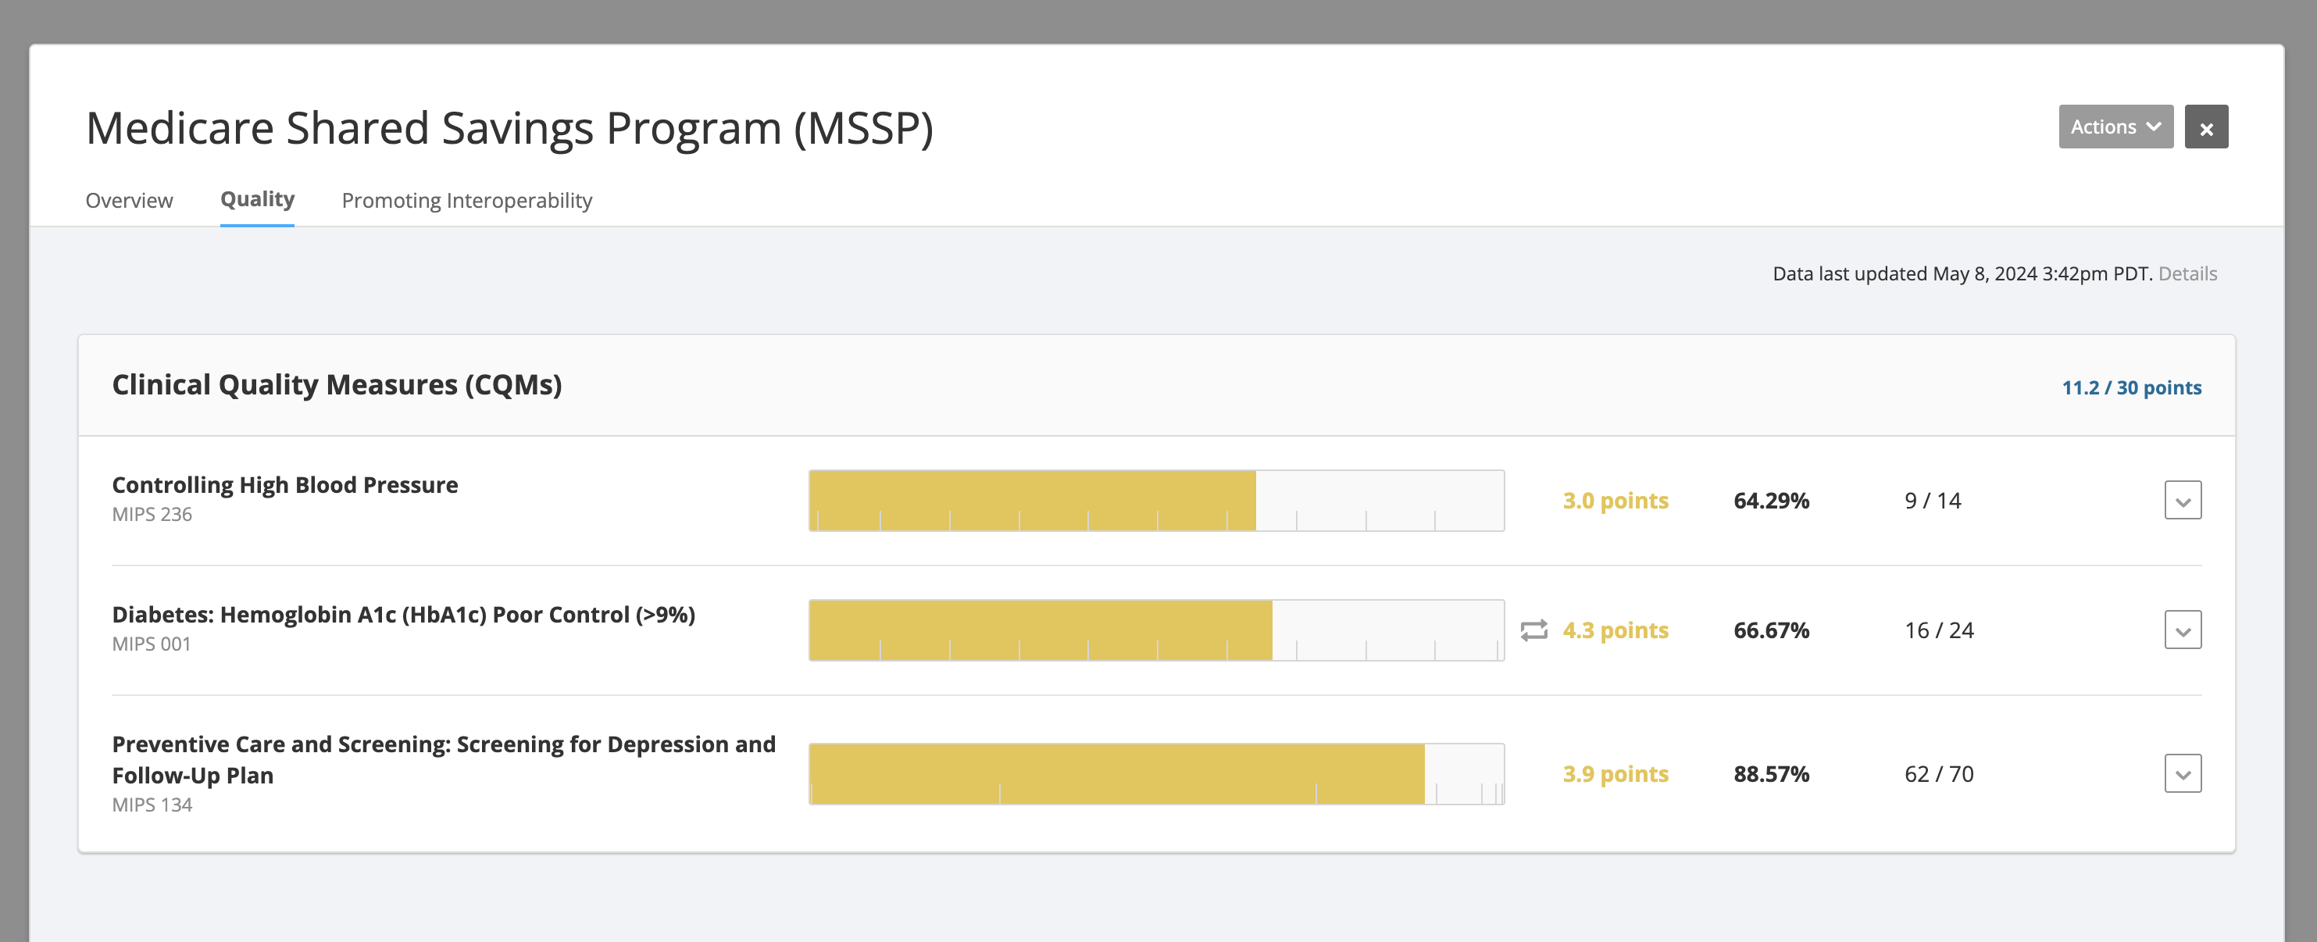
Viewing and Tracking Quality Performance

Slide 23
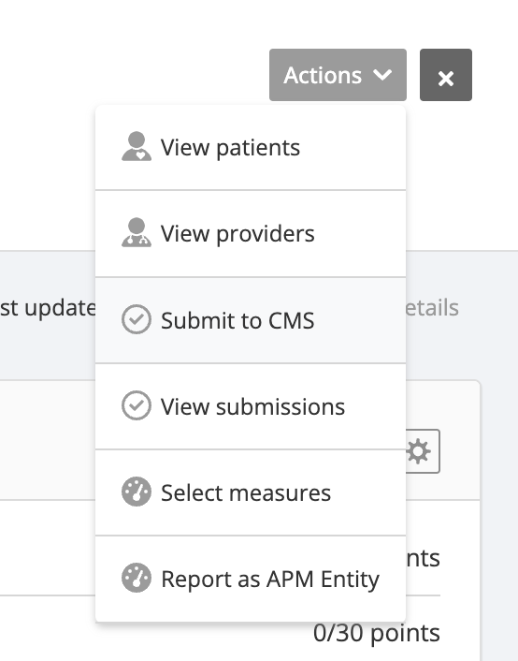
Submission through Able Health Qualified Registry
Use the Actions menu to open the submission wizard.
You will be guided through a step-by-step process of filling out all the configurations and attestations needed for your submission.
You can use the submission wizard to submit via the Able Health qualified registry.
Once the submission is complete, you can download all documentation related to your submission.

Slide 24
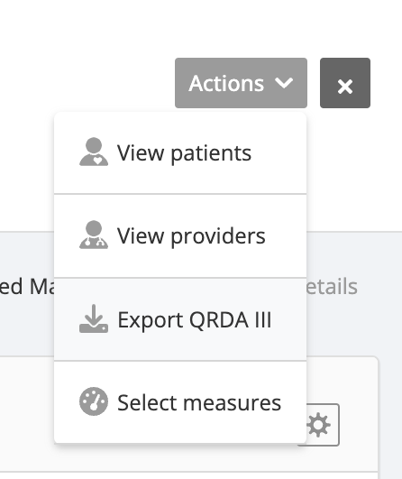
Submission through QRDA III Export
Use the Actions menu to export QRDA III file(s).
You will be emailed a secure link to download the QRDA III files.
Log into the QPP web portal using a HARP account.
Upload the QRDA III files to the QPP web portal.
Use the MeasureAble submission wizard to submit PI measures.

Slide 25
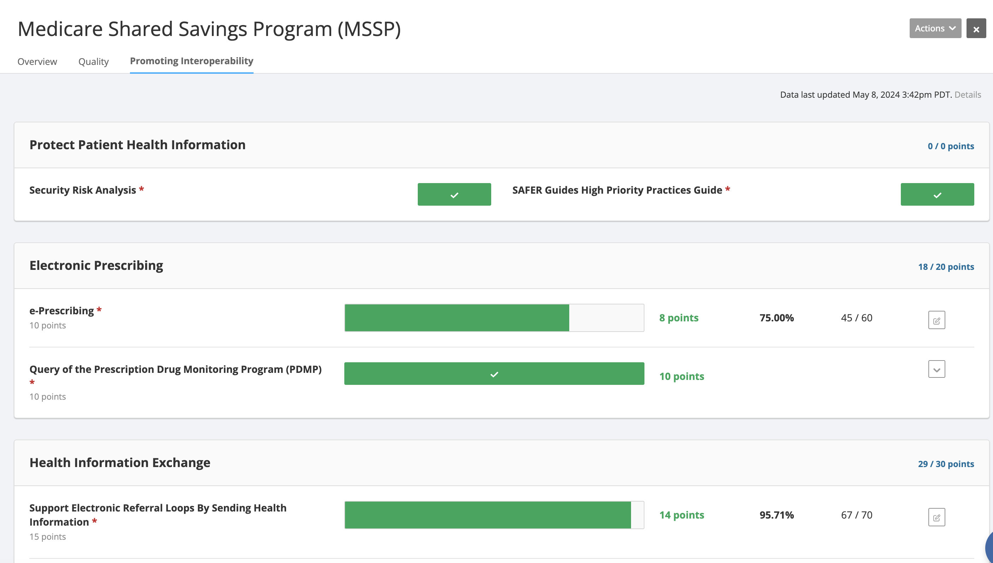
Promoting Interoperability

Slide 26
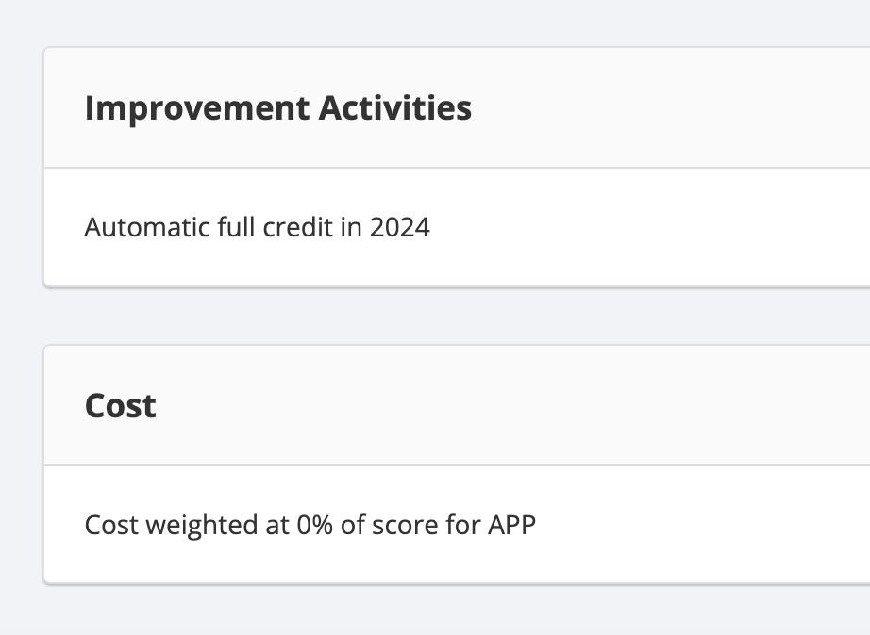
Improvement Activities and Cost

Slide 27
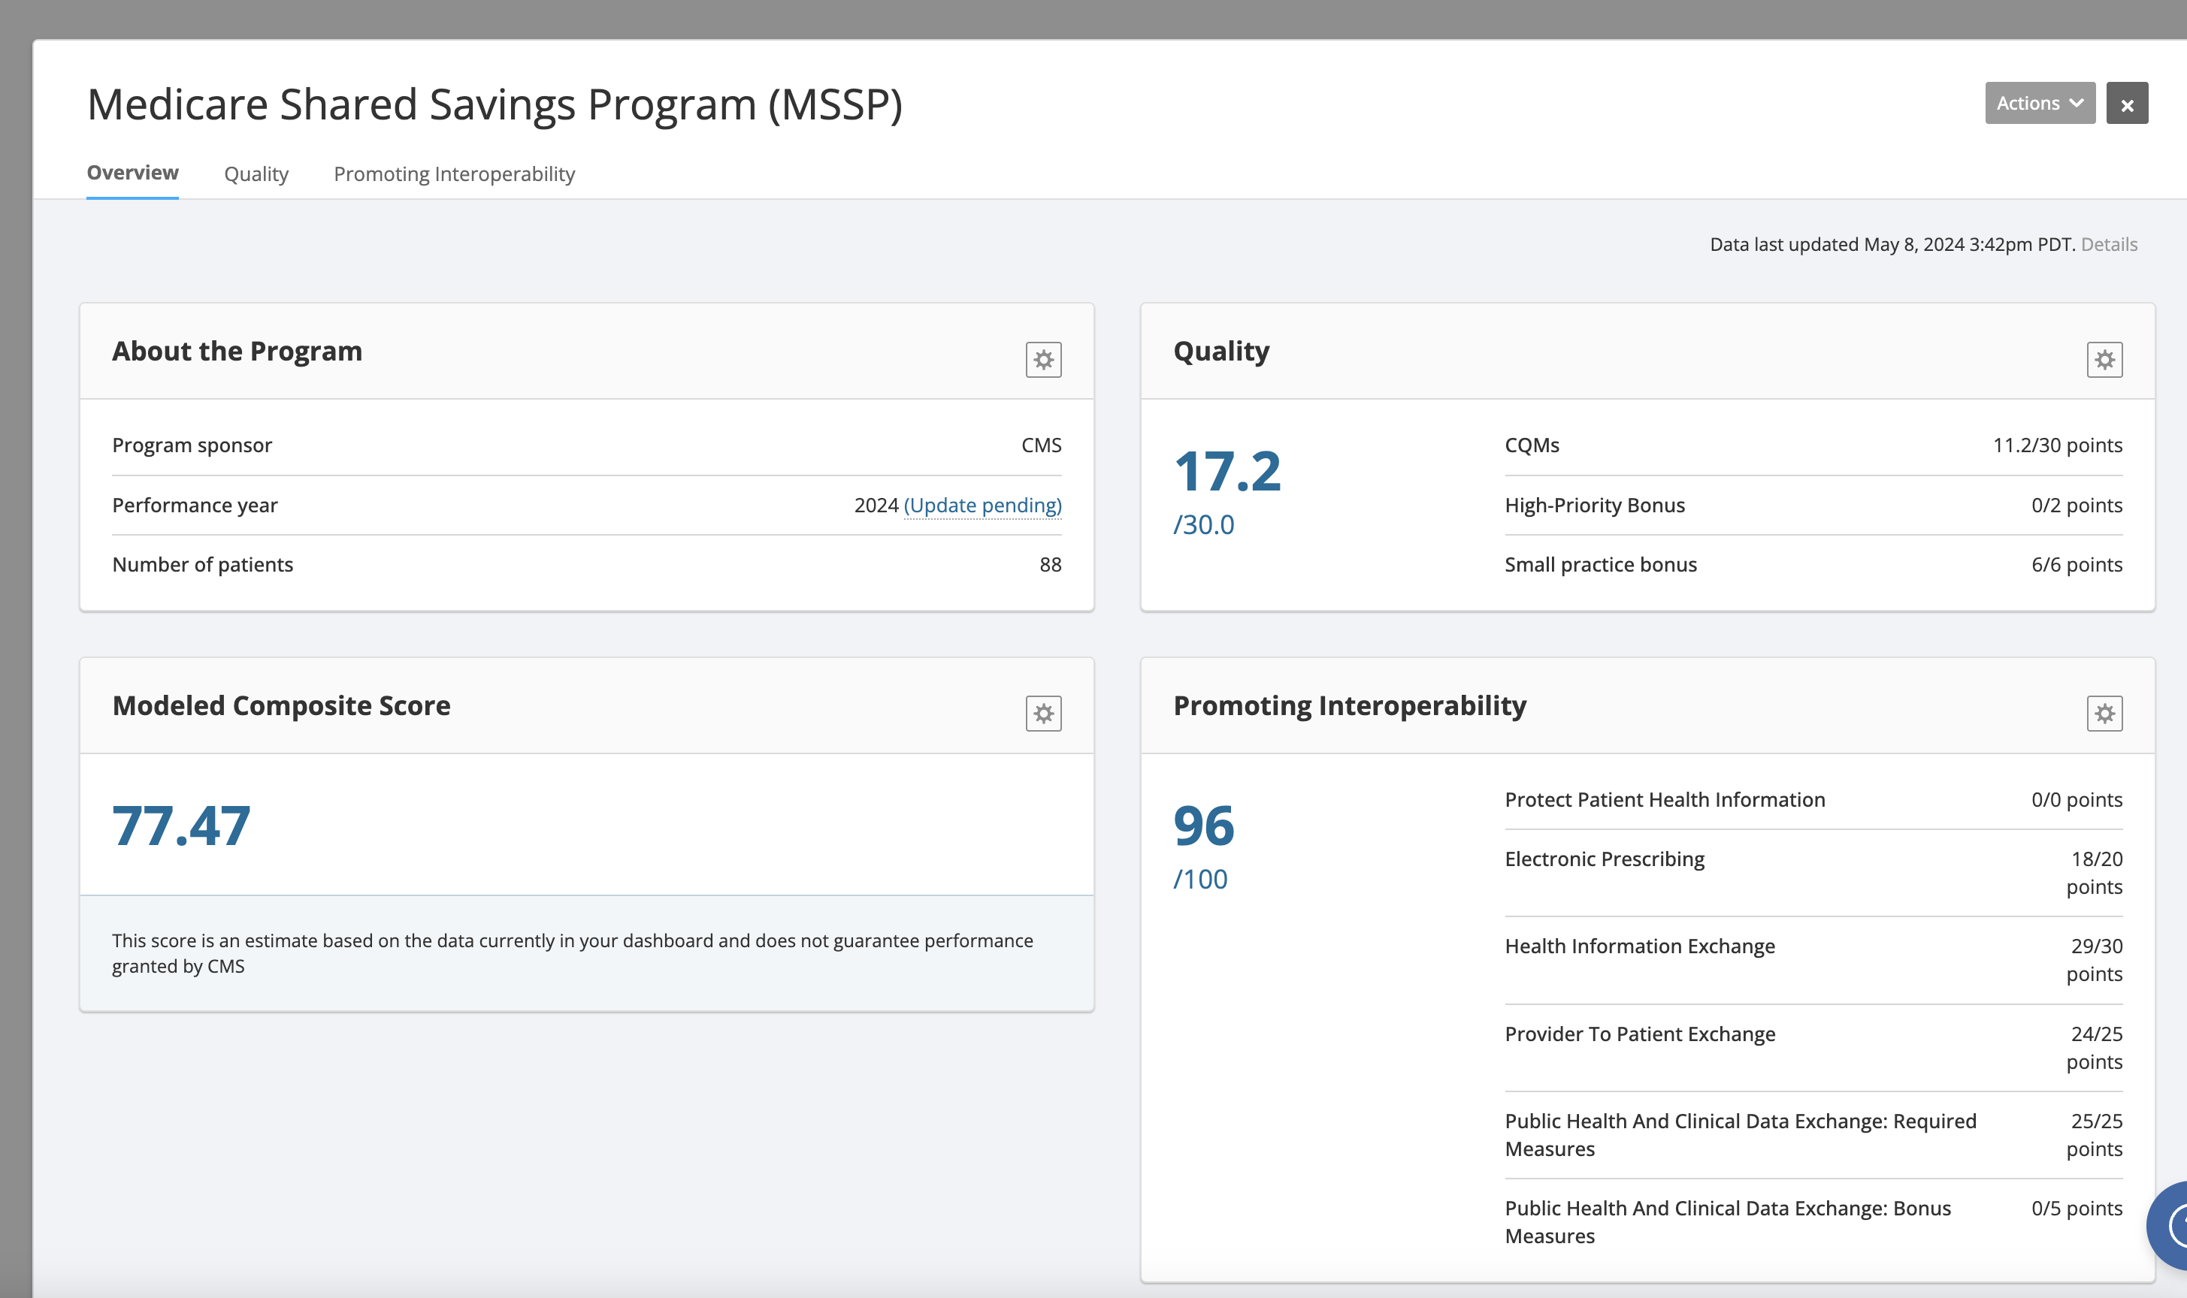
Estimating Your Composite Score

Slide 28
Resources for MSSP ACO Quality Reporting
APP Quality Requirements (MSSP ACOs)
MSSP: Reporting MIPS CQMs and eCQMs in the APP
2024 MIPS Quality Measures List
2024 MIPS Quality Measure Specifications
2024 Medicare CQM Specifications
2024 Medicare CQM Checklist
2024 MIPS Quality Data Completeness Quick Guide

Slide 29
Presenters
Shannon Campbell | Sr. Manager of Regulatory Measures Program
Hazel Morrison | MeasureAble Product Manager
Host
Alora Martin | Webinar Program Manager
hcwebinars@healthcatalyst.com

Slide 30
Thank You!

