Slide 1
Why Your Tools Are Failing You:
Implement Augmented Intelligence for
Intentional and Accurate Improvement

Slide 2

Jason Jones, PhD
Chief Analytics & Data Science Officer
& General Manager of Platform
Health Catalyst

Slide 3



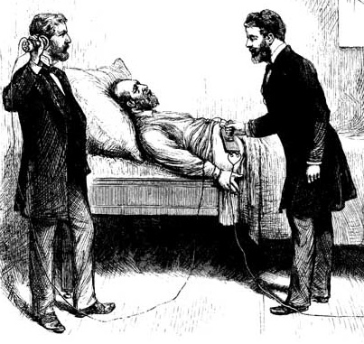

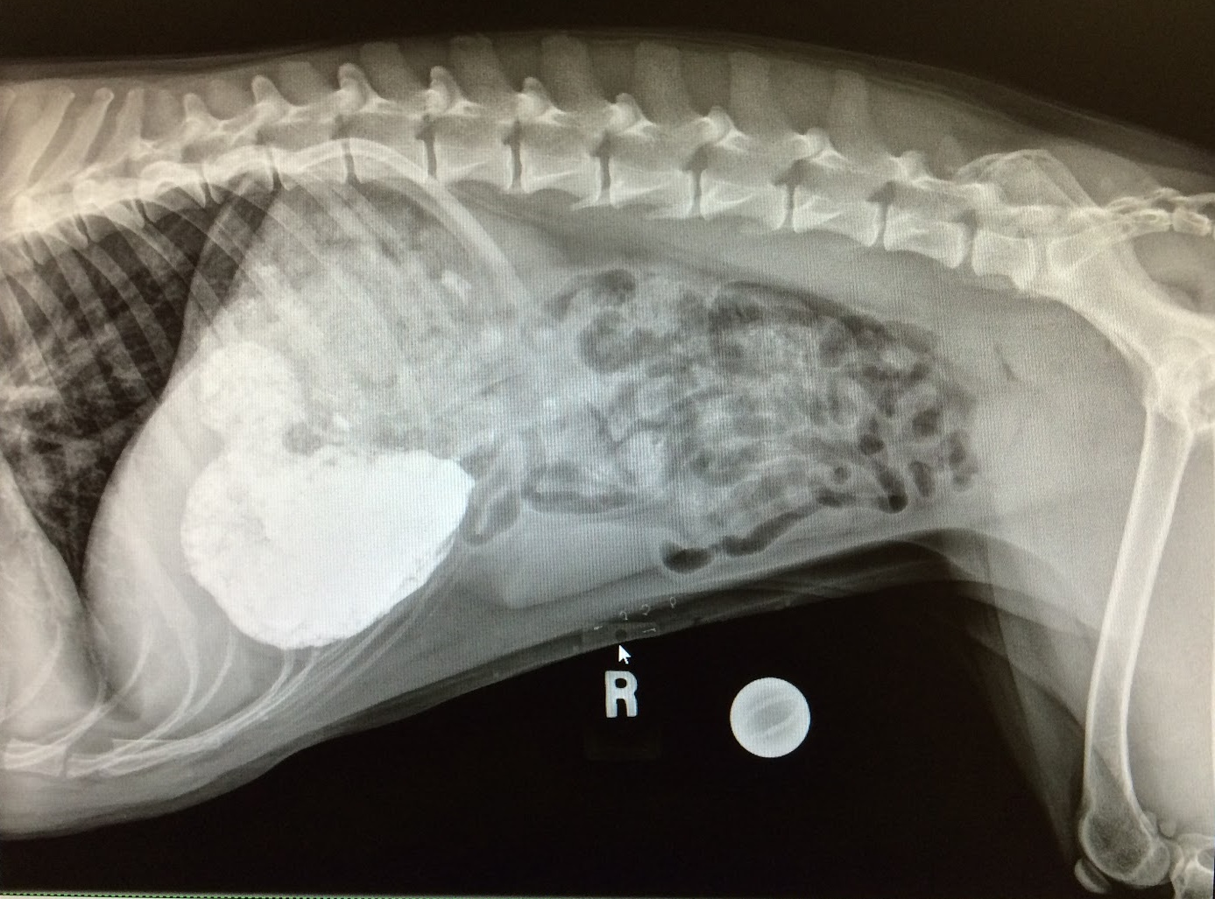






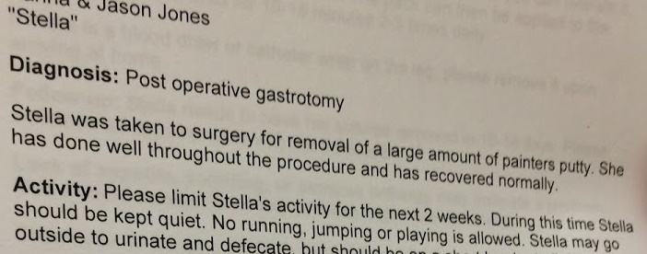
Seeing and Hand Washing Can Save Lives
Notes:
100 years ago, President Garfield died because, despite months of searching inside him with their unwashed hands physicians could not locate the bullet that was stuck inside him
5 years ago, our dog Stella was very sick. In minutes the X-ray that was unavailable to President Garfield located a tub‘s worth of painters putty in her gut and she was saved—we were unsuccessful in limiting her activity, per the discharge orders
100 years ago, the basic technology to augment analytics and drive more correct, consistent, and transparent insights was available
Today, augmented analytics are becoming accessible and it is on us to leverage the capabilities in our pursuit of the Quadruple Aim
The tech we need is available
It's accessible
There is no shame in accepting it

Slide 4

The Stakes Are Higher than Ever – But So Are the Opportunities
Faster turnaround requirements and smaller margins for error
Across the breadth of stakeholders needing support
While balancing a smaller budget
Notes:
Talk track: "Healthcare executives are on a tightrope trying to make sure they are making the best decisions for the success of the organization and its members"

Slide 5


Failing to Leverage Accurate AI Tools Where it Can Do the Most Good
C-Suite
Core Quality & Ops
Innovation
Variable Compensation
Board Document Prep
Investment Allocation
Care Performance​
Health Equity​
Shift Staffing
Site Selection
Improvement Strategy
Return on Investment

Slide 6
When was the last time you suspect your organization made a significant error in executive decision making that was preventable?
  Last week
  Last month
  Last quarter
  Last year
  Never

Slide 7



Types of Information Where You Need AI
Correctly identifying what is right in
front of you
Dealing with overwhelming complexity
Being able to see
what is around
the corner
Performance ​
Over Time
Performance Across an Organization ​
(or Measures…)
Performance ​
Between Approaches ​
(or Parts…“My Patients Are Sicker”)

Slide 8

Correctly Identifying what Is Right in Front of You
Performance Over Time

Slide 9


Slide 10
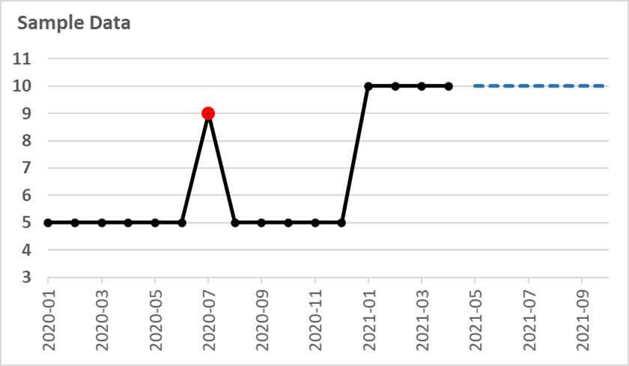
What You Need to Know
Isolated Extreme Point
Persistent Shift in Performance
Forecast = 10
Baseline = 5
Direction of Good/Better

Slide 11
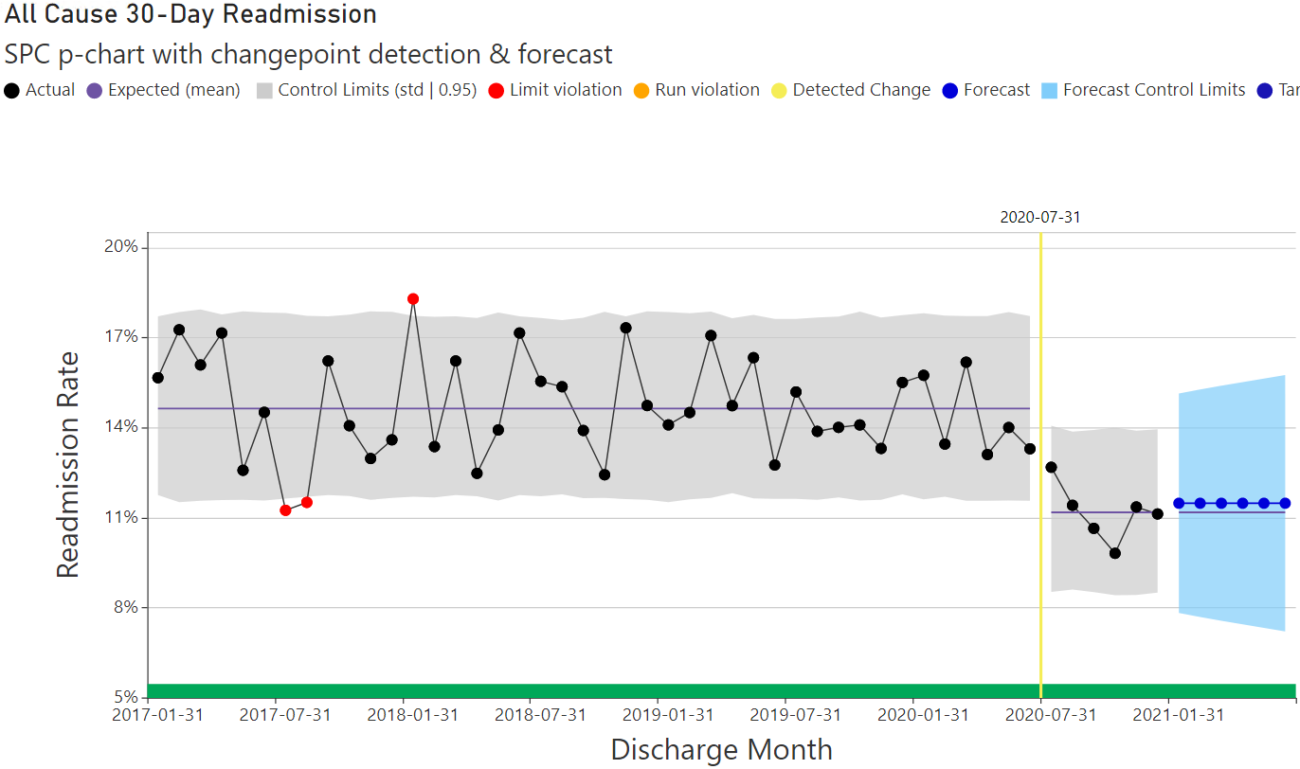
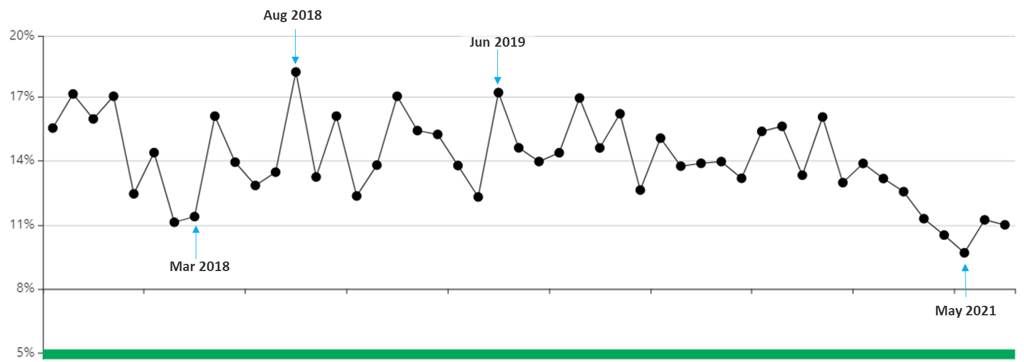
Augmentation of Raw Data
Note: Several points in a row above or below the center line (orange points) – no example on this chart

Slide 12
How confident are you that you can identify the 4 key things you need to know from a time series line chart?
  Very confident
  Somewhat confident
  Not confident

Slide 13
Augmentation of Raw Data
Shift in Level
(or Trend)
Normal Variation
(Gray Region)
Forecast: ~11%
Baseline: ~15%
(Purple Line)
Direction of Good/Better
Isolated Extreme Points
Note: Several points in a row above or below the center line (orange points) – no example on this chart
Notes:
Talk track: "Let's use this exercise as an example. Can you identify the baseline? What about isolated extreme points, do you see where they might be? How about a persistent shift in performance?
Click: "let's take a look at what a sophisticated AI tool can bring to this time series line chart..."
Click:
Click:
ETC...

Slide 14
Why Your Tools Are Failing You
Here’s The Good News
Modern BI tools have made it easy to create beautiful charts. AI can make it easy to draw correct, consistent, and transparent conclusions from them.
Correctly identifying what is right in front of you
Notes:
Modern BI tools have made it easy to create beautiful charts
AI can make it easy to draw correct, consistent, and transparent conclusions from them

Slide 15

Dealing with Overwhelming Complexity
Performance Across
an Organization (or Measures…)

Slide 16




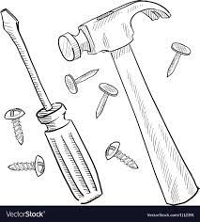
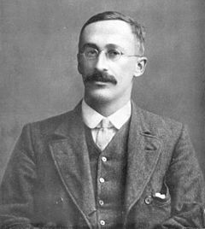
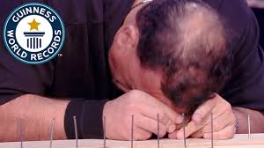



Leadership Tasks with Analytic Contribution
  We are familiar with screws calling hammers.
  Either would be better than a forehead.
  William Gossett invented the t-test (circa 1908) to improve decision making about how to increase the quantity and quality of Guinness Beer while reducing cost.
  William Gossett invented the t-test (circa 1908) to improve decision making about how to increase the quantity and quality of Guinness Beer while reducing cost.
https://www.guinnessworldrecords.com/news/2017/2/hammer-head-pro-wrestler-nails-world-record-with-his-forehead-guinness-world-r-461914
https://priceonomics.com/the-guinness-brewer-who-revolutionized-statistics/
Notes:
We've always had these problems, (a reminder of the journey we've taken) we've always had these tools, now we just need to use them.

Slide 17
When was the last time you used a statistical technique to support an executive decision?
  Last week
  Last month
  Last quarter
  Last year
  Never

Slide 18
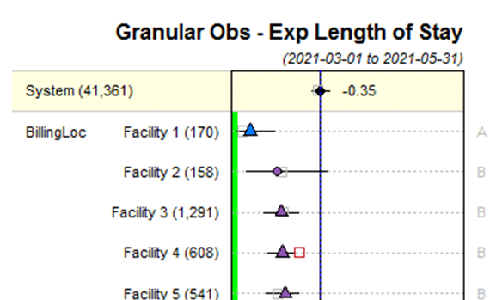
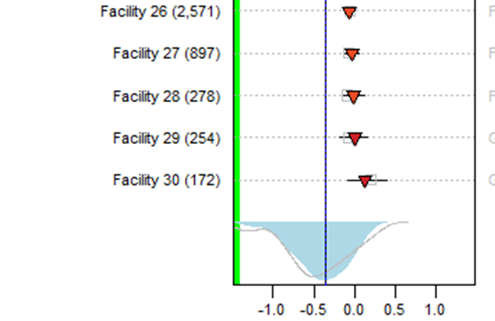
Performance Across an Organization (or Measures)—Forests
  System insights:
    Where are we?
    Where are we going?
  Top performer at top of chart.
  Shapes indicate significantly different from system.
  Colors and letters indicate performance clusters.
  Squares indicate projected performance.
Obs - Exp Length of Stay—Correct
Notes:
The right approach
We need to understand where we are going also.

Slide 19
Correct Answers
  Facility order 1…30.
  Facility 1 doing best (followed by Facility 2…).
  Facility 4 projected to get worse (others projected to stay about the same).
Obs - Exp Length of Stay—Correct
Notes:
The right approach
We need to understand where we are going also.

Slide 20
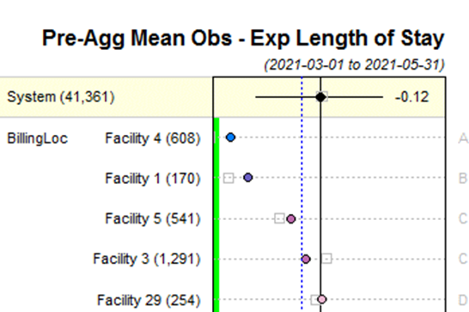
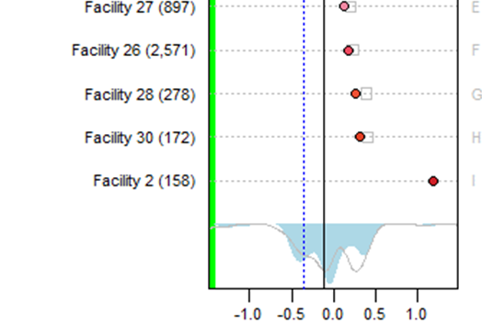
Correct Answers Compared to Typical and Wrong Answers
Typical and Wrong—Average
Obs - Exp Length of Stay—Correct
  Facility 2 looks worst.
  Facility 4 looks best.
We Can Do Better!
Notes:
The right approach
We need to understand where we are going also.

Slide 21
Why Your Tools Are Failing You
Here’s The Good News
You can expect more than tabular displays of data with inferior methods. In the face of increasing complexity, AI can help you make better decisions with confidence.
Dealing with overwhelming complexity

Slide 22

Being Able to See
What Is Around the Corner
Performance Between Approaches
(or Parts… “My Patients Are Sicker”)

Slide 23
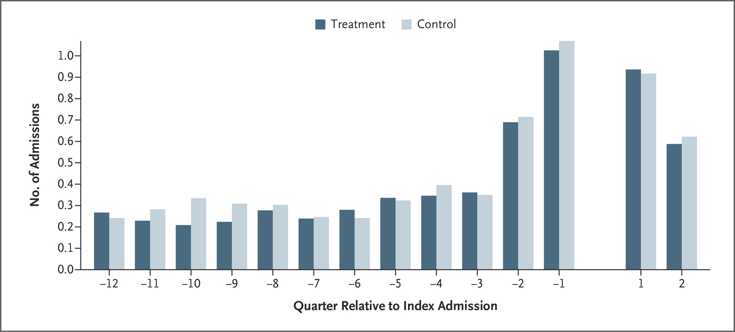
Why We Do Trials…
Hot Spotting
We Knew (2011)¹¹: Dealing with social determinants of health for high-risk patients could reduce hospitalizations.
We Learned (2020)¹²: High-risk patients did experience decreased hospitalization—but there was no difference between treatment and control groups…and now we’re trying refined approaches.
We were able to learn only because we had the right study design up front.
The same has happened with intensive monitoring in severe sepsis or septic shock and tight glucose control.
Gawande A. (2011). The hot spotters: Can we lower medical costs by giving the neediest patients better care? New Yorker (New York, N.Y.), 40–51. Finkelstein, A., Zhou, A., Taubman, S., & Doyle, J. (2020). Health care hotspotting – A randomized, controlled trial. The New England Journal of Medicine, 382(2), 152–162. https://doi.org/10.1056/NEJMsa1906848

Slide 24
For which of the following types of decisions have you used AI (or other advanced techniques) recently?
  Drug formulary
  Surgical device/implant/cart
  Care management implementation/expansion
  Facility/provider comparison
  Care/revenue process change
  Other, similar type of decision
Notes:
"select all that apply"

Slide 25
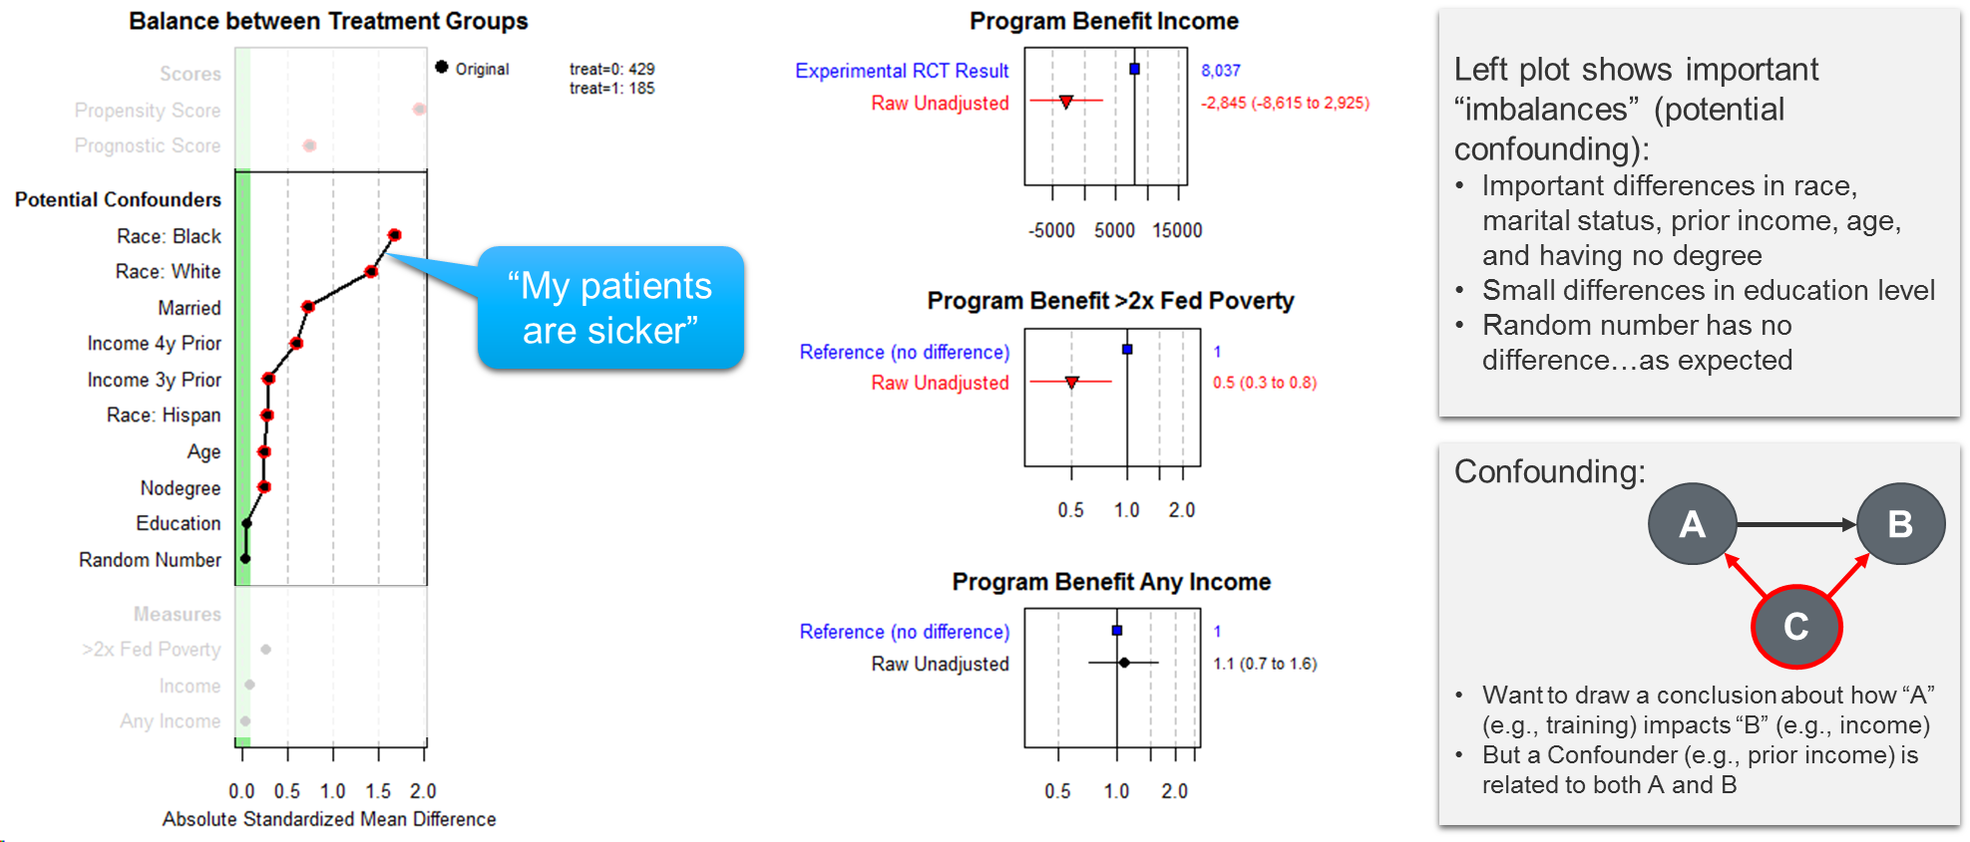
Should We Continue/Expand Support for a Work Training Program?
Understanding the “Apples to Oranges” Comparison
Left plot shows important “imbalances” (potential confounding):
  Important differences in race, marital status, prior income, age, and having no degree.
  Small differences in education level.
  Random number no difference…as expected.
“My patients
are sicker”
Confounding:
  Want to draw a conclusion about how “A” (e.g., training) impacts “B” (e.g., income).
  But a Confounder (e.g., prior income) is related to both A and B.
A
B
C

Slide 26
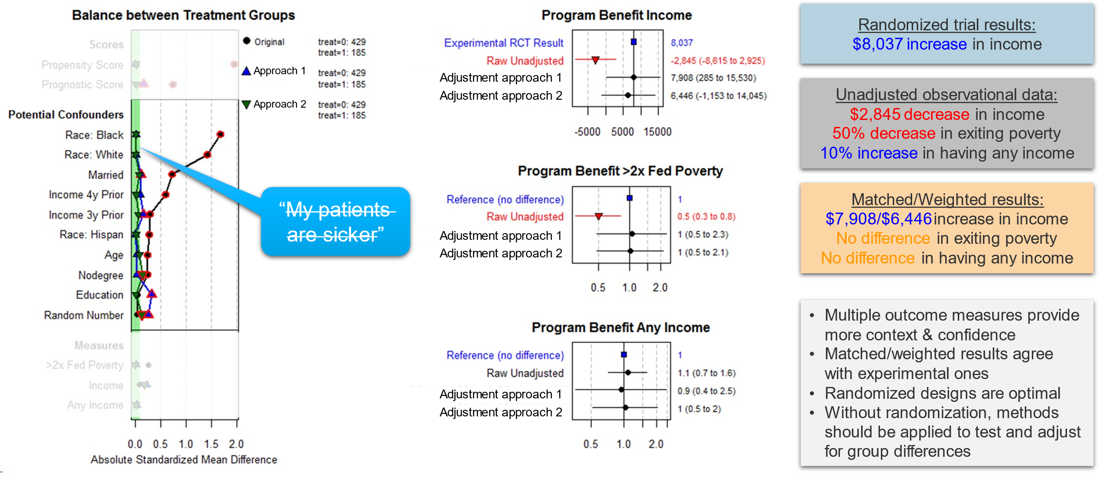
Should We Continue/Expand Support for a Work Training Program?
Adjusting for Differences and Drawing More Valid Conclusions
Randomized trial results:
  $8,037 increase in income.
Unadjusted observational data:
  $2,845 decrease in income.
  50% decrease in exiting poverty.
  10% increase in having any income.
Matched/Weighted results:
  $7,908/$6,446 increase in income.
  No difference in exiting poverty.
  No difference in having any income.
“My patients
are sicker”

Slide 27
Why Your Tools Are Failing You
Here’s The Good News
Healthcare analytics are always complex. AI tools allow you to address the (un)known unkowns such as when some patients are sicker, allowing you to draw more valid conclusions.
Being able to see what is around the corner

Slide 28
Accessibility and Application

Slide 29
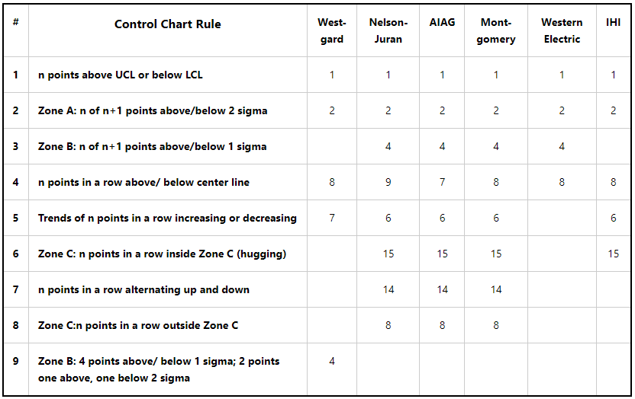
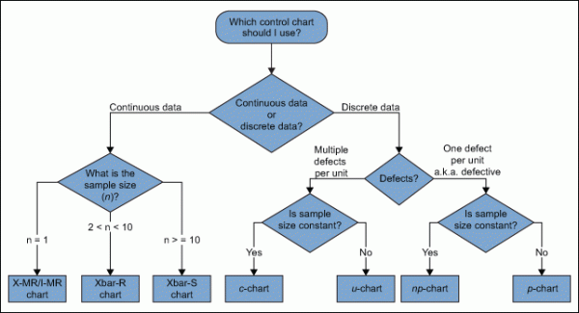
Closing the Accessibility Gap
https://www.isixsigma.com/tools-templates/control-charts/a-guide-to-control-charts/
https://www.qimacros.com/control-chart/stability-analysis-control-chart-rules/

Slide 30
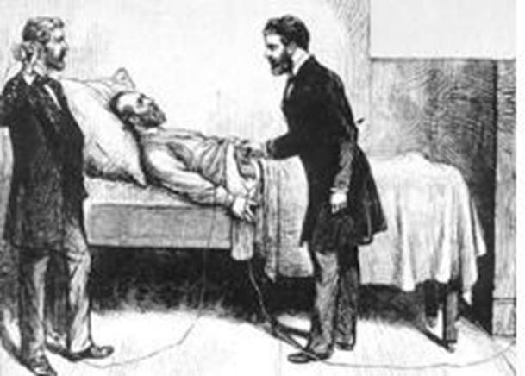
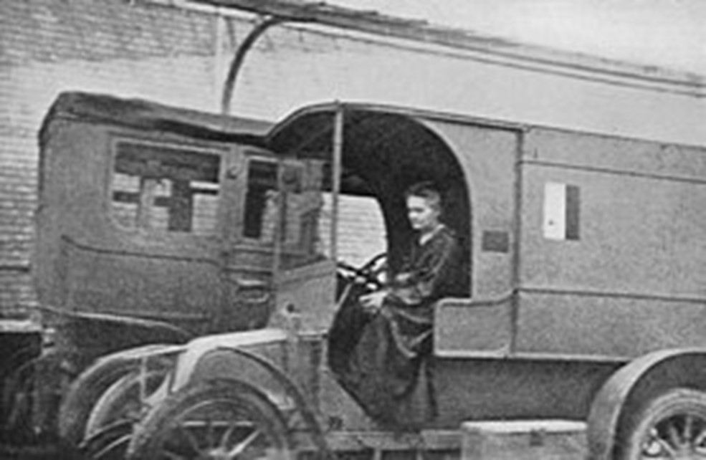
Evolution of Augmented Decisions
1891
1917
https://www.nps.gov/articles/000/the-tragedy-and-triumph-of-president-james-a-garfield-and-alexander-graham-bell.htm
https://commons.wikimedia.org/wiki/File:Marie_Curie_-_Mobile_X-Ray-Unit.jpg
https://www.smithsonianmag.com/history/how-marie-curie-brought-x-ray-machines-to-battlefield-180965240/

Slide 31
Job to Be Done and Requirements for Success
What Leaders Do:
  Select focus.
  Allocate resources.
  Set targets.
  Decide policy.
Information Required:
  Baseline performance.
  Separate signal from noise.
  Expected future.
  Expected value.
Types of Inputs We Discussed:
  Performance over time.
  Performance across an organization (or measures…).
  Performance between approaches (or parts…).
X-ray is a tool required for standard medical care today
AI is becoming a tool required for standard executive decision making in healthcare.

Slide 32
Jason Jones, PhD
Chief Analytics & Data Science Officer
General Manager of Platform
Health Catalyst

Slide 33

Why Your Tools Are Failing You
Without accurate interpretation of analytics, healthcare leaders don’t have real data-driven insight to know how to strategically improve and measure wins and losses.
Only
Test Your Knowledge
4%
are accurate
https://tinyurl.com/4afvukpu
Notes:
Is your organization’s leadership part of the 4% that can correctly identify the four key things you need to know while interpreting data presented over time?
Take the analytics interpretation online assessment to find out.

