Slide 1
Automated Patient Reported Outcomes (PROs) for Hip & Knee Replacement
Don’t Limp Into Mandatory Reporting
John Janas, MD

Slide 2
Overview of Voluntary and Mandatory Patient-Reported Outcome (PRO) Collection for Total Hip and Knee Arthroplasty (THA/TKA)
  Requirements
  Potential Impact
Automated Patient Reported Outcomes (PROs) for Hip & Knee Replacement
  Clinical Workflows
  PRO components
  Improving Patient Engagement
Q&A

Slide 3
Voluntary and Mandatory Patient-Reported Outcome Collection for Total Hip and Knee Arthroplasty
FY2023 Inpatient Prospective Payment System (IPPS) and Long-Term Care Hospital Prospective Payment System (LTCH PPS) Final Rule
Hospital-Level, Risk Standardized Patient-Reported Outcomes Performance Measure (PRO-PM) Following Elective Primary Total Hip Arthroplasty (THA) and/or Total Knee Arthroplasty (TKA)
Hospital-Level Risk-Standardized Complication Rate (RSCR) Following Elective Primary THA/TKA
2 New Quality Measures for 2024:
  CMS56v12: Functional Status Assessment for Total Hip Replacement
  CMS66v10: Functional Status Assessment for Total Knee Replacement

Slide 4
Comprehensive Care for Joint Reconstruction (CJR) Model
Initially a Voluntary PRO data collection program in the Comprehensive Care for Joint Reconstruction (CJR) model—to address disparities in outcomes and clinical practice across US hospitals
Clinical improvement measured based on the difference in patient score on joint-specific PRO instruments between preop PRO assessment and postop PRO assessment
  Meet or exceed a threshold of 22 points on Hip dysfunction and Osteoarthritis Outcome Score for Joint Replacement (HOOS, JR) for THA and 20 points on Knee injury and Osteoarthritis Outcome Score for Joint Replacement (KOOS, JR) for TKA

Slide 5
Poll Question #1
Are you (your hospital) currently participating in the Voluntary Patient-Reported Outcome (PRO) Collection for Total Hip and Knee Arthroplasty (THA/TKA)?
  Yes
  No

Slide 6

Alphabet Soup
PRO = Patient Reported Outcome
PROM = Patient Reported Outcome Measure
  Standardized tools
  Surveys, scales, or single-item measures
PRO-PM = Patient Reported Outcome-based Performance Measure
  Performance measure based on patient-reported outcome measure (PROM) data aggregated for an accountable health care entity.
  Data collected directly from the patient using the PROM tool, which can be an instrument, scale, or single-item measure

Slide 7
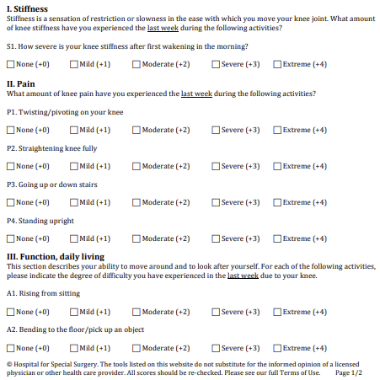
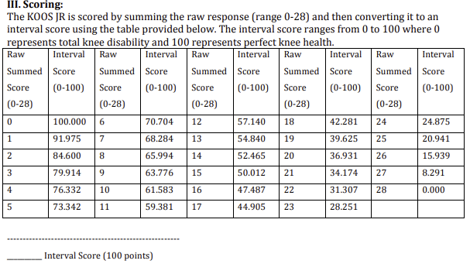
KOOS JR: 7 Items
SCORING: Convert Raw Score (0-28) to Interval Score (0-100)*
*Meet or exceed a threshold of 20 points on Knee Injury and Osteoarthritis Outcome Score for Joint Replacement (KOOS, JR)

Slide 8
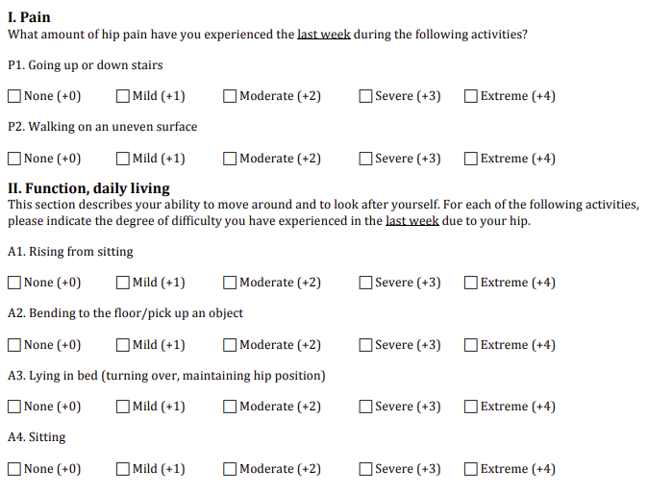
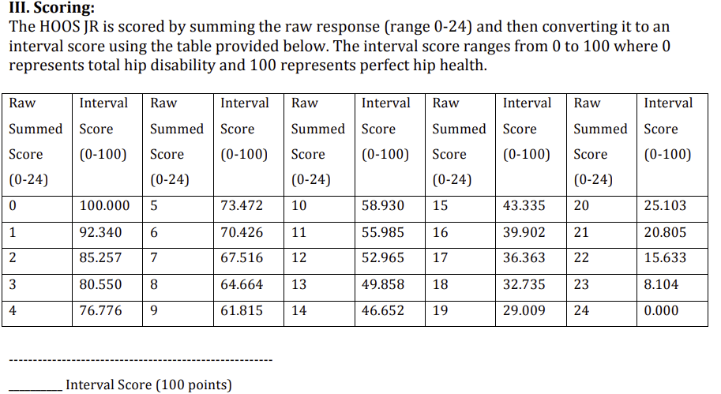
HOOS JR: 6 Items
SCORING: Convert Raw Score (0-24) to Interval Score (0-100)*
*Meet or exceed a threshold of 22 points on Hip dysfunction and Osteoarthritis Outcome Score for Joint Replacement (HOOS, JR)

Slide 9
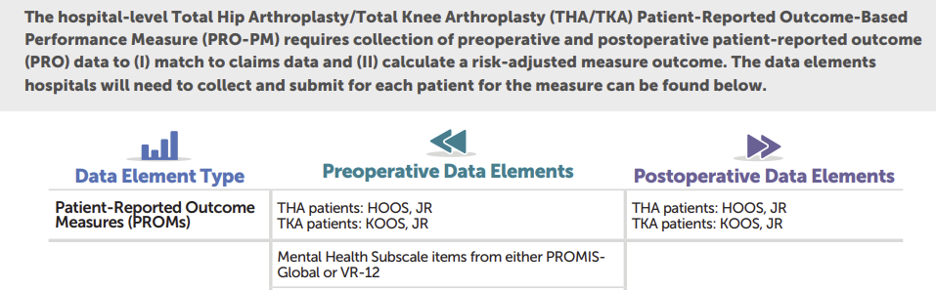

What Data Needs to Be Reported and How to Submit
HCQIS Access Roles and Profile (HARP) account access to the Hospital Quality Reporting (HQR) website
“What Data Should I Collect?” from CMS QualityNet THA/TKA PRO-PM Resources.

Slide 10
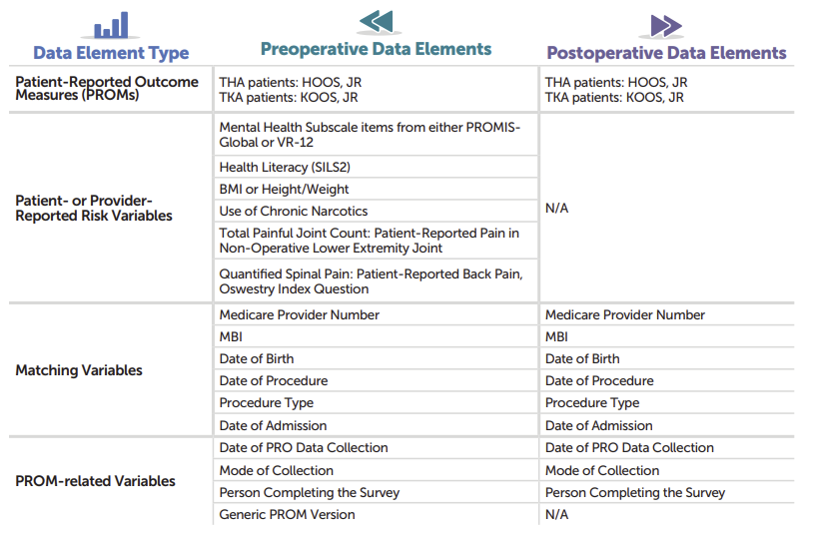
What Data Needs to Be Reported

Slide 11
CJR Model Quality Measures
Hospital Inpatient Quality Reporting (HIQR) program already collect:
THA/TKA Complications Measure (NQF #1550)
  Risk-standardized complication rate (RSCR) in the 90-day period following THA and/or TKA
Hospital Consumer Assessment of Healthcare Providers and Systems(HCAHPS) Survey Measure (NQF #0166)
  AKA CAHPS Hospital Survey

Slide 12
2024 Performance Measure CMS56v12: Functional Status Assessment for Total Hip Replacement
Percentage of patients 19 years of age and older who received an elective primary total hip arthroplasty (THA) and completed a functional status assessment within 90 days prior to the surgery and in the 300 - 425 days after the surgery
Numerator: Patients with patient-reported functional status assessment results (i.e., Veterans RAND 12-item health survey [VR-12], Patient-Reported Outcomes Measurement Information System [PROMIS]-10-Global Health, Hip Disability and Osteoarthritis Outcome Score [HOOS], HOOS Jr.) in the 90 days prior to or on the day of the primary THA procedure, and in the 300 - 425 days after the THA procedure
Denominator: Patients 19 years of age and older who had a primary THA between November two years prior to the measurement period and October of the year prior to measurement period; and who had an outpatient encounter between November of the year prior to the measurement period and the end of the measurement period
https://ecqi.healthit.gov/ecqm/ec/2024/cms0056v12

Slide 13
Denominator Exclusions
Exclude patients who are in hospice care for any part of the measurement period.
Exclude patients with severe cognitive impairment that starts before or in any part of the measurement period.
Exclude patients with one or more specific lower body fractures indicating trauma in the 24 hours before or at the start of the total hip arthroplasty.
Exclude patients with a partial hip arthroplasty procedure on the day of the total hip arthroplasty.
Exclude patients with a revision hip arthroplasty procedure, an implanted device/prosthesis removal procedure or a resurfacing/supplement procedure on the day of the total hip arthroplasty.
Exclude patients with a malignant neoplasm of the pelvis, sacrum, coccyx, lower limbs, or bone/bone marrow or a disseminated malignant neoplasm on the day of the total hip arthroplasty.
Exclude patients with a mechanical complication on the day of the total hip arthroplasty.
Exclude patients with a second total hip arthroplasty procedure 1 year before or after the original total hip arthroplasty procedure.
Exclude patients who die on the day of the total hip arthroplasty procedure or in the 300 days after.
https://ecqi.healthit.gov/ecqm/ec/2024/cms0056v12

Slide 14
2024 Performance Measure CMS66v10:
Functional Status Assessment for Total Knee Replacement
Percentage of patients 18 years of age and older who received an elective primary total knee arthroplasty (TKA) and completed a functional status assessment within 90 days prior to the surgery and in the 270-365 days after the surgery
Numerator: Patients with patient-reported functional status assessment results (i.e., Veterans RAND 12-item health survey [VR-12], Patient-Reported Outcomes Measurement Information System [PROMIS]-10 Global Health, Knee Injury and Osteoarthritis Outcome Score [KOOS], KOOS Jr.) in the
90 days prior to or on the day of the primary TKA procedure, and in the 270 - 365 days after the TKA procedure
Denominator: Patients 19 years of age and older who had a primary total knee arthroplasty (TKA) in the year prior to the measurement period and who had an outpatient encounter during the measurement period
https://ecqi.healthit.gov/ecqm/ec/2022/cms066v10

Slide 15
Denominator Exclusions
Exclude patients with two or more fractures indicating trauma at the time of the total knee arthroplasty or patients with severe cognitive impairment that starts before or in any part of the measurement period.
Exclude patients who are in hospice care for any part of the measurement period.
https://ecqi.healthit.gov/ecqm/ec/2022/cms066v10

Slide 16
POLL QUESTION #2
Are you (your Organization) already collecting Patient Reported Outcomes pre and post-operative for the:
  Veterans RAND 12-item health survey [VR-12] or [PROMIS]-10 Global Health
  Hip Disability and Osteoarthritis Outcome Score [HOOS], HOOS Jr
  Knee Injury and Osteoarthritis Outcome Score [KOOS], KOOS Jr
    YES
    NO

Slide 17
PATIENT REPORTED OUTCOMES (PRO) AND
RISK VARIABLE DATA
Veterans RAND 12 Item Health Survey (VR-12) or
PROMIS-10 Patient-Reported Outcomes Measurement Information System (PROMIS) Global-10 generic PRO survey
Knee Injury and Osteoarthritis Outcome Score [KOOS], KOOS Jr.) in the 90 days prior to or on the day of the primary TKA procedure, and in the 270 - 365 days after the TKA procedure
Hip Disability and Osteoarthritis Outcome Score [HOOS], HOOS Jr.) in the 90 days prior to or on the day of the primary THA procedure, and in the 300 - 425 days after the THA procedure

Slide 18
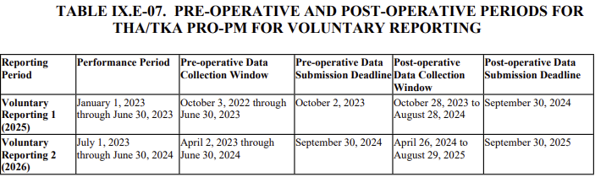

Voluntary to Mandatory
Surgery Performed
Pre-op PROM
Submit Pre-op
Post-op PROM => Submit
2022-16472.pdf (federalregister.gov)

Slide 19
Impact of Mandatory Reporting
7/1/2024: Mandatory Reporting Begins
Minimum Required: 50% of their eligible Patients
Penalty for not meeting above requirement: 25% reduction of the applicable percentage increase on their APU for FY2028
4/2/2024: Requirement to start collecting Patient Reported Outcome Measures (PROM)
QualityNet Home (cms.gov)

Slide 20
IMPACT of MANDATORY REPORTING
No penalties for hospitals that choose to not participate in voluntary reporting
  Voluntary Reporting Ends in 2023 ➔ becomes MANDATORY Reporting July 1, 2024 (START CAPTURING PRE-OP SURVEYS April 2, 2024!)
Hospitals that do not meet the minimum requirement of submitting timely data on more than 50% of their eligible patients will be penalized:
  one-quarter (25%) reduction of the applicable percentage increase—on their annual payment update (APU) for FY 2028
QualityNet Home (cms.gov)

Slide 21

Potential Financial Impact
Operating Margins for Hip and Knee Replacement are narrow!
  Adding in a 25% reduction in the APU
  could mean the difference between make or break!!!
The American Association of Hip and Knee Surgeons (AAHKS) reports that the price of hip replacement surgery in the U.S. can be $30,000–112,000. The hip implant costs about $3,000–10,000, and the overall cost also includes staff and surgeon fees.
The average surgeon reimbursement from Medicare for this surgery is $1,375–1,450, according to the AAHKS.
CMS has proposed payment for THA at $8,923.98 in the ASC and $12,558.56 in the HOPD. CPT 27130 (THA) is proposed as a “device-intensive” code under OPPS—identified with payment indicator J8 and designated by CMS as having adjusted pricing attributable to implant cost. No additional implant payment would be made by Medicare to ASCs beyond the proposed rate of $8,923.98, which is based on the national unadjusted payment rate.

Slide 22
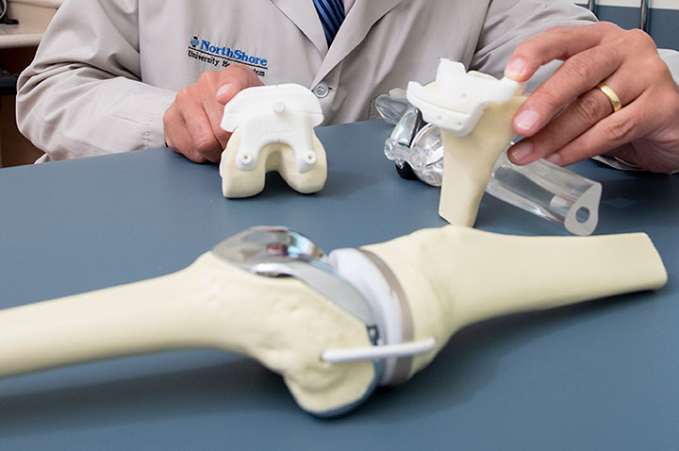
Mandatory Reporting – Minimal Margins
INCREASING Demand
Main Issue: ​
Hospitals do NOT have time to set up a customized solution​
Average Ortho Practice:​
~500 Hip Replacements/year​
3-5% Readmission rate​
~$15k/Readmission​
Demand (by 2030):​
Primary Total Hip Arthroplasties is projected to grow by 174% to 572,000​
Primary Total Knee Arthroplasties is projected to grow by 673% to 3.48 Million

Slide 23
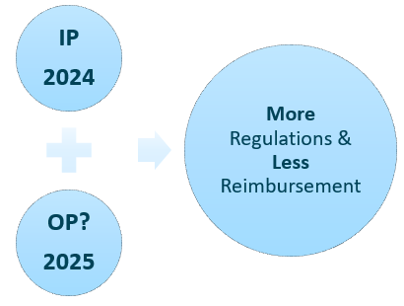
Just the Beginning!
Voluntary becomes Mandatory
Incentive becomes Reduction
(FY2028 25% reduction in APU)
25% becomes 50% becomes 75% becomes 100%
Hospital-based (IP) for 2024 => OP in 2025?

Slide 24

Automated Patient Reported Outcomes (PROs) for Hip & Knee Replacement: Clinical Workflow
Clinical Pathway Automatically Launches at time Surgery is Scheduled
Patient receives PRO questionnaires using secure SMS text within 90 days of surgery date
  Automated reminders and patient outreach to assure completion
  Automatically scored and captured as structured data for reporting
  NOTE: can be incorporated into existing pre-op clinical pathways OR launched as a stand alone!
Patient receives PRO questionnaires using secure SMS text post-op
  270 - 365 days after the TKA & 300 - 425 days after the THA
  Automated reminders and patient outreach to assure completion
  Automatically scored and captured as structured data for reporting

Slide 25

KEYS to SUCCESS is AUTOMATION & DESIGN
Does not require Provider or Staff involvement to start, complete, or score
Patient can complete at their convenience
  Friendly reminders until completed
Easy to Use interface and standardized PROs
Automatic Scoring & Capture of Structured Data for Reporting

Slide 26

CURRENTLY AVAILABLE PATHWAYS
Total Hip Arthroplasty/Total Knee Arthroplasty Patient-Reported Outcome Based Performance Measure (THA/TKA PRO-PM)
Pre-Surgery & Post-Surgery
▪ HOOS Jr (THA) or KOOS Jr (TKA)
▪ Mental Health Subscale items from PROMIS Global or complete PROMIS-10 Global (optional)
▪ Health Literacy (SILS2)
▪ Use of Chronic Narcotics
▪ Total Painful Joint Count: Patient-Reported Pain in Non-Operative Lower Extremity Joint ▪ Quantified Spinal Pain: Patient-Reported Back Pain, Oswestry Index Question
THA_PRO_PM_for_CMS_Pre_Surgery
THA_PRO_PM_for_CMS_Post_Surgery
TKA_PRO_PM_for_CMS_Pre_Surgery
TKA_PRO_PM_for_CMS_Post_Surgery

Slide 27
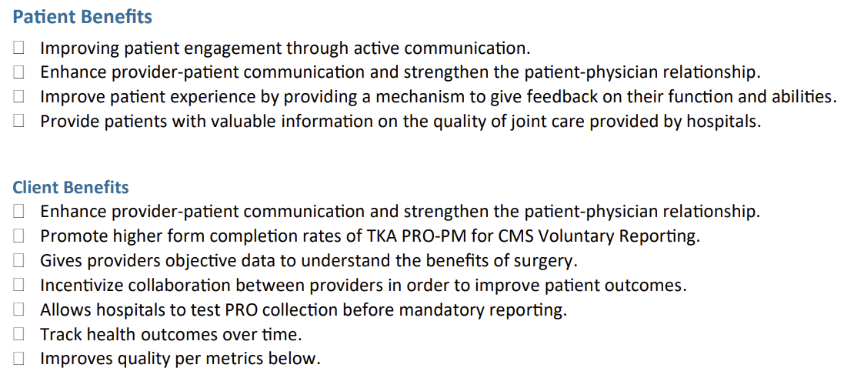
BENEFITS: Patients & Clients

Slide 28
Suggested Key Quality Measures
% adoption
% provider and patient engagement
Patient satisfaction
% increase in form response rate from baseline
% of completion of PRO forms
% decrease in staff hours dedicated to PRO collection
Improvement in patients’ self-reported pain and functional status prior to and after their elective, primary THA/TKA
NOT Part of the PRO-PM Requirements!
Used for Internal Monitoring
of Process

Slide 29
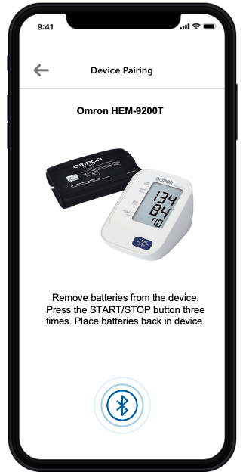
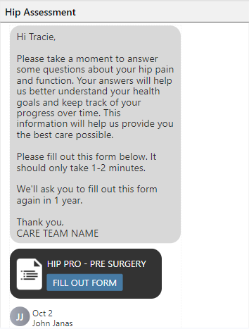
Total Hip Arthroplasty
Patient-Reported
Outcome-Based Performance Measure (THA/TKA PRO-PM)
When THA Surgery Scheduled, Patient Automatically Receives Secure SMS Text Message with Link to THA PRO-PM
Pre-surgery Pathway in Secure Web Browser
Patient clicks to
“Fill Out Form”

Slide 30
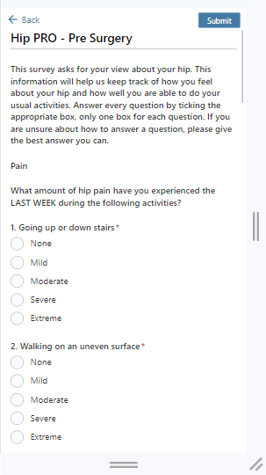
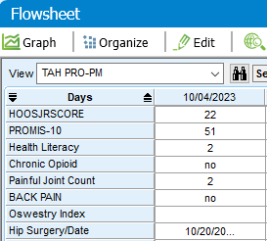
Total Knee Arthroplasty
Patient-Reported
Outcome-Based Performance Measure (THA/TKA PRO-PM)
Patient completes HOOS JR and additional required components in form and then “Submits”
HOOS JR & PROMIS-10 automatically scored
Results automatically sent as structured data to EHR

Slide 31
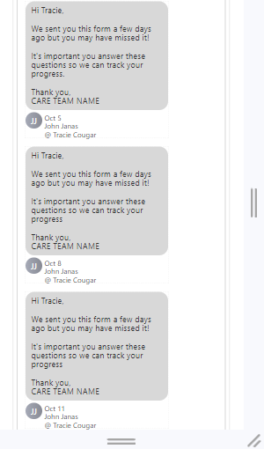
Total Knee Arthroplasty
Patient-Reported
Outcome-Based Performance Measure (THA/TKA PRO-PM)
Patient receives reminders to complete the questionnaire
Every 3 days X 3
After 3 reminders, if not completed, can automatically alert Team Member (optional)

Slide 32
BENEFITS: Patients & Clients

Slide 33
QUESTIONS & ANSWERS

Slide 34
QUESTION 1
Q: What is your typical patient response rate for completion of the PRO Forms?
A: ~90% Completion Rate (~100% Pre-op)
    80-85% directly by patient
    Additional 5-10% completed by family member/care taker

Slide 35
Question 2
Q: What other PRO-PM CQMs are there for 2023/2024?
A: There are numerous PRO-PM CQMs for 2023/2024 and more being proposed for future years (see next slide)

Slide 36
PRO-PM CQMs by PROGRAM
o Quality Payment Program (QPP):
§ Functional Status Assessment for Total Knee Replacement (CQM #470)
§ Functional Status Assessment for Total Hip Replacement (CQM & eCQM (#376/CMS56v11))
§ Urinary Symptom Score Change 6-12 Months After Diagnosis of Benign Prostatic Hyperplasia (CQM & eCQM (#476/CMS771v4))
§ Functional Status Change for Patients with Knee Impairments (CQM #217)
§ Functional Status Change for Patients with Hip Impairments (CQM #218)
§ Functional Status Change for Patients with Lower Leg, Foot or Ankle Impairments
(CQM #219)
§ Functional Status Change for Patients with Low Back Impairments (CQM #220)
§ Functional Status Change for Patients with Shoulder Impairments (CQM #221)
§ Functional Status Change for Patients with Elbow, Wrist or Hand Impairments
(CQM #222)

Slide 37
PRO-PM CQMs by PROGRAM
o Quality Payment Program (QPP):
§ Cataracts: Improvement in Patient’s Visual Function within 90 Days Following Cataract Surgery (CQM #303)
§ Varicose Vein Treatment with Saphenous Ablation: Outcome Survey (CQM #420)
§ Back Pain After Lumbar Surgery (CQM #459)
§ Leg Pain After Lumbar Surgery (CQM #461)
§ Functional Status After Lumbar Surgery (CQM #471)
§ Functional Status Change for Patients with Neck Impairments (CQM #478)
§ Person-Centered Primary Care Measure Patient Reported Outcome Performance Measure (PCPCM PRO-PM) (CQM #483)
§ Psoriasis – Improvement in Patient-Reported Itch Severity (CQM #485)
§ Dermatitis – Improvement in Patient-Reported Itch Severity (CQM #486)

Slide 38
PRO-PM CQMs by PROGRAM
o Quality Payment Program (QPP) PROPOSED (Future Years):
§ Gains in Patient Activation Measure (PAM®) Scores at 12 Months
  Patient Activation Measure® (PAM®)
§ Ambulatory Palliative Care Patients’ Experience of Feeling Heard and Understood
  Feeling Heard and Understood (HU) Survey
§ Improvement or Maintenance of Functioning for Individuals with a Mental and/or
Substance Use Disorder
  12-item World Health Organization Disability Assessment Schedule (WHODAS 2.0) or Sheehan Disability Scale (SDS)
§ Reduction in Suicidal Ideation or Behavior Symptoms
  Columbia Suicide Severity Rating Scale (C-SSRS)
§ Person-Centered Primary Care Measure Patient Reported Outcome Performance
Measure (PCPCM PRO-PM)
  PCPCM PROM (ABFM)

Slide 39
PRO-PM CQMs by PROGRAM
o Hospital Outpatient Quality Reporting Program (HOQRP):
§ OP-31: Improvement in Patient’s Visual Function Within 90 Days Following Cataract Surgery
§ (proposed) Risk-Standardized Patient-Reported Outcomes Following Elective Primary Total Hip and/or Total Knee Arthroplasty
• Proposed in CY2024 Proposed Rule as voluntary for CY2025 and 2026 (procedures performed 1/1/25 through 12/31/26); mandatory for CY2027 (procedures performed 1/1/27 through 12/31/27)

Slide 40
PRO-PM CQMs by PROGRAM
o ASC Quality Reporting Program (ASC QRP):
§ ASC-11: Improvement in Patient’s Visual Function within 90 Days Following Cataract Surgery
§ (proposed) Risk-Standardized Patient-Reported Outcomes Following Elective Primary Total Hip and/or Total Knee Arthroplasty
• Proposed in CY2024 Proposed Rule as voluntary for CY2025 and 2026 (procedures performed 1/1/25 through 12/31/26); mandatory for CY2027 (procedures performed 1/1/27 through 12/31/27)

Slide 41
QUESTION 3
Q: You said: Clinical improvement measured based on the difference in patient score on joint-specific PRO instruments between preop PRO assessment and postop PRO assessment
  Meet or exceed a threshold of 22 points on Hip dysfunction and Osteoarthritis Outcome Score for Joint Replacement (HOOS, JR) for THA and 20 points on Knee injury and Osteoarthritis Outcome Score for Joint Replacement (KOOS, JR) for TKA
If maximum score on HOOS JR is 24 and KOOS JR is 28, how can you possibly achieve the threshold of 22 and 20 points???
A: Difference is based on the change in the INTERVAL SCORE (0-100) not the RAW SCORE

Slide 42
KOOS JR: 7 Items
SCORING: Convert Raw Score (0-28) to
Interval Score (0-100)*
*Meet or exceed a threshold of 20 points on Knee Injury and Osteoarthritis Outcome Score for Joint Replacement (KOOS, JR)

Slide 43
HOOS JR: 6 Items
SCORING: Convert Raw Score (0-24) to
Interval Score (0-100)*
*Meet or exceed a threshold of 22 points on Hip dysfunction and Osteoarthritis Outcome Score for Joint Replacement (HOOS, JR)

Slide 44
Question 4
Q: Does the Mandatory Reporting apply to Outpatient Procedures (THA/TKA)?
A: For 2024, it only applies to INPATIENT Procedures! Expect it to apply to Outpatient Procedures in near future.

