Slide 1
Automated Medication Compliance Tools for the Provider and Patient
Melissa Welch, MD, MPH, Chief Medical Officer
Jo Laucirica, PMP, Customer Success Operations Lead

Slide 2
Poll Questions

Slide 3
Topics to Be Covered
Care Team Burnout and Inefficiency Impacts
Leveraging Technology for Workflow Efficiencies and Engagement
Case Study Applications
5 Step Strategy
© Health Catalyst. Confidential and proprietary.

Slide 4
Care Team Burnout and Inefficiency Impacts

Slide 5
Multiple research studies show that 47% of physicians feel burned out.
Insights
Efficient care models that increase 'top of license' work are key.
Reducing bureaucratic tasks is the highest contributor.
Source: Medscape 2022 Physician Burnout & Depression Report: n:13,069 physicians across 29 specialties
© Health Catalyst. Confidential and proprietary.
Notes:
Core motivators, positive Programmed motivational pursuits. (autonomy, mastery, relationships, meaning, achievement)
Deci/ ryan with self determination theory, martin Seligman, positive phycology ,

Slide 6
Impact on Staff
40%
Improper chart review and manual review processes can lead to safety and quality concerns.
Clinical work that is redundant or otherwise wasted effort. IHI, 2019
Requests that are duplicate or not on the active medication list. McGuirt (2018)
9.5%
4.5
Average minutes it takes a pharmacist to review a patient chart per renewal request. J Am Pharm Assoc, 2013; J Prim Car
More pressure on staff to meet internal productivity measures (e.g., 24-hour turnaround time).

Slide 7
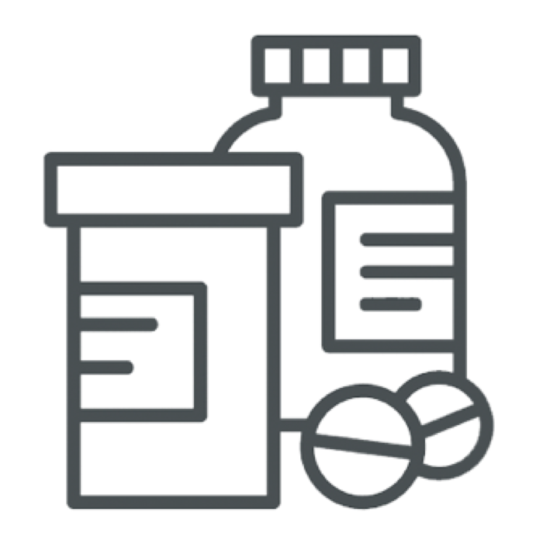
Impact on Patients
Ambulatory care and hospitals rank below internet retail, banking, and the automotive industry in consumer satisfaction. American Consumer Survey, 2017
22.4%
Patients’ experiences with care correlate with adherence to medical advice and treatment plans.
Patients who don’t receive recommended lab monitoring for adverse medication effects.
Long turnaround on prescription renewal requests.

Slide 8
Impact on Information Services
Time to create protocols for most commonly prescribed medications
Time to build one protocol
10 hrs.
2,500 hrs.
Lack of content maintenance = risk for inappropriate monitoring and lack of trust in decision support tool.
Highly demanded resource
Limited number of staff and time.
Analysts spend hours stuck in the middle of consensus discussions.

Slide 9
Leveraging Technology for Workflow Efficiencies and Engagement

Slide 10
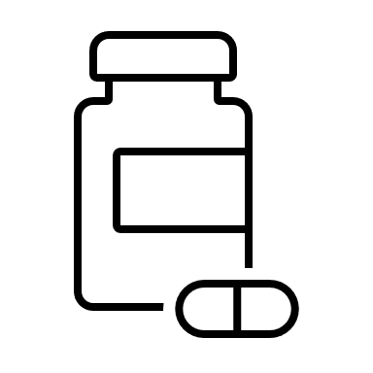
How can technology help?
Identify
Process
Populate
Identify Rx renewal requests
Document key information
Apply protocols
Customized protocols are applied when a refill request is received or proposed.
Standard workflows supported by robust protocols will enable staff to efficiently and safely work at the top of their license.
Notes:
Talk through how we embedded refills work.
Renew request comes in from surescripts or is proposed within the EMR
The refill requests gets matched to the correct protocol
The chart is scrubbed for all relevant information required for that protocol
Information required for that protocol is displayed with the refill request so that staff can make an informed decision without chart digging

Slide 11
The Value of Health Catalyst Embedded Refills™
Consensus
Alignment on Clinical Rules that drive your protocols.
Delegation
Protocols enable staff to work at the top of their license through delegation.
Implementation
Embedded Refills drives efficiency and effectiveness.
Optimization
Expand on learnings to enhance efficiency and achieve a higher ROI.
Strengthen Analytics Accuracy & Trust
Repeat for additional clinical workflows
Notes:
Talk through the different stages.
Consensus – Health Catalyst provide a robust set of foundational protocols that have been carefully curated by our clinical content team. The CS team then works with a select group of providers who will be the voice of the providers in coming to consensus on protocol criteria. These change leaders will be critical to create a set of protocols that support the organization’s patient population, policies, initiatives, and best practices.
Delegation – Having a robust set of protocols promotes top of licensure work providing higher levels of satisfaction to the providers, staff, and patients.
Implementation - Clear and standardized guidance provides the staff the ability to work efficiently, the providers confidence that refills are being managed with the highest regard to patient safety, and the patients with a quicker turnaround time and access to their medications. The CS team will work with your organization to discuss best practices and workflow optimization to drive improvements in efficiency and effectiveness leveraging the protocols.
Optimization – Post Implementation we will continue to work with you to optimize protocols and workflows to meet your SMART goals. The clinical content team also releases quarterly updates on medications to provide you with the most current recommendations on safe monitoring for medications.

Slide 12
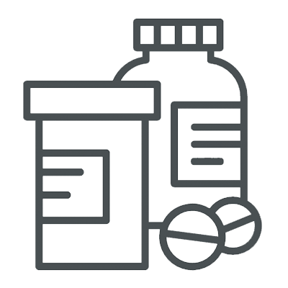
Protocols
Protocol Components:
Medication
Office Visit
Monitoring
Delegation Level
Protocols can be constructed on a spectrum of specificity:
Full therapeutic or pharmaceutical class
Single medication
All routes
Single route
Notes:
Protocols can include but are not limited to include the medication per route, office visit interval, monitoring criteria, and delegation level. Protocols can be customized per medication, per route.
During protocol consensus the CS team will help guide discussions around the customization and technical abilities of protocols to best fit your organization and patient population needs.

Slide 13
Workflow Efficiency
Renewal request is received via phone, fax, Surescripts, or interface message.
Provider or staff review patient chart for relevant renewal information.
Request approved/denied by provider or staff and necessary follow-up performed.
Average minutes spent per renewal request
Without Embedded Refills with
with
with
With Embedded Refillswith
Notes:
Our Customer Success teams works with your organization to determine the best workflow to meet your needs and structure, while respecting state statute.
Through workflow observation and consensus, the CS team will help guide conversations and provide best practices to help gain workflow efficiencies. We can provide a consultative approach for both centralized and decentralized teams. We can also provide industry expertise to organization who are currently decentralized and are looking to leverage a centralized team to drive even greater efficiencies and increased standardization within their organization.

Slide 14
Fully Integrated Refill Protocols
Notes:
Discuss/show how the product looks within different EMRs

Slide 15
Fully Integrated Refill Protocols
Notes:
Discuss/show how the product looks within different EMRs

Slide 16
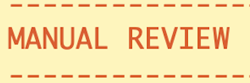
Refill Categories
Quickly See Key Identifiers
Medication is set as historical or has been discontinued.
Medication is active but at a different strength/form.
Medication is a controlled substance.
Medication does not meet protocol due to overdue office visits or abnormal/overdue labs.
Medication requires review for requirements outside of office visits and diagnostics.
Medication was previously processed within the last 7 days for non-controlled meds or 3 days for controlled medications.
Notes:
For all most integrations, we categorize refill requests so staff can quickly identify next steps for that refill. Here are some examples of the refill categories we offer:
In Protocol – Refill meets all protocol criteria and it's safe to refill
Potential Mediation Error and Medication Status Problem – Strength/form or status of the medication on the patient's chart does not match the refill request received. Indicates the staff should review the request for patient safety and take the time to update the patient's medication list.
Off Protocol/Controlled Substance – Staff can quickly and easily identify when a refill must be reviewed by a provider

Slide 17
Care Due Messages
Identify patients that require labs or office visits based on the refill protocol to improve patient outcomes.
Minimize multiple lab tests and office visits to improve the patient experience.
How Care Due Messages are Identified
At the time of the refill, if the patient’s provider is live on Embedded Refills, Care Due messages will check all active medications on the chart to identify any due or coming due diagnostic and office visit requirements associated with those medications.
*Based on configuration and specialty
Notes:
Care Due Messages are based on protocols. At the time of a refill, it provide recommendations for any overdue or coming due labs or office visits that are required for active medications for that patient. This allows staff to work more efficiently, streamline the patient experience (less pokes is always good!), promote medication adherence, and increase office visit and lab revenue.
Impacts Staff – Complete on lab order that includes diagnostics needed for all active meds instead of having to place lab orders as refill requests come in for the individual medication
Patients – Less pokes as they can proactively get labs completed which will then lead to their next refill for those medications to be in protocol. In protocol means a quicker turnaround time.
Revenue – Through what we just discussed, this will provide increase revenue if labs are being completed in house and patient med adherence.

Slide 18
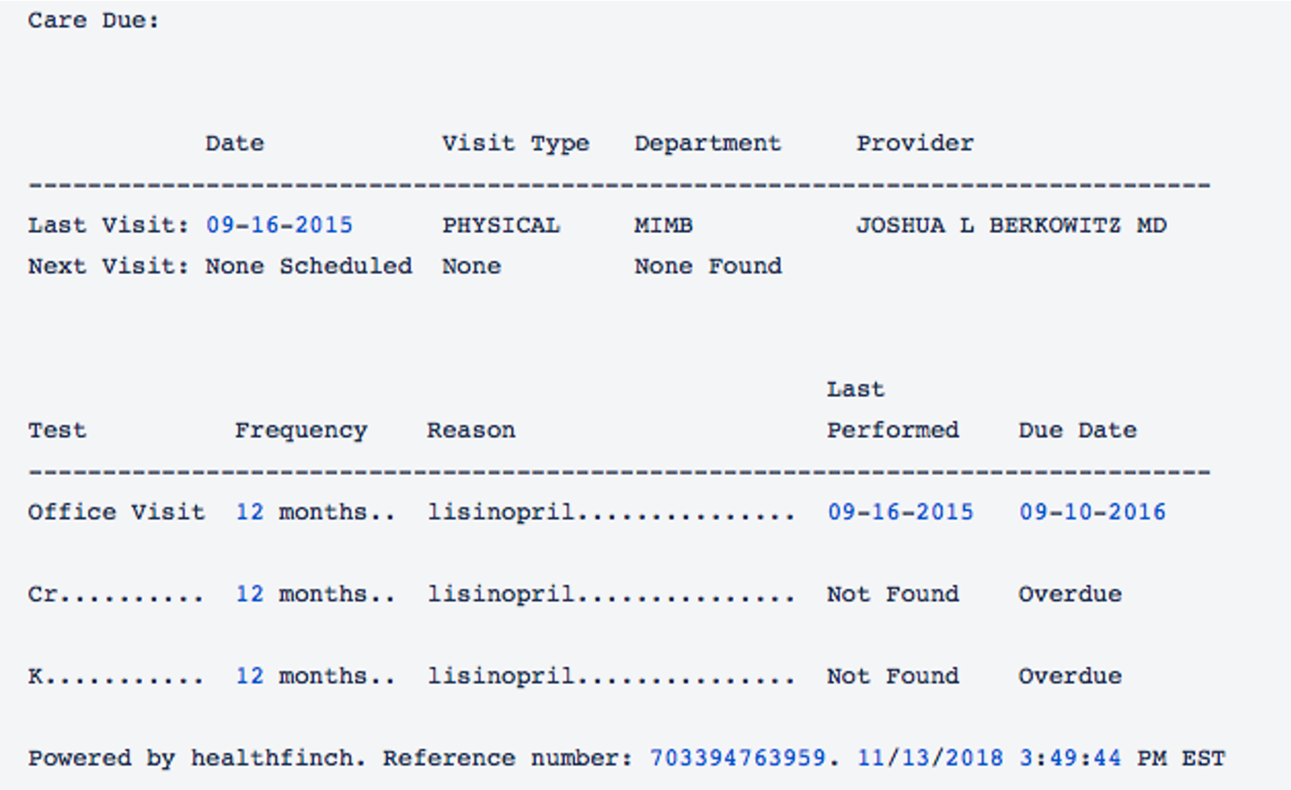
Care Due Messages
Notes:
Discuss/show how the product looks within different EMRs

Slide 19
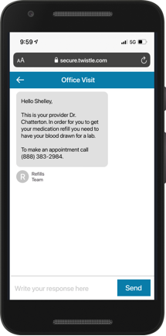
Embedded Refills with Twistle by Health Catalyst™
Automate Patient Outreach for Lab Orders and Office Visit Appointments required for medication adherence.
Embedded Refills surfaces lab and office recommendations for the patient to stay within protocol for requested medication refill.
Staff places and signs suggested orders.
Twistle is triggered to send a secure SMS message to the patient for care due.
Notes:
Embedded Care Due Messages surfaces overdue and coming due lab and office recommendations for other active medications on the patient's medication list.

Slide 20
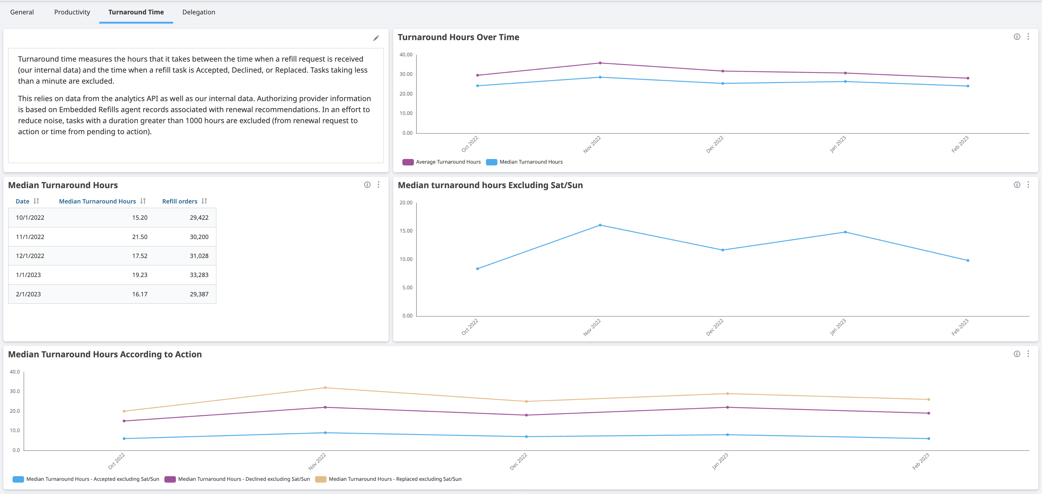
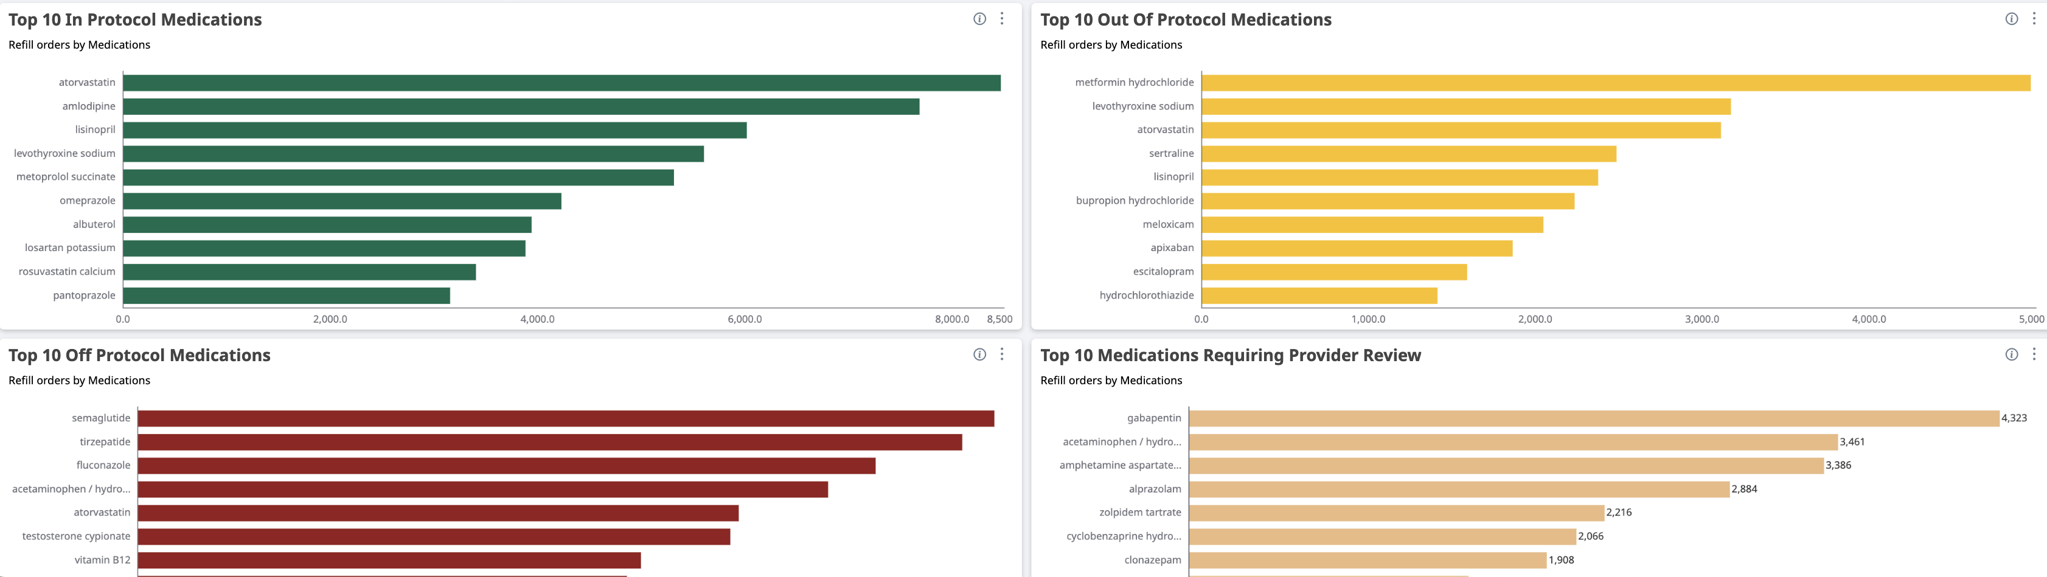
Continued Optimization
Protocol Maintenance
Quarterly meetings are recommended to review:
Additional medications to be protocolized.
Protocol requirements based on new recommendations from Health Catalyst and the needs of your organization’s initiatives.
Analytics dashboard for optimization opportunities.
Analytics Dashboard
Health Catalyst will provide leadership with access to an on-demand dashboard to quickly review trends and have access to your organization’s protocols.
Notes:
Post Implementation, you will be supported as we continue to partner with you to review protocols and refine them as trends and opportunities are identified for optimization.
Health Catalyst will provide your organization with access to Pop Insights, giving you in depth insight into actionable data to help support continued refinement of protocols and workflows while monitoring outcome improvements around things like turn around time and refill user productivity (depending on the EMR integration).

Slide 21
Key Success Metrics
Examples of Metrics Realized by Embedded Refills Customers
75%+ | Percentage of renewals handled by staff
< 24 hrs. | Turnaround time
30:1 | Provider to staff support ratio
5+ | Percentage point increase of closed care gaps
Notes:
75%+: Through supported protocols and top of licensure work, staff can easily handle 75% or more of refill requests, allowing providers to focus on direct patient care.
< 24 hrs: Through the implementation of streamlined workflows and standardization of care, organizations have been able to reduce turnaround time to less than 24hrs.
30:1: Supported by Embedded protocols and efficient workflows, Centralized customers have been able to staff their refill team to handle 30 providers per 1 FTE.
5+: Through protocols, customers have been able to realize a 5+ point increase in closing care gaps.

Slide 22
The Benefit of Health Catalyst’s Embedded Refills™
Patient:
Increased satisfaction and quality
Staff:
Operational workflow efficiencies
Health System:
Financial and Quality Improvements
Quality-Based Care with Workflow Effectiveness
Notes:
In summary, benefits that our solution deliver include
Benefits for the patient such as:
Shorter turnaround time to receive medications leading to higher patient satisfacation
Proactive quality care
Benefits for Staff include:
More time freed up for direct patient care
Reduced chart scrubbing or time spent on duplicates
Trusted to work top of license
Benefits for the health system include:
Financial gains through
lower cost per renewal
increased office visit and lab testing
Increased patient med adherence rates
Reduced unnecessary ED visits to receive renewals
Higher workforce satisfaction and staff retention
Help reduce provider burnout and pajama time
...

Slide 23
Case Study Applications

Slide 24
Workflow Efficiency with Embedded Refills
Challenge
Approach
Medical assistants unable to practice to the top of their license.
Medication refill processing responsibilities grew, threatening patient care.
Manual refill process created variability in prescribing patterns.
Medication protocols not consistently followed, creating liability.
Used Embedded Refills to automate a delegated refill workflow.
Workflows to Categorize refills as: In Protocol, Out of Protocol, Off Protocol, Duplicate, and Controlled.
Refills categorized as In Protocol and Duplicate are handled by non providers, creating efficiency.
60%
31
/hour
24 hrs
Fewer refill requests sent to providers
Turn around time
Refills are processed per hour,
per FTE
© Health Catalyst. Confidential and proprietary.
Notes:
Valley Medical Group identified that they needed additional support for their staff to work top of licensure and ensuring the highest degree of patient safety. Leveraging Embedded Refills, they were able to provide the guidance that their staff and providers desired to ensure consistent patient care across the organization and help reduce provider burnout.
They realized a 60% reduction of refills being sent to providers, a decrease in turnaround time to 24hrs, and the ability to now process 31 refills per hour.

Slide 25
Increasing Capacity for Prescription Renewals
Challenge
Approach
Renewal request were taking approximately five minutes to complete.
Challenges with duplicate renewals from pharmacies.
Sought to expand centralized workflow for prescription renewal without having to hire additional staff.
Automated a centralized prescription renewal workflow with Embedded Refills.
Integrated directly with a health system’s EMR and existing workflows.
Leveraged and automated evidence-based medication protocols.
47
3.5%
10,000
Hours of staff time saved each month
Reduction in prescription duplicates
Medical errors identified
© Health Catalyst. Confidential and proprietary.
Notes:
Martin’s Point desired a technology that would support their initiative to centralize refill requests as current EMR functionality did not support a standard way to approach refills across the organization. Leveraging Embedded Refills they were able to centralize their refill process taking work away from the clinic so they can focus on direct patient care. Through this process we partnered with Martin’s Point to establish best practices and workflows for their centralized team which led to:
47 hours of staff time saved every month
3.5% Reduction of duplicates received from pharmacies
Increased patient safety by proactively identifying over 10,000 potential medication errors

Slide 26
Medication Adherence with Digital Engagement
Challenge
Approach
Challenges with medication adherence, measured by medication possession ratio (MPR).
Sought to improve the patient experience.
Challenges with staff satisfaction and efficiency.
Specifically, too many telephone calls and voice message management associated with refills.
Automated delivery of refill reminders and collection of delivery parameters.
Regular check-ins re: side effects, adherence, and more.
Pathway alerts for pharmacist intervention.
57%
95%
4.4%
Decrease in delivery arrangement time
Increase in medication adherence
Patient Adoption
© Health Catalyst. Confidential and proprietary.

Slide 27
Approach to Increase Engagement, Efficiencies and Adherence
Five Strategies
Adopt workflow friendly technology that is integrated into the EMR.
Start small to test the effectiveness and impact on a sub-set of the patient population or pick a specific disease management focus.
Incorporate patient outreach via text reminders to improve medication access and patient engagement between clinical appointments.
Leverage data to track and measure results and implement best practices across targeted patient populations.
Assess patient and physician satisfaction for ongoing continuous improvement efforts.

Slide 28
Key Messages
Healthcare Provider Burnout is Real
Improved Clinical Management
Administrative efficiencies most cited issue.
Staff and patients are adversely impacted.
Inefficiencies cost systems time and money.
Expand Access to all Populations.
Text Communication and Personalized Outreach.
Content is embedded within EMR workflows.
Technology Drives Efficiencies
Five Strategies
Embedded workflows are easy and custom.
Methodology is sound and easy to implement.
Expect treatment initiation and adherence.
Reduce provider and staff burnout.
Technology integration into EMR.
Start small, test, and refine.
Automated text reminders increase engagement.
Leverage data for measurement.
Assess for provider and patient satisfaction.

Slide 29
Thank you! Contact us: communications@healthcatalyst.com

