Slide 1
Looking Ahead: Market Trends Impacting Key Healthcare Issues
Tim Zenger
Leslie Falk
Market Insights, VP, Health Catalyst
Chief Client Success Officer, Health Catalyst

Slide 2
Key Healthcare Issues:
  Economics
  Data, analytics, and AI
  Value-based care
  Health equity

Slide 3
Poll Question
What area are you most interested in today?
  Economics
  Data, analytics, and AI
  Value-based care
  Health equity

Slide 4
Signal or Noise?
1.4%
of 87,792

Slide 5
Economics

Slide 6
Large Macro Trends
Key Insights
Good news, healthcare as a percentage of GDP has decreased from COVID.
Bad news, healthcare as percentage of GDP is still 17 percent-plus, and likely to increase as GDP contracts.
Costs are constant and likely to rise.
Buying stays expensive, but doesn’t increase as fast
Source: Altarum, Federal Reserve

Slide 7














Is Your Business Model Sustainable in This Environment?
Key Insights
Operating margins have improved as some healthcare costs resources have decreased.
Margins are small and there is no room for error.
Data/analytics can provide insights into revenue and cost opportunities.
($11.6M)
3M
($48M)
12M
($14.9M)
3M
($28.6M)
9M
($21.1M)
3M
($177M)
9M
($36.6M)
12M
($58.6M)
3M
($16.4)
3M
($28.6M)
3M
($104.4M)
9M
($291M)
3M
($310M)
3M
($3B)
12M
Source: KaufmannHall, Beckers

Slide 8
Healing Hands, Strained Hearts
How would you rate the level of stress you have experienced in your job while working as a nurse?
 | 2021 | 2023
A great deal | 38% | 56%
A lot | 27% | 25%
A moderate amount | 22% | 15%
A little | 10% | 3%
Not at all | 3% | 1%
Key Insights
We already see these trends impacting quality of care, costs, and revenue.
Will technology help or contribute to the burden?
AI is already available to identify and alleviate areas of burden.
Source: AMN, Jarrard

Slide 9
Data, Analytics, and AI

Slide 10



Needing More Data Isn’t The Problem Anymore
97% of data
hospitals produce goes unused
Key Insights
Many improvement teams can’t articulate the questions they’re trying to answer.
Data volume does not equal data value.
General mistrust is a common barrier to data and analytics
71% of clinicians
don’t know what to do with data
69% of clinicians
feel overwhelmed by the amount of patient data
Source: World Economic Forum, Elsevier, ZS

Slide 11
How Does Healthcare’s Analytics Maturity Compare?
High Maturity
Maturity Distribution By Industries
  90% of provider leaders have lost revenue due to inefficient data use
Key Insights
Healthcare persistently has a low analytic maturity.
Analytically mature organizations perform better on 3, 5, and 10-year revenue and margin performance.
Low Maturity
Source: International Institute for Analytics, IMO

Slide 12
Poll Question
What is the principle challenge your organization faces in becoming data-driven?
  People
  Processes
  Culture
  Technology

Slide 13



Technology Alone Is Not The Solution
Data-Ingestion Challenges
Key Insights
People and process are critical for improvement efforts.
Lack of available, skilled resources encourages the need to seek business process optimization and managed services.
68%
Lack of
human capital
52%
Lack of financial capital
44%
Lack of
technical capital
Source: New Vantage Partners, Sage Growth Partners

Slide 14
What Level Of Investment Is Required To Transform Your Business?
Key Insights
Maintenance does not allow for transformation.
Automation and AI can help reduce maintenance costs, enabling transformation.
Do we know the ideal spend and category mix?
Source: Gartner

Slide 15
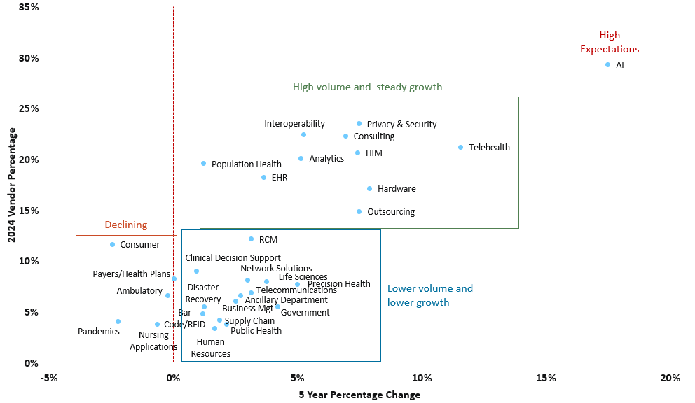
AI: A Trend Or Fad?
Key Insights
Trend or fad? Who cares, it can make a difference.
Lack of strategic investment in AI may put you behind.
AI is not a panacea; we need to use the guiding question, “What is the cost to the patient of being wrong?”
For every $1 companies invest in AI, they are realizing an average of $3.5 in return
Source: HIMSS, IDC

Slide 16
Value-Based Care

Slide 17
87% Had A Unique Population Health Definition, But Some Common Elements Exist…
Key Insights
It’s less about the definition, but more about a central goal.
Is your unit aligned toward a central goal?
The measure of success is important.
Source: Health Catalyst

Slide 18
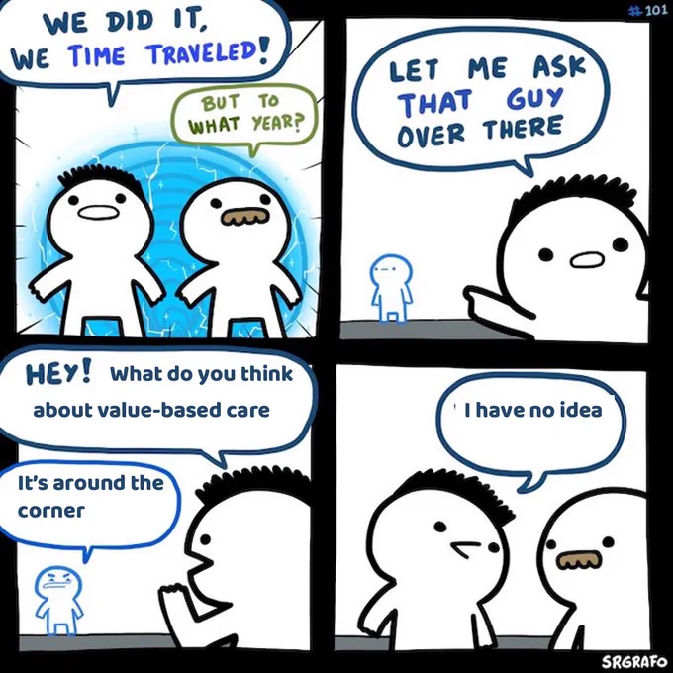
Move To VBC Slower Than Expected Or Predicted
Key Insights
Misaligned incentives continues to be a major issue.
How do we accelerate adoption?
Is it even feasible given healthcare’s financial structure?
Source: HCPLAN

Slide 19
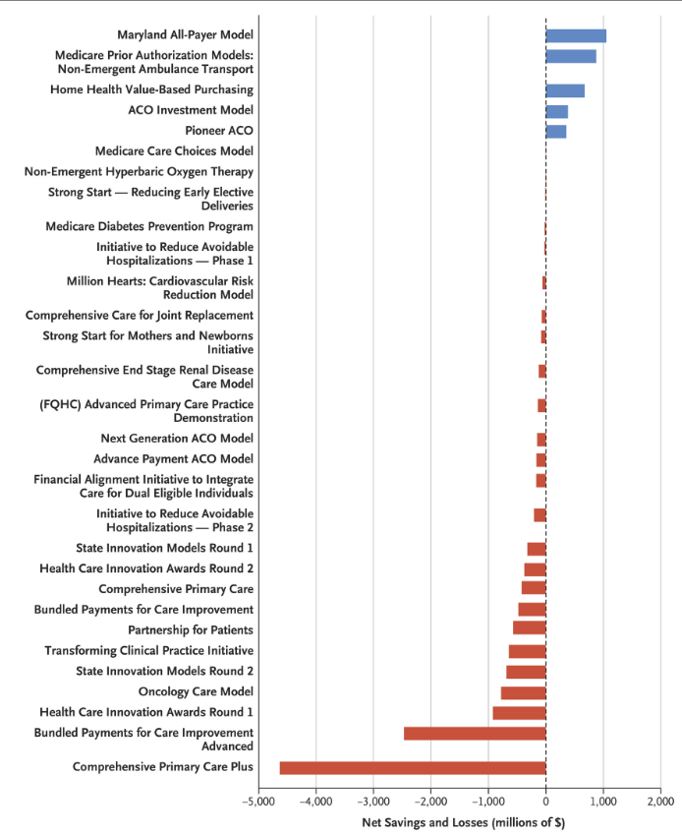
Is VBC Sustainable In Improving Outcomes?
Key Insights
Should we even be focused on VBC when most models have lost money and aren’t increasing value?
Is healthy competition—like retail—the answer?
Will individual state initiatives lead to solutions or are they a Trojan horse?
90% of models aren’t showing the benefit.
CMS Innovation Center Has Launched 54 Models, 1M providers, 26M patients
Source: CMS, MGMA

Slide 20
Health Equity

Slide 21
Health Equity: A Priority, But Lacks Resources
Key Insights
Prioritization and allocated resources don’t match.
Why the discrepancy? Right thing to do, ROI, regulatory?
Inequities have an impact irrespective of costs and outcomes.
Source: Deloitte

Slide 22
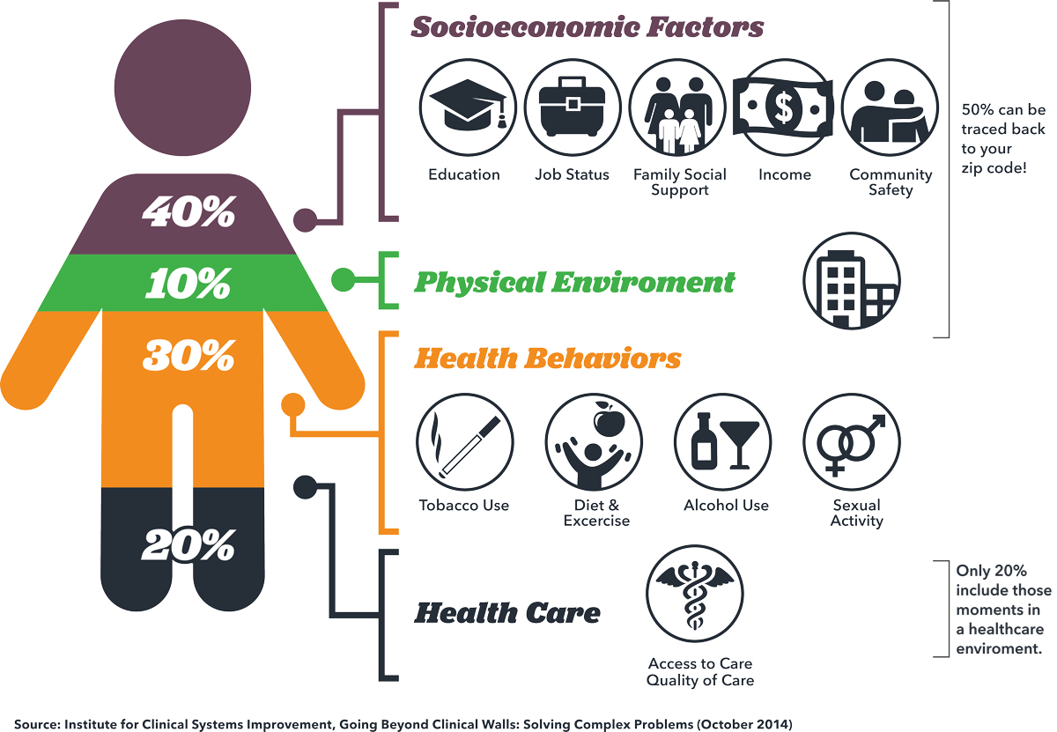
How Much Can Providers And Their Organizations Move The Needle On Patient Outcomes And Personal Health?
Key Insights
80% of the patient’s health is outside of traditional care.
Providers ideal is to focus on the 100% not just 20%.
Structural issues and incentives influence and drive these results.
How much time do you, as a physician, CURRENTLY have to effectively address your patients' SDOH?
Source: The Physicians Foundation

Slide 23


Avoid and Defer
Key Insights
When will wellness become the focus for patients and providers instead of sick care.
While cost isn’t the only barrier to focusing on wellness, it is the largest factor.
8 out of 10 full-time employed, insured women delay care until symptoms worsen or impact their daily lives
Source: Qualtrics, Parsley Health

Slide 24
Patient Access: Still A Difficult Problem To Solve
Key Insights
We are struggling to meet patients’ demand for access.
Is there an opportunity to consider managed services for areas like clinical staff, IT/analytics, and revenue cycle?
Source: KaufmanHall

Slide 25
Leslie Falk and Tim Zenger
hcwebinars@healthcatalyst.com
Alora Martin, Webinar Program Manager

