Slide 1
Healthcare Tech Insights: AI, Trends, and Platforms Demystified
Dave Ross, CTO
Tim Zenger, VP of Market Insights & Research

Slide 2
Cybersecurity
Macro Pressures
AI
Data & Analytics Platforms

Slide 3
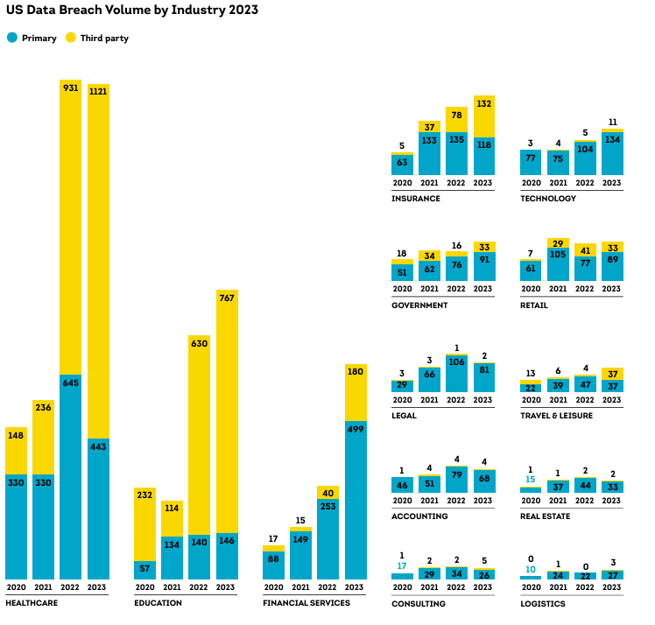
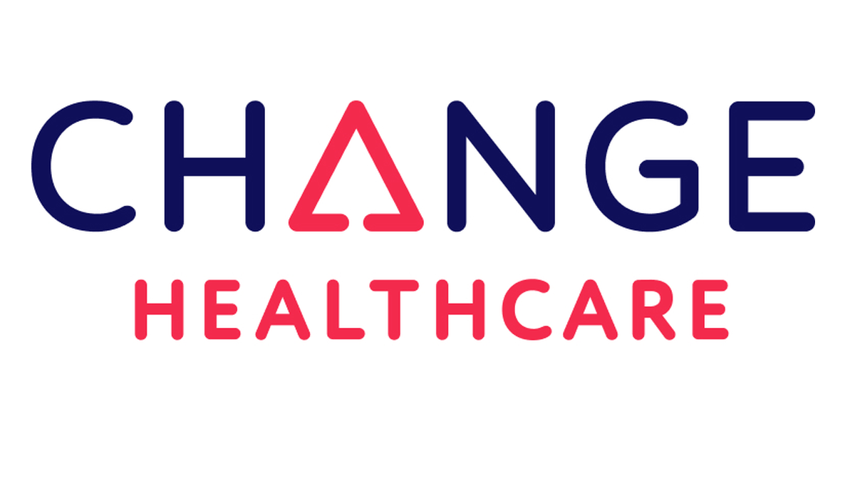
Change healthcare ransomware attack
#4. Exit Scam.
#3. Possible but unconfirmed $22M ransom paid
#1 Freelance hacker gets onto Blackcat services
Notchy
#2. Infiltrated and stole data (~4-8Tb)
94% of hospitals reported some financial impact
60% of hospitals had affected revenue totaled at least $1 million per day.
Source: AHA, TransUnion
Notes:
AHA survey n:1000 hospitals
Question is, can CISO have done anything to prepare or stop this. What else is needed. How does the hospital CISO can do everything they can. Over consolidation creates risk, flying on one engine.
Due diligence, critical systems, business systems.

Slide 4
Thriving in an age of continuous reinvention How long do you think your business will be economically viable?
45% of CEOs believe their current business model won’t be viable in 10 years
Inflation
Patient Access
Covid
Employee Safety
Inflation
Labor Supply
Finances
PE Ownership
Reimbursement Levels
Alternative Care
AI
Source: PWC n:4702
Notes:
How does an organization decide which factors are impactful to the business and which aren’t?
Up from 39% last year
Drivers that are driving, finances, covid, telehealth, mall is a shell of what it once was. Time to be seen, patient access. Consumer expectations

Slide 5
HIMSS vendor categories 30+ Categories & 230+ segments, 1022 vendors
High Expectations
High volume and steady growth
Declining
Lower volume and lower growth
Notes:
How does anyone make sense of what is real or not?
300 Gen AI specific 1500 total AI vendors

Slide 6
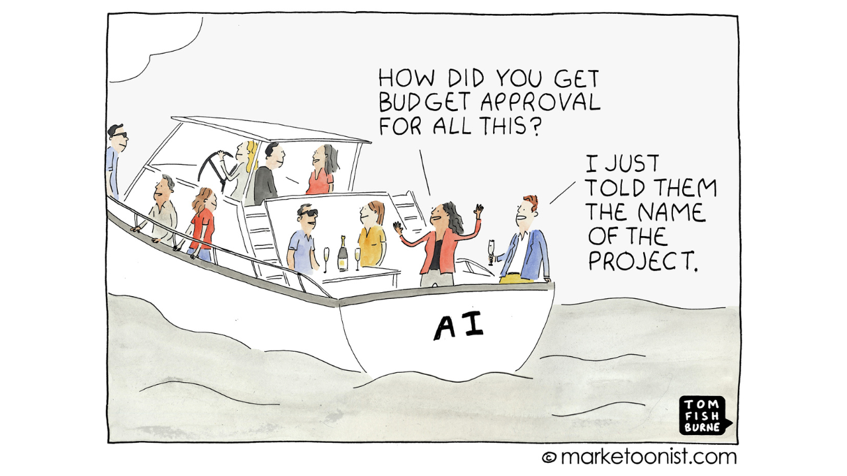
Fear of missing out
Rate of technology progress
Performance
Average customer adoption limits
Time
Notes:
In 2024, many companies will find attractive ROI from GenAI, but only a few will succeed in achieving transformative value from it. GenAI may appear easy to use, and many cloud service providers are already embedding GenAI capabilities in their offerings. But realizing GenAI’s full potential requires more than just letting employees use new capabilities in enterprise applications, however powerful they may be. It requires taking advantage of GenAI’s capacity to be customized to your specific needs and its remarkable scalability — while also paying close attention to its potential risks.

Slide 7
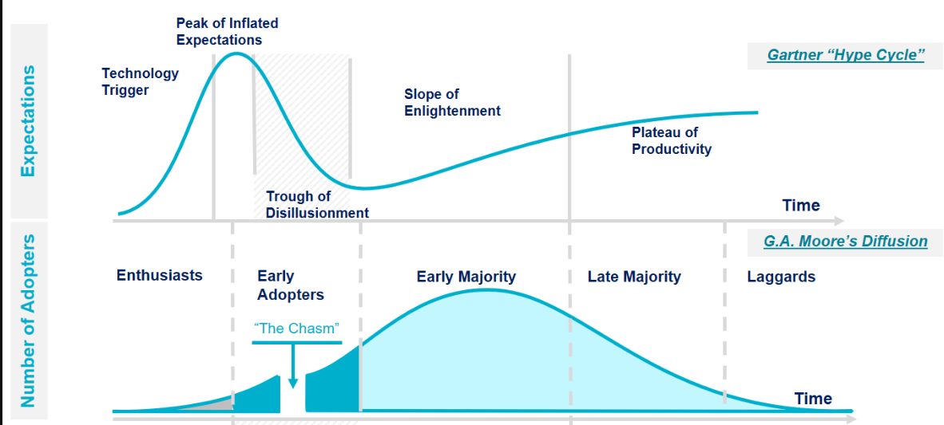
Technology hype
LLM
LLM
AI Virtual Assistants
Technology shakes out or fails

Slide 8
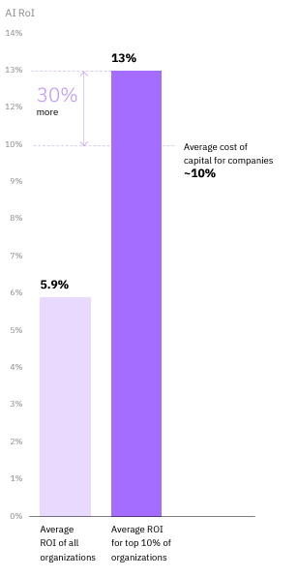
You should not have an AI strategy. Rather, AI should enable your existing strategy
Enthusiasts
Skeptics
Incremental
Acting quickly — maybe too quickly.
Over time the scattershot approach to investment has resulted in technological bloat, wasteful or duplicative spending, and has muddied the overall organizational strategy
Hesitant to act on AI. Challenges like investment, implementation, and risk-aversion cause this group to, at best, wait and watch, or at worst, fully ignore the technological advances around them.
Moving now on AI in a systematic, potentially slower manner than headfirst enthusiasts. They only invest in use cases that will meaningfully impact their overall strategy instead of seeking out the most interesting AI use cases
Source: Advisory Board, IBM

Slide 9
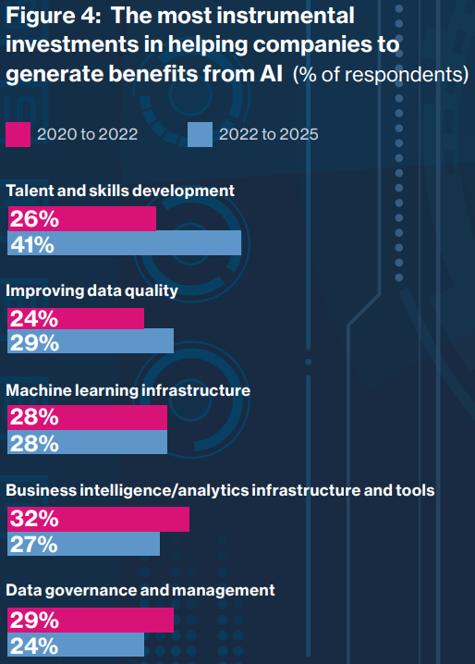
Analytics and AI outcomes are about more than technology
New Venture Partners, MIT
Notes:
116 diverse Fortune 1000 and leading organizations during 2022 participated in this year’s survey – up 22% over last year’s survey.

Slide 10
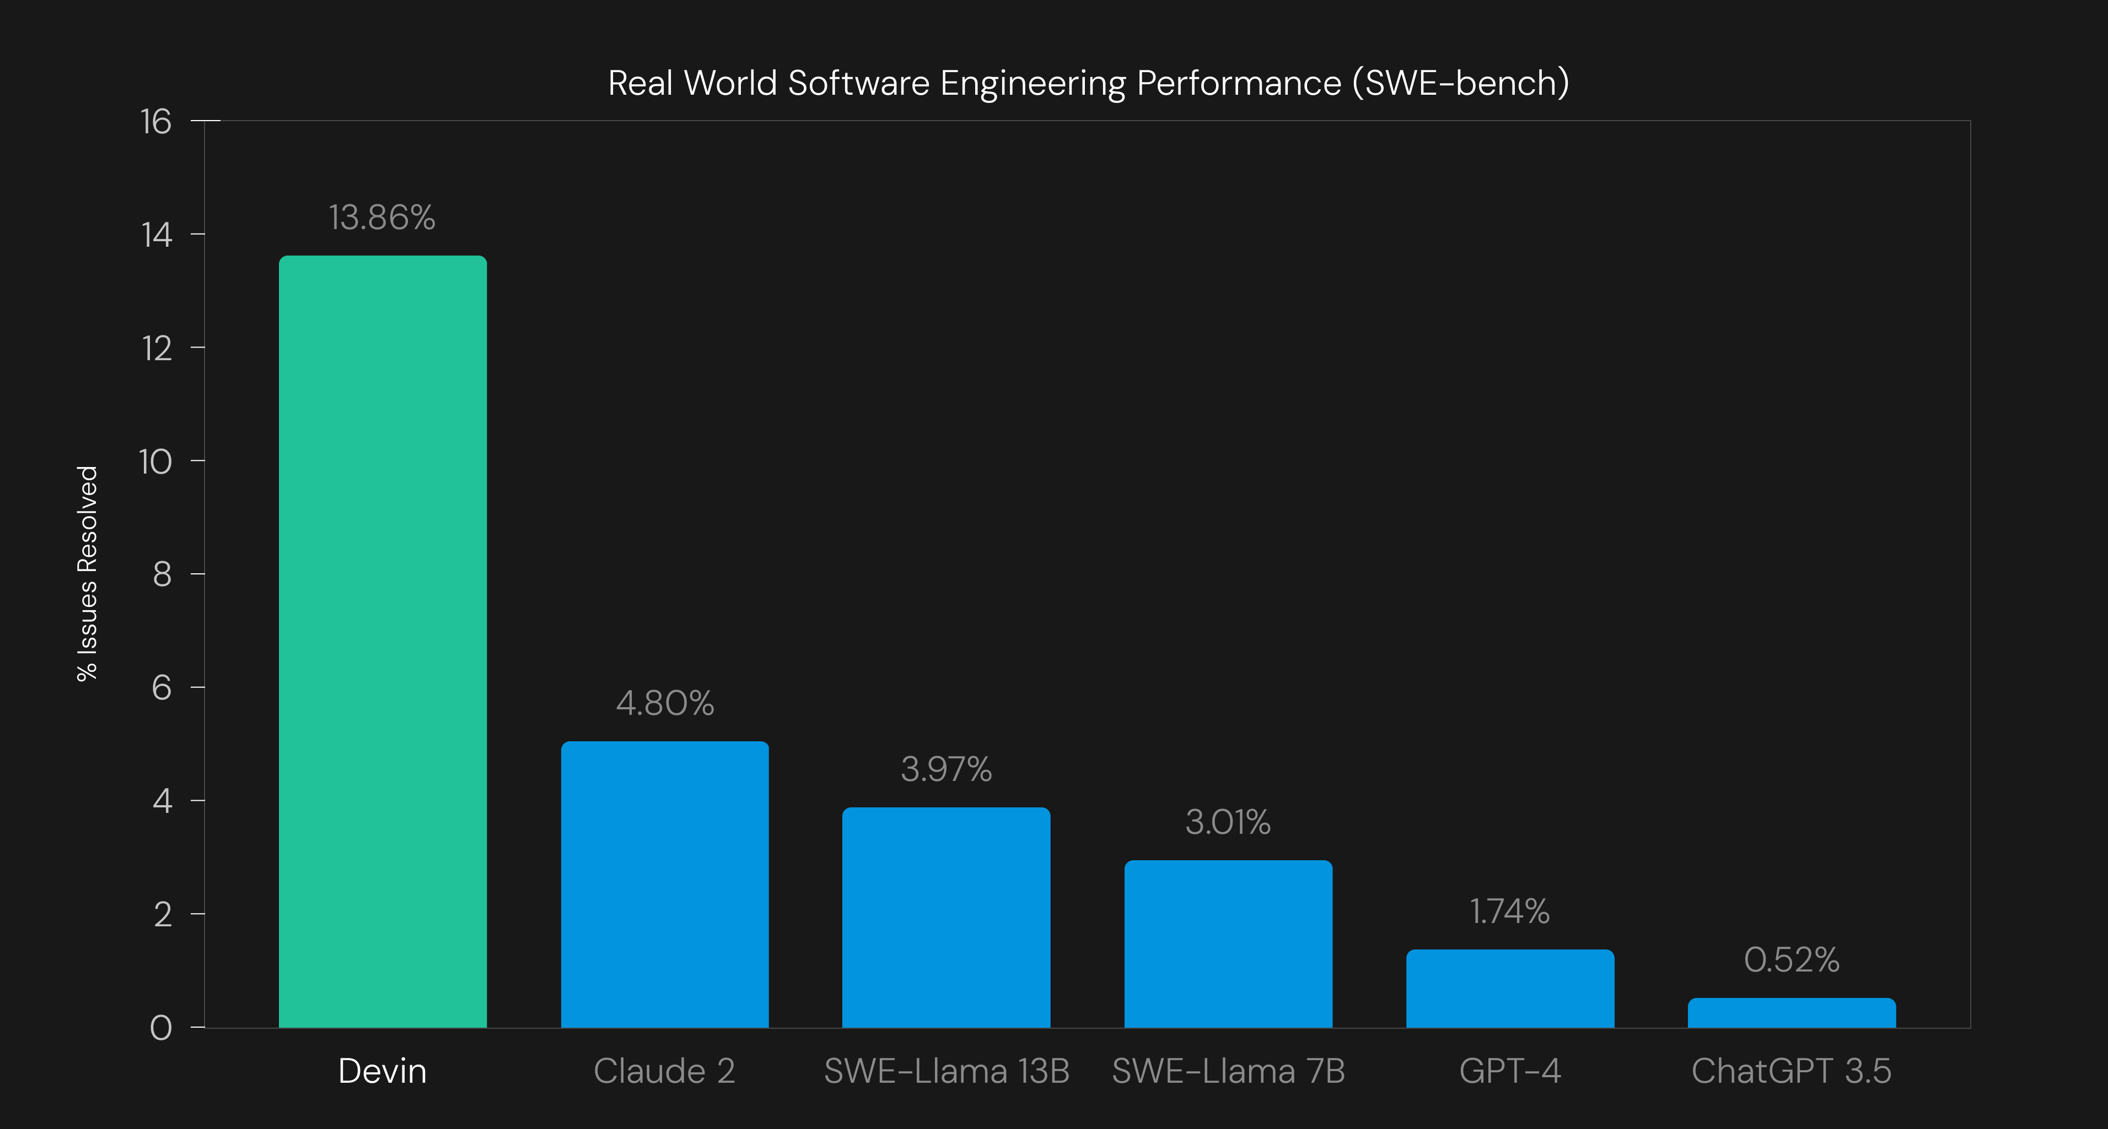
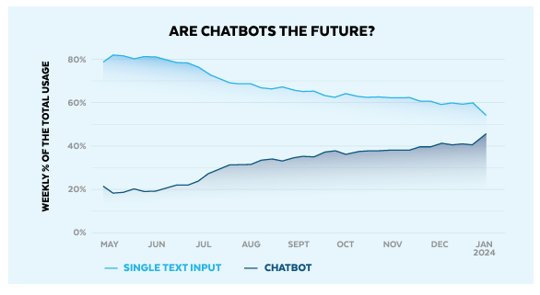
Compelling use cases; fully autonomous to co-pilot
Source: Snowflake, Health Catalyst, Cognition Labs
Notes:
On Github there are things called “issues” which are essentially bugs or enhancement requests that are reported for a codebase. Devin right now autonomously write code to solve 13% of GH issues. Chat GPT 4 can only solve 1.74%

Slide 11
Where are provider organizations spending new money in 2024
#1
Data & Analytics tools
#2
Cybersecurity tools
#3
Patient engagement
Priorities remain unchanged from 2023
Source: Gartner n:93
Notes:
Is PE about keeping, more patient access. CX Data- 51%
Cybersecurity – 43%
Patient Engagement – 39%

Slide 12
Modern Data Platforms

Slide 13
Dave Ross and Tim Zenger
hcwebinars@healthcatalyst.com
Alora Martin, Webinar Program Manager
Notes:
We hope the data and analysis we've shared around these healthcare issues—and the insights have been helpful.
As we briefly discussed, high-value data and analytics solutions and services can help address these challenges as we briefly highlighted.
Thanks to many of you, and our product and services teams, we’ll get a chance over the next three days to deep dive and talk about how you all leading cultural change, driving data governance, and using high-value data and analytics and services to address these issues, positively impacting your team members, the patients, and community members that you serve.

