Slide 1
Three Keys to a Successful Margin:
Charges, Costs, and Labor
Bob Alexander – Financial Empowerment - Cost
William Malm – Financial Empowerment – Charge

Slide 2
Agenda & Objectives
How can cost management and complete charge capture protect and enhance the margin?

Slide 3
High level –US the highest cost provider with high mortality
Why Margin Matters
Moving from Fee for Service to Value brings Cost
to forefront
Cost Management – An essential component of
margin management
Charge Management – The second component of
margin management
A system strategy to move forward with cost and charge in perioperative areas, including Cath Labs
Some Examples

Slide 4
Objectives
In this webinar, we will look at 2024 margin pressures likely to impact your organization’s financial resiliency. This presentation will also share how organizations can move from Fee-for-Service to Value; bringing Cost to the forefront.
Learning Objectives:
• Participant will be able to identify the three components of margin management.
• Be able to state the importance of patient activity cost management.
• Be able to state how historical charge capture practices alone are insufficient.
• Be able to describe two actions that participant can take back to their organization.

Slide 5
High Level Impact

Slide 6
Per Capita Spending on FFS – July 2023
Reference: https://www.pgpf.org/blog/2023/07/how-does-the-us-healthcare-system-compare-to-other-countries

Slide 7
Inefficiency and Administrative Waste
Reference: https://www.pgpf.org/blog/2023/07/how-does-the-us-healthcare-system-compare-to-other-countries

Slide 8
Spend Does Not Equal Outcome
Reference: https://www.pgpf.org/blog/2023/07/how-does-the-us-healthcare-system-compare-to-other-countries

Slide 9
CEO / CFO Concerns
This has always been a focus of facilities however now seeing:
  Increased medication and supply costs
    Post covid maintaining larger inventory as supply chain still disrupted
  Increased payroll and contract labor
    Locums and Travel Nurses increased during and since Covid
    Nurses leaving the workforce / retiring
    Labor is a very costly undertaking – ranges from 50-60% of Net Patient Service Revenue !
  Capped / shrinking reimbursement
    Payers are capping services, Medicare bundling more services – can no longer depend on pricing to change the margin as it did in the past
  Culture of Fee for Service requiring change to value care and/or fully capitated services changing the focus to Per-Member-Per Month methodology.
    This has been slow to be adopted

Slide 10
3 Major Payment Models
(Business Models in Healthcare)
Fee-For-Service / Percent of Charge – Still the leader for payment methods
  Insurance pays Care Delivery System for every component of care
    Example: A surgical back procedure includes 3 lab tests, an MRI, and 4 medication doses and a 5 day stay in the hospital – the health system receives payment for each individual care component
Bundled per Case – Advancing with Medicare and Private / Managed Care
  Insurance pays a pre-negotiated set amount for a specific type of procedure
    Example: A health system receives $50,000 for a spine fusion surgery, regardless of how many lab tests, medications, MRIs are used and how long the patient stays in the hospital
Condition Capitation / Full Capitation (Provider at Risk) – Slow Adoption
  Insurance pays a pre-negotiated monthly rate to care for a population of patients
    Example condition capitation: Insurance agrees to pay $225 per member per month to care for a population of patients with back pain issues (whether they get surgery or not)
    Example full capitation: Insurance agrees to pay $525 per member per month to care for all health issues for a population
Notes:
FACILITATOR
SAY:
Now, we need to mesh this up with the 3 major types of payment, or business, models in healthcare
First= Fee for Service (95% of the country is still here). Paid for everything you do.
One lab test = get paid for it, Three lab tests = get paid three times as much
Paid for every surgery, don’t get paid if I don’t do the surgery
Middle = Bundled per Case
Get paid a set amount every time I do one procedure
Every knee surgery is a certain amount, if I do four lab tests I don’t get paid anymore. I get paid a fixed amount per procedure.
Final = Condition capitation or full capitation
Not paid for what I do, but paid to take care of a population of patients
Have a group of people with lower back pain, I get paid a fixed amount per member per month. Not going to change regardless of what I do
If I prevent things from happening, avoid expensive procedure, then I won’t incur expenses. But if I let something go on too long and don’t intervene so a simple procedure becomes complicated, I incur more expenses
So the provider is at risk (sometimes called value-based care, provider at risk)
Much harder for health systems to adapt, especially when they come from a fee-for-service model.
DO:
N/A
Additional Notes:

Slide 11








Waste Category Question
Symbol Key
Current State
Ideal State
Improvement
Fewer inappropriate cases
Early intervention
to prevent disease or injury
Who should get care and when?
Needs care
Case-rate utilization
(# cases per population)
Received care
Procedures
Only the right care is included: avoid duplicate testing and eliminate complications and less effective interventions
Do what we
know works
What care should be included?
Diagnostic test
Labs
Drugs
Within-case variation
(# and type of units per case)
Behavioral consults
Patient education
Is each care component delivered efficiently?
Lower-cost
drugs and supplies are used
Technical and administrative processes are streamlined to reduce indirect costs
Time
(both patient and clinician time)
=
=
Resources
(both direct and indirect costs)
Efficiency
(cost per unit of care)
Notes:
FACILITATOR
SAY:
But here is the challenge
Working with the first question (who should get the care and when)
Click for animation
Patients in green need the care
Red plus means that they received care
Current state, some people who don’t need care get it, others who needed care didn’t get it
Click for animation
Ideally, just those that need the care, get the care
Not giving back surgery when physical therapy is sufficient
Helping someone not experience heart failure by educating them and ensuring medication is being taken and refilled appropriately.
Second category includes all the things included in one of those cases
Click for animation
Lab tests, diagnostic tests, procedures, drugs, patient education
Lots of variation between doctors, units, and clinics
Click for animation
Want to do just what we know works
Not doing 3 labs when we only need 1
Not doing an MRI when an ultrasound would work
Final category is looking at an individual component of the care.
Click for animation
The time and resources we are spending on that component
Click for animation
Are we using the time and resources efficiently?
Are we having a highly skilled nurse do something that a medical assistant could do? That isn’t efficient
Are we paying too much for a medication when we could get a volume discount and negotiate a lower price with the vender?
DO:
Bolded above
Additional Notes:

Slide 12

A Change In Focus Is Required – Prioritize Cost
Cost Management
Charges / Reimbursement

Slide 13
The Cost of Medical Errors – Significant Contributor to Declining Margins & Lives
Reference: https://pubmed.ncbi.nlm.nih.gov/29763131/#:~:text=Extent%20of%20the%20Challenge,approximately%20%2420%20billion%20a%20year.

Slide 14
Why Margin Matters

Slide 15
Model Changes Required for Actionable Margin Maintenance
New Required Model – Focus on Labour and Cost
Current:
Cost to Provide
Labor 50-60% NPSR
Charges / Reimbursement
Cost
Labor
Charges / Reimbursement

Slide 16
Deloitte LLP
2024 Outlook for Health Care Planning for the Future of Health: Top trends for 2024 – Tina Wheeler; Section Leader
M&A, consolidation, and convergence
Generative AI and digital transformation
Workforce talent challenges
  More than half of health system executives (57%) expect talent shortages and workforce challenges will impact their organization’s strategy in 2024
Outsourcing and offshoring
  Challenging margins—combined with rising labor costs and high interest rates—are putting financial pressure on health care organizations. Health care organizations should determine what they do well and consider ways to outsource functions that can be done more efficiently and at a lower cost
Affordability and empowered consumers
  Medical inflation, combined with rising coverage costs, could leave consumers with higher out-of-pocket costs in 2024.
Reference: https://www2.deloitte.com/us/en/blog/health-care-blog/2022/2023-outlook-for-health-care-could-margins-staffing-stall-progress-to-future-of-health.html?id=us:2em:3cc:4dchttps://www2.deloitte.com/us/en/blog/health-care-blog/2023/outlook-for-health-care.htmlom_share:5awa:6dcom:health_forward_%E2%80%93_a_health_care_blog_%7C_deloitte_us

Slide 17
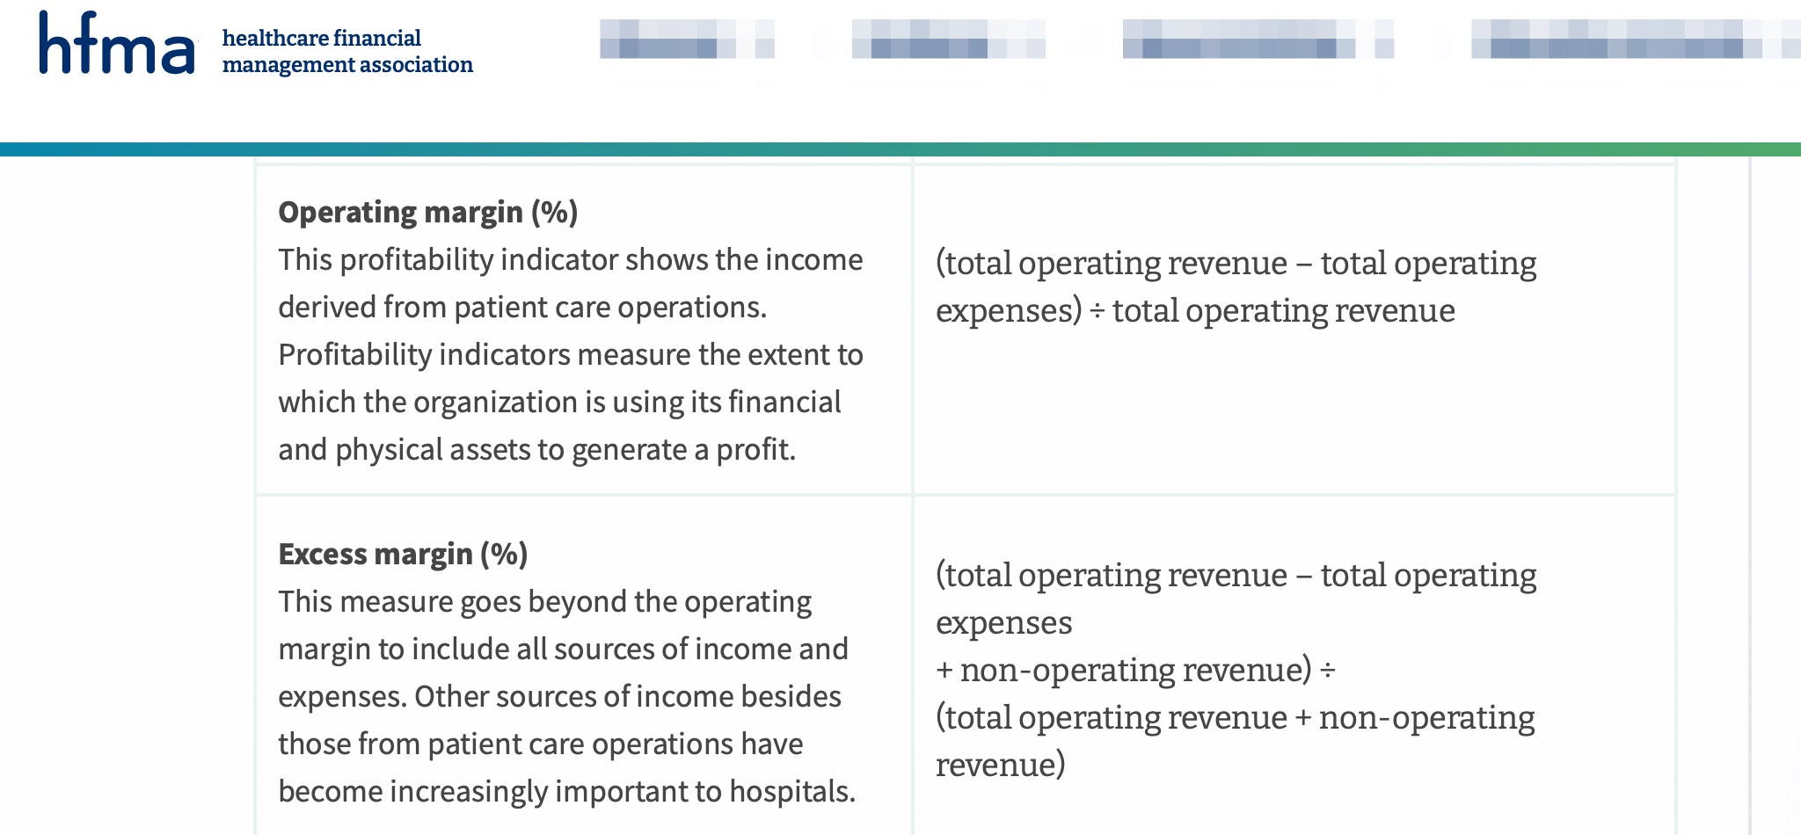
Margin Defined - HFMA
Reference https://www.hfma.org/finance-and-business-strategy/1113/

Slide 18
Kaufmann Hall - 2024

Slide 19
Financial Incentive Alignment
Under Different Payment Mechanisms to Remove Waste
WASTE REMOVAL LEVEL
PAYMENT METHOD
% of all
waste
Provider
at risk
Per
case
FFS
Case-rate Utilization
(# cases per population)
3.
45%
Note:
For green arrows, savings from waste elimination accrue to the care delivery organization.
For red arrows, savings go to payer organizations.
Within-case Variation
(# and type of units per case)
40%
2.
1.
Efficiency
(cost per unit of care)
15%
*Adapted from James Brent C and Poulsen Gregory P. The case for capitation: It’s the only way to cut waste while improving quality. Harv Bus Rev 2016; 94(7-8):102-11, 134 (Jul-Aug).
Notes:
FACILITATOR
SAY:
Here is the challenge.
Explain x and y axes
When we make improvements (e.g., eliminate a heart failure readmission), it hurts our bottom line in a fee for service and bundled per case model. We don’t get the revenue from that.
In a fee for service model, only efficiency improvements benefit the financial bottom line
Not until we move into a full capitation or provider at risk model (meaning I get paid per member per month) that we make money by making improvements and preventing heart failure from happening.
This is a big challenge because 85% of the waste in healthcare does not align with the current predominant business model
When we do something that is clinically the right thing for the patient, it hurts us financially as a healthcare delivery system.
DO:
N/A
Additional Notes:

Slide 20
Financial Survival = Operating Margins
Total revenues (+)
(top line)
Net
Operating Income
(NOI; margin)
Total operating costs (-)
(bottom line)
Notes:
FACILITATOR
SAY:
Here is a little more detail
Put in oversimplified terms, Net Operating Income is your revenues minus your costs. That’s your bottom line
Most common strategy right now, to improve the Net Operating Income, is to grow their revenue
DO:
Go to next slide to finish thought.
Additional Notes:

Slide 21
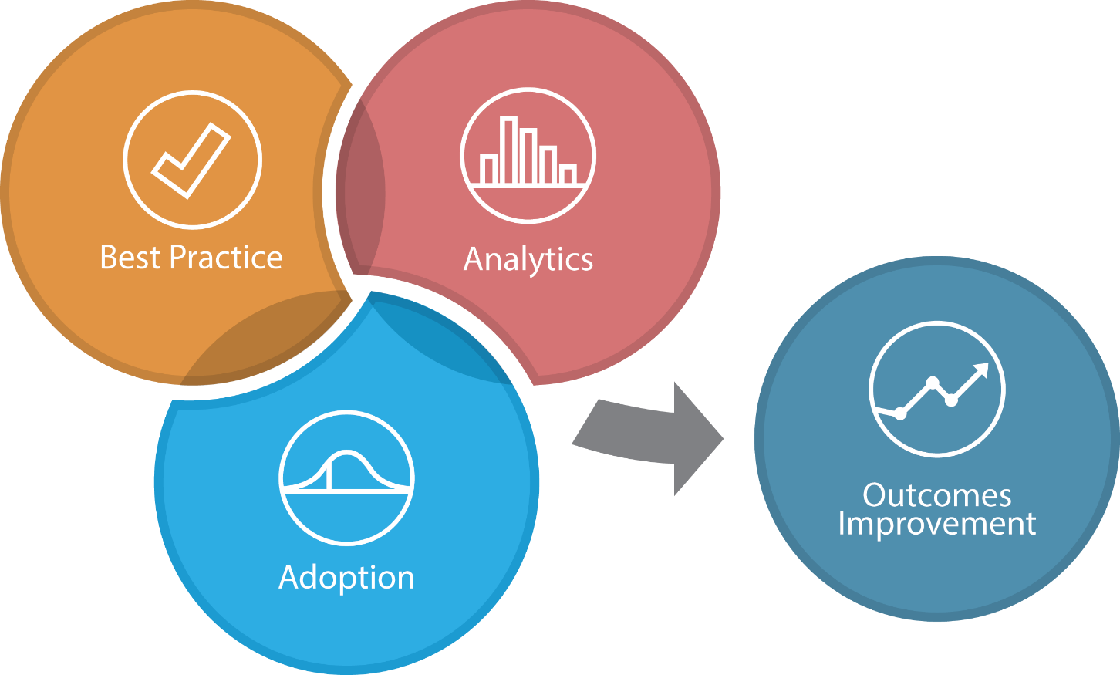
Value Creation Framework
Do we know what we should we be doing?
Quantify ideal process potential gains
Identify root cause of process challenges/pains
Re-design and improve processes
  Follow Evidence-based guidelines & protocols
  Establish expert consensus
  Standardize work operationally
Can we measure how we are doing and
predict how we will do?
Capture correct data about the process
Integrate all relevant data
Grant access to data broadly
Generate insights from data
Promote more informed decisions and actions with better tools
What value can we realize?
The Measurable Improvement:
    Health impact
      Lives saved
      Lives improved
    Financial impact
      Revenue enhancement
      Productivity gain
      Cost avoidance
      Hard cost reduction
      Shared savings
    Experience impact
      Patients & their families
      Clinicians
      Admin/support staff
Can we transform?
Educate People to learn required
  Skills
  Knowledge
  Attitudes
In addition, Accelerate Adoption with
  Strategy
  Competences
  Culture
  Operating Model
Notes:
FACILITATOR
SAY:
So if we dive into a little more detail,
Click for animation
Best practices is all about the process.
What is the root cause of our pains? And how could we improve the process? Could be following evidence-based guidelines (etc., read the bullets on the slide).
So those are all about improving the actual process flow.
Click for animation
In addition to that, we’ve got to understand the data side
What data should we be capturing about the process?
Data might be captured by different transactional systems, can we integrate that data together and give the right people access to it so we can give them an insight that will then lead to a better-informed decision or a more correct action
The way we do that is by having better tools that capture, analyze, and present data so that we can make better decisions and take better actions.
That all supposes that we can do the hardest of the three, which is adoption.
Click for animation
People often need new skills, new knowledge, and changes in attitudes.
It requires a different strategy, competencies, might require a change in culture and the way their operating model works.
Adoption is the hardest piece, you can install a tool but no one will install the tool if these things in the adoption category don’t change
So it is only when we have all three working together that we see
Click for animation
Improved health impact… (read the rest of the bullets)
Better experiences for patients, clinicians, even the support staff.
One of the things we hear all the time when folks stop doing spreadmarts and start building analytic accelerators is that their job satisfaction goes up because they are doing more meaningful work
So that is the Value Creation Framework. Let me pause here and ask what questions you have about that.
DO:
N/A
Additional Notes:

Slide 22
The Levers to Pull for Margin Enhancement
Increase charges and/or volume of services
  Fee for Service - Low return on this lever
Increased quality measure and cost-effective management – larger return
  Value based and capitation driven
Cost avoidance – Immediate return
  Avoid high-cost setting for care
  Manage in the most cost-effective setting
  Inpatient care will be most costly – one avoided stay may enhance the margin contribution better than the reimbursement

Slide 23
MUCH Higher Financial Impact:
Quality eliminating waste vs. Revenue Growth
Revenue growth:
5 to 9% contribution
for each case added
Net
Operating Margin
(and return
on investment)
Quality, Avoidable Errors and Practice Patterns eliminate waste:
50 to >100% contribution
for each case avoided
Notes:
FACILITATOR
SAY:
They have rev cycle initiatives, trying to make that revenue grow faster or they are trying to buy a neighboring hospital to get greater market share. All of that is to increase revenue
Each additional case they add, gives the about a 5-9% contribution to the bottom line. You don’t get the full revenue, you get the revenue minus the costs, and if that comes out positive it gets added to the bottom line.
However, if I can get into a value-based contract, and the majority of my contracts are value-based, when I eliminate waste
Do: Click for animation
I could add 50-100% contribution to the bottom line.
Here is an example of how that might work
DO:
Go to next slide to continue thought
Additional Notes:

Slide 24
Charge Management
The Mainstay of
Fee-For-Service

Slide 25
Factors Impacting Margin in 2024
Costs
Increased Supply
Reimbursement
LOST CHARGES !
Increased Pharmaceuticals
Increased Labor
Increased Inventory
Capped procedures
Move to Value away from Fee for service
More bundled procedures
Shrinking reimbursement

Slide 26
Charge Leakage
HFMA in 2017 stated about 1% of net patient service revenue (NPSR) is attributable to charge capture leakage
  Within the industry, different percentages are stated but average 1-3% of NPSR
Despite automation charge capture processes still occur within silos continuing the charge loss phenomenon
Charge leakage contributes to lost NPSR and degrades the margin
  The cost to perform the service has been booked against the margin (negative margin)
  Loss of potential reimbursement not only results in lost revenue but acquired costs affecting the margin negatively in both cost and charges.
Managing charges before the claim is generated is essential
Avoidance of rework due to charge leakage and late billing
Requires looking beyond basic charge reconciliation to a more robust data driven process
  Technology
  Identification of opportunities through charge association and rules processes

Slide 27
Common Charge Practice Issues
Service Line | Charge Errors | Causes
Pharmacy | Units of Service Below Expected (especially chemotherapy) | Conversion Error from Dispensed to Billed
Pharmacy | Medications charged without administration | Lost highly reimbursable administration charges
OB/GYN | Non-invasive testing frequently not charged | Lost separate reimbursement
Operating Room | Procedures are coded based on EMR without the correct time charges | Lost revenue from lost time charges
Operating Room Devices | Incorrect charges, late charge, HCPCS coding for devices is inaccurate | Reimbursement can be affected by all of these items
Emergency Services | Blood Transfusions, Injections / Infusions and Vaccinations, lost procedure charges | Items can result in lost revenue especially on outpatient basis

Slide 28
Common Charge Practice Issues
Service Line | Charge Errors | Causes
Infusion Devices | Frequently missed as a bedside procedure, observation procedure or outpatient infusion clinic | High volume procedures that are missed consistently
Endoscopy Suite | Frequent charge loss from time charges without complete coding, recovery room without procedures | Soft coding (HIM) and Hardcoding (CDM generated codes) collide
Excessive Units of Service | MUE and P2P edits (compliance) | Cause claim submission errors
Medical Necessity Errors | Failed Medicare / Payer medical necessity guidance | Line item or claim denial
Radiology | Missing Procedures – see 70xxx series but no procedure charges | Lost revenue
All service lines | Incomplete or failed charge reconciliation | Lost charges / lost reimbursement

Slide 29
Common Charge Practice Issues
Service Line | Charge Errors | Causes
Cardiology – Non Invasive | Charge loss for radioisotopes without the stress test tracing | Different departments charging same procedure
Cardiology – Invasive | Missing devices, devices with wrong HCPCS Codes, Missing primary procedures | Multiple issues with the Cath lab as they generally place charges into a Cath lab bolt on system
Charge Description Master | Old codes, deleted codes, missing modifiers | CDM creates both charge and code and CDM accuracy is paramount
Personnel | Late charges, missed charges, failed charges for supplies | The human component always is the weakest link
Interim / Travelling Staff | Unfamiliar with the system, charge capture is secondary they are there to provide care | Human component is always the weakest link
Information Systems | Charge mapping is inaccurate – charging wrong item or failed to charge at all | Complex EMR and Charging systems with documentation driven charges

Slide 30
Charge Capture – Pre Bill or Post Bill ?
Charge capture can be performed as a pre-bill review or post-bill review
Pre-bill would require 100% of daily itemized charges to be reviewed
Post-bill would require the detailed charges from the UB-04 / 837i data set
Each present advantages and disadvantages but both require 100% of the charges to be processed daily
Objective:
  To review 100% of the charges against a benchmark coding and billing source that will identify aberrancies to review and remediate

Slide 31
Charge Capture Process
Ingest Itemized Billing
Compare against Coding and charging standards
Identify aberrancy
Review EMR
Confirm Documentation Present
Identify the missing charge
Add the charge
Place back into queue for billing
Billing Complete

Slide 32
Know the Targets and the Triggers
In the case of the itemized charge the trigger will be that procedure, service, supply or pharmaceutical that is charged
The “target” will be the missing charge item
Rules based logic will ingest 100% of daily charges
  If a “trigger” is in the charges, THEN
  Look for a “target”. If the Target is present the rule does not fire
  If the “target” is not present, then the rule will fire for human review
By incorporating technology, the ability to review 100% of charges is possible when only targeted audits were previously possible
Some EMR vendors do incorporate a method to do this, such as EPIC Revenue Guardian™ however, these require the facility to build and maintain the rules
Other vendors create a complete rule library and maintain the library allowing for a “bolt on” technology to be an efficient approach which does not require the facility to maintain the rules.

Slide 33
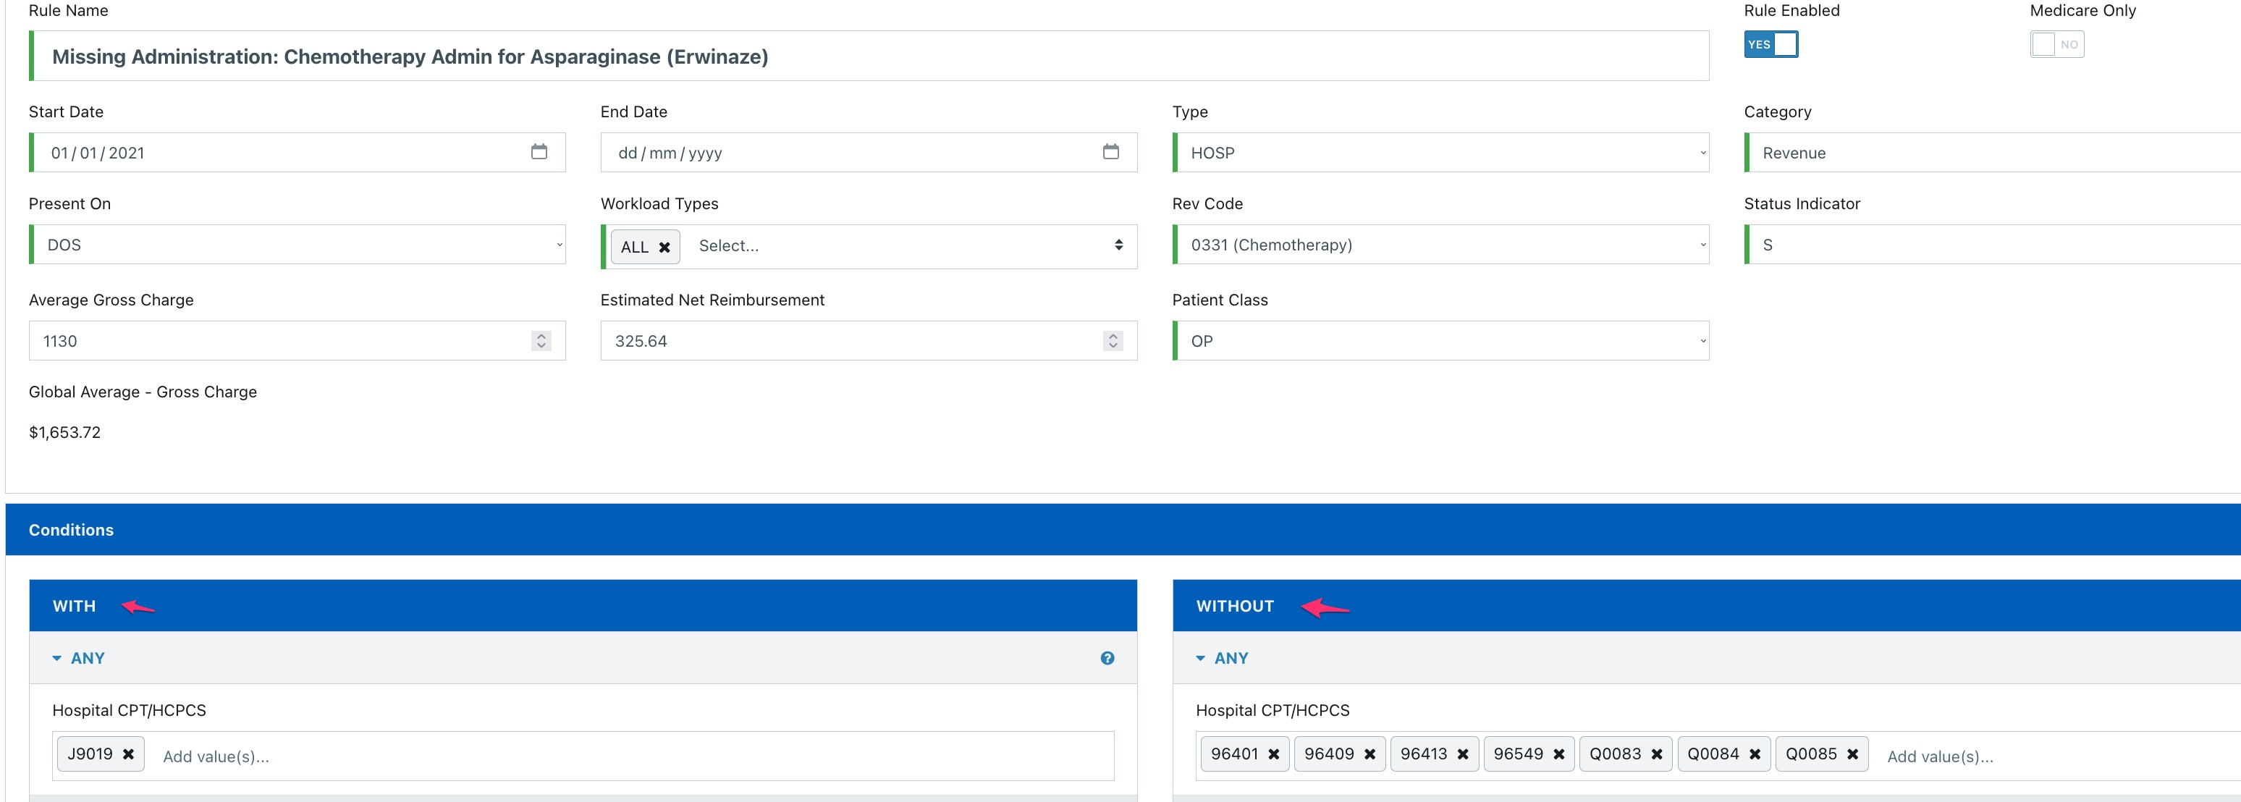
Trigger Charge is J2019 Requiring a Target (Without) to also be charged

Slide 34
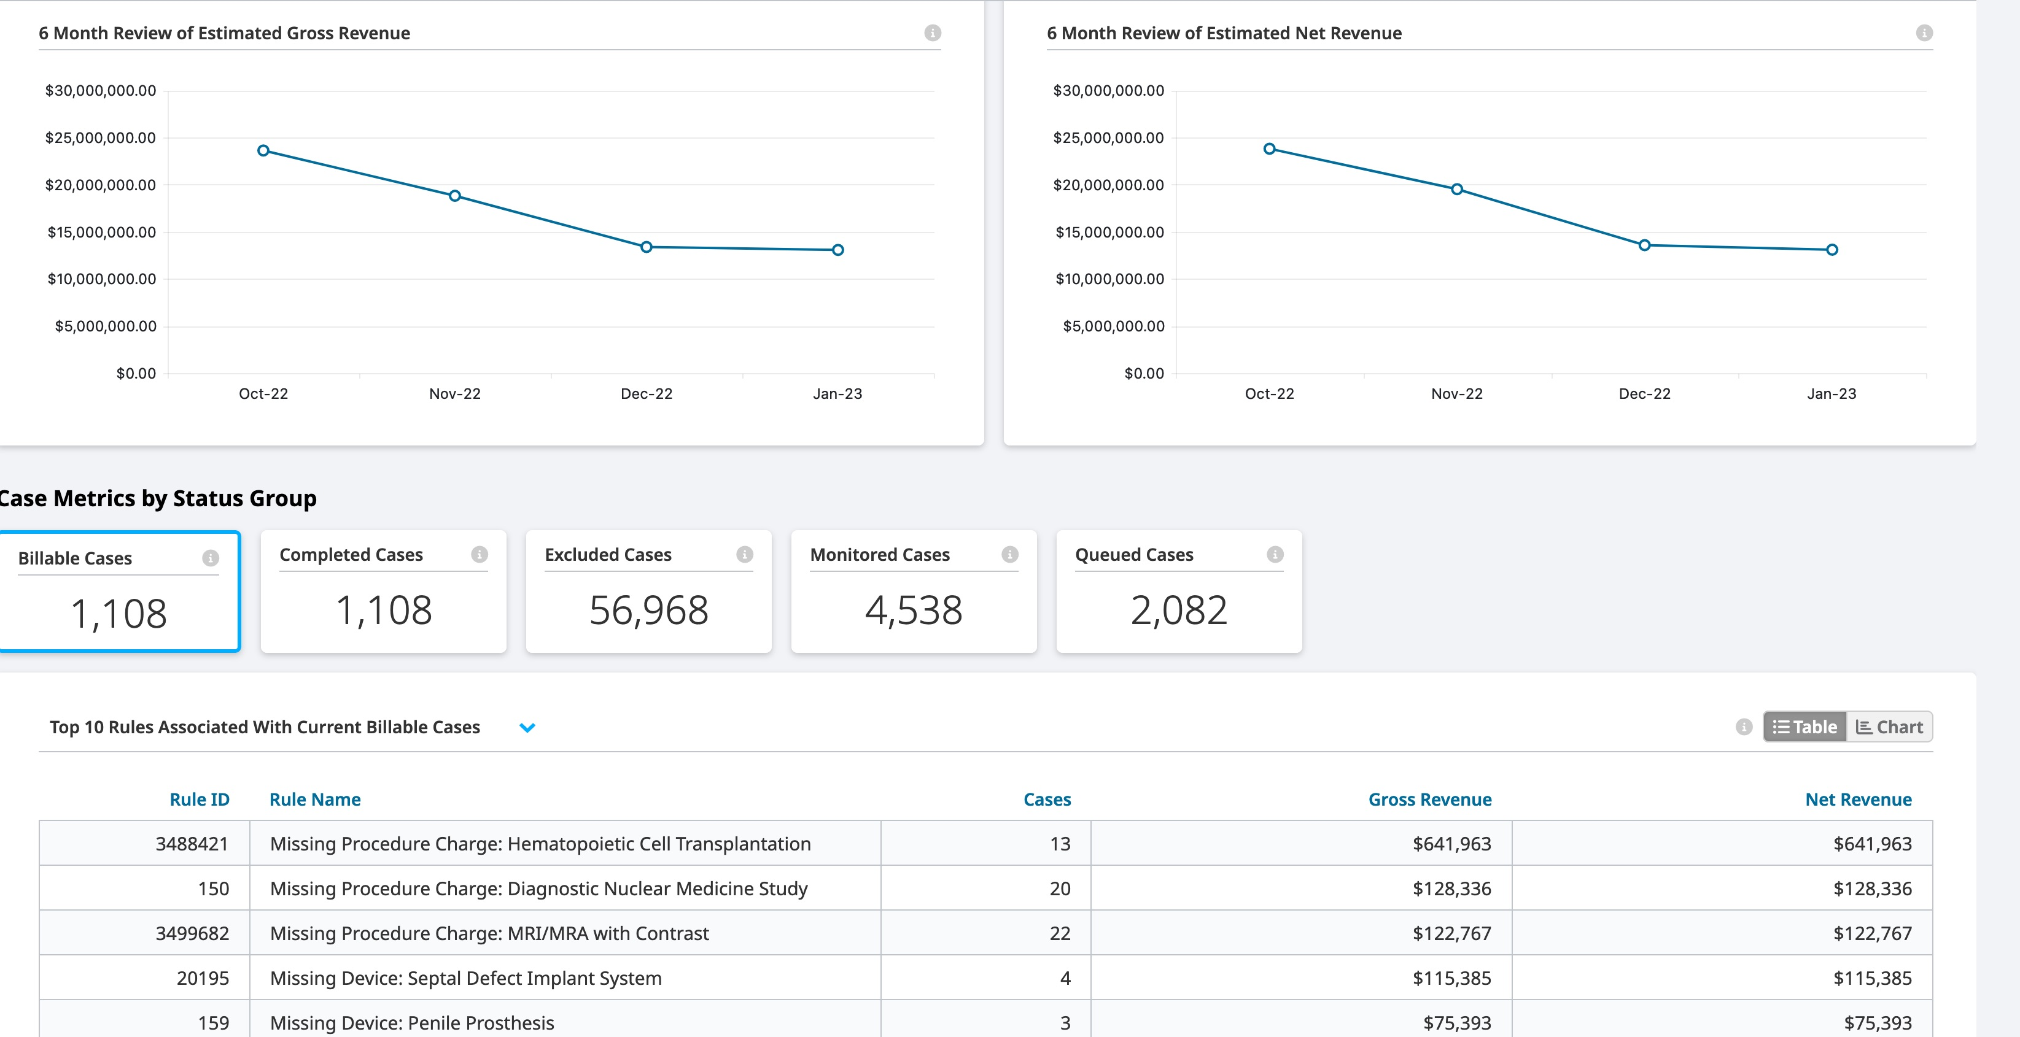
Daily & Historical Insight(s) Behind the Charge Leakage

Slide 35
Meeting the Objectives
Ability to review 100% of daily charges, have vendor-maintained rules and be able to customize any rule the objective(s) are met:
  Enhanced visibility and root cause identification / remediation
  Reducing charge leakage below the national standard of 1-3%
  Contribute to the margin through earned reimbursement
  Reduce re-work and failed claims
  Reduce future denials
  Ensuring compliant charge capture

Slide 36
Cost Management:
The New Focus for facilities and patients!

Slide 37
The Fundamental Problem
“Fee-for-Service” payment system incentivizes doctors and hospitals to order more tests and do more procedures
Cost management methods such as Relative Value Units (RVUs) or Ratio of Cost to Charges (RCC) were necessary in the 1980s, 1990s, and 2000s but fail to scale beyond the limitations of charge codes
Without a reliable understanding of what it costs to provide care to patients, hospitals and health systems struggle to agree on basic information about the services they provide – such as what services are most profitable? What should we stop doing? How can we trust the answers to those questions?
Healthcare costs in the USA are the highest/worst in the developed world

Slide 38
The Fundamental Problem
Cost management methods such as Relative Value Units (RVUs) or Ratio of Cost to Charges (RCC) were necessary in the 1980s, 1990s, and 2000s but fail to scale beyond the limitations of charge codes (EXAMPLE)
How to calculate a Ratio of Cost to Charges (RCC) for a Nursing Unit:
Step 1:
Sum Total Costs ($263,000)
Step 2:
Sum Total Charges ($1,000,000)
Step 3:
Divide total Costs by total Charges
$263,000 / $1,000,000
=
0.263
Usually calculated quarterly or yearly

Slide 39

RCC COSTING FLAWS
EXAMPLE: NURSING UNIT
Patient A
Patient B
Patient C
RCC | 0.263
RCC Cost | $816
Minutes | 1,467
ABC Cost | $934
Difference | $118
RCC | 0.263
RCC Cost | $816
Minutes | 1,308
ABC Cost | $833
Difference | $17
RCC | 0.263
RCC Cost | $816
Minutes | 1,232
ABC Cost | $785
Difference | ($32)
RCC | 0.263
RCC Cost | $816
Minutes | 1,467
ABC Cost | $934
RCC | 0.263
RCC Cost | $816
Minutes | 1,308
ABC Cost | $833
RCC | 0.263
RCC Cost | $816
Minutes | 1,232
ABC Cost | $785

Slide 40
The Fundamental Problem
Cost management methods such as Relative Value Units (RVUs) or Ratio of Cost to Charges (RCC) were necessary in the 1980s, 1990s, and 2000s but fail to scale beyond the limitations of charge codes (EXAMPLE)
How to apply RVUs in an Imaging Unit performing MRIs:
Step 1:
Assign RVUs to modality:
- Upper Extremity 1.62
- Pelvis 1.46
- Brain 2.36
Step 2:
Calculate Cost per RVU:
$400,000 / 11,765
=
$34 / RVU
Step 3:
Multiply Cost per RVU by modality RVU
- Upper Extremity:
$34 * 1.62
=
$55

Slide 41
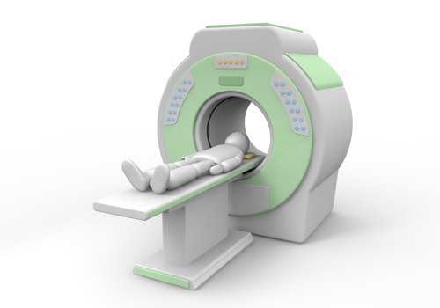
RVU COSTING FLAWS
EXAMPLE: MRI SERVICES
MRI Upper Extremity
MRI Pelvis
MRI Brain
RVU | 1.62
Cost / RVU | $34
RVU Cost | $55
Minutes | 40
ABC Cost | $116
Difference | $61
RVU | 1.46
Cost / RVU | $34
RVU Cost | $50
Minutes | 87
ABC Cost | $250
Difference | $200
RVU | 2.36
Cost / RVU | $34
RVU Cost | $80
Minutes | 39
ABC Cost | $112
Difference | $32

Slide 42
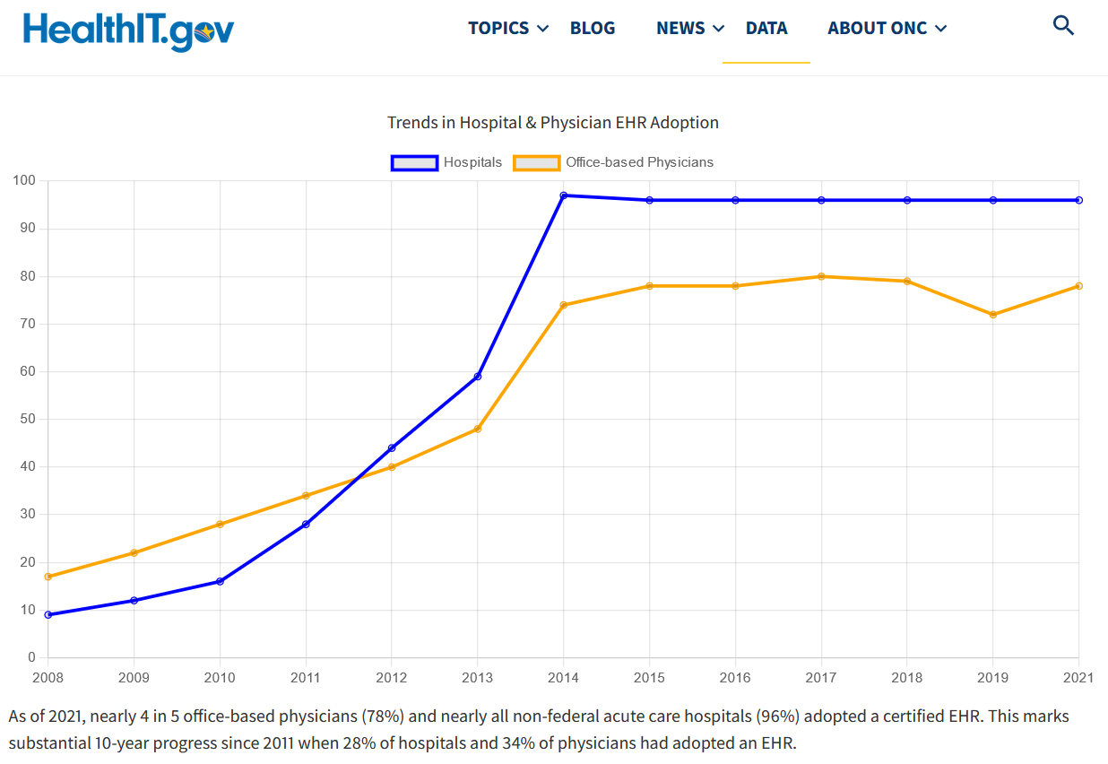
The Fundamental Problem
Broad and standard use of EMRs is still a relatively new reality

Slide 43




Managing Costs by Patient Pathway
3 patients having the same procedure
Patient 1
Patient 2
Patient 3
1
2
3
Notes:
Let me help you visualize this value through the journey of three different patients who need meniscus surgery.
Imagine these patients come to the hospital via three different routes:
One of them could have been in car accident and came through the ED (Emergency Department).
Another has been having issues and finally talked to his orthopedic surgeon and they agreed, let’s get it fixed.
The third person might have gone through their primary care physician and tried some rehab on her own, and is now going to a specialist, before ending ends up there.

Slide 44
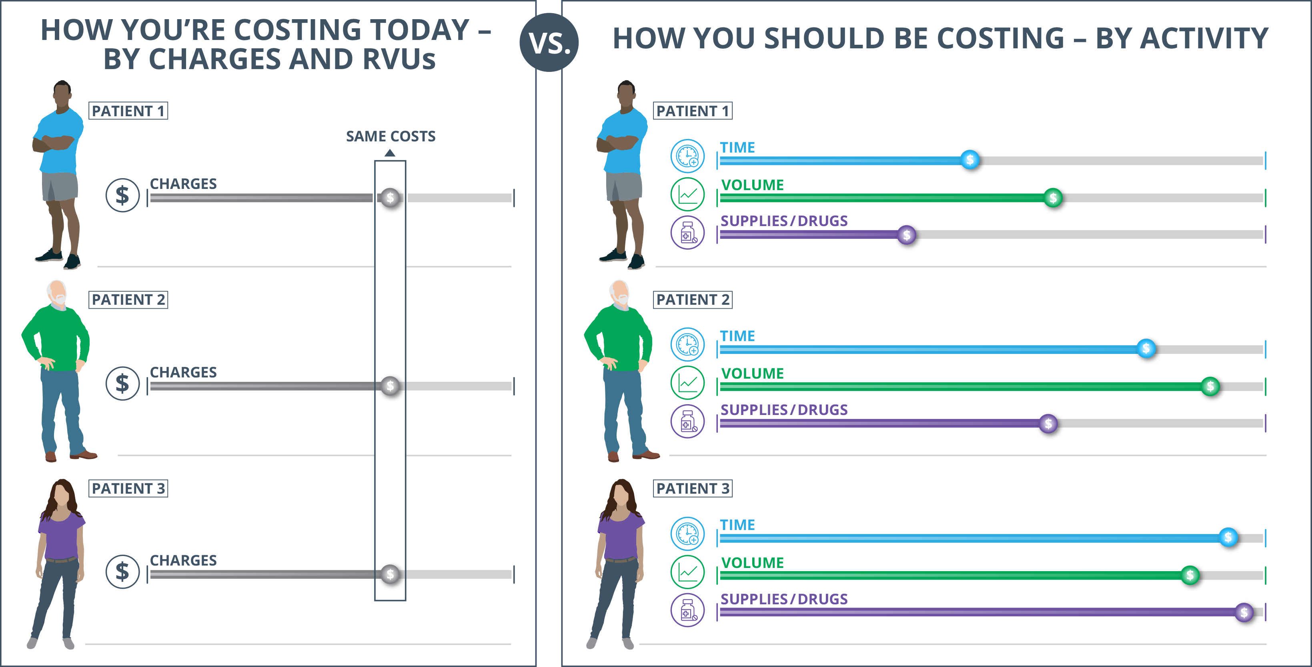
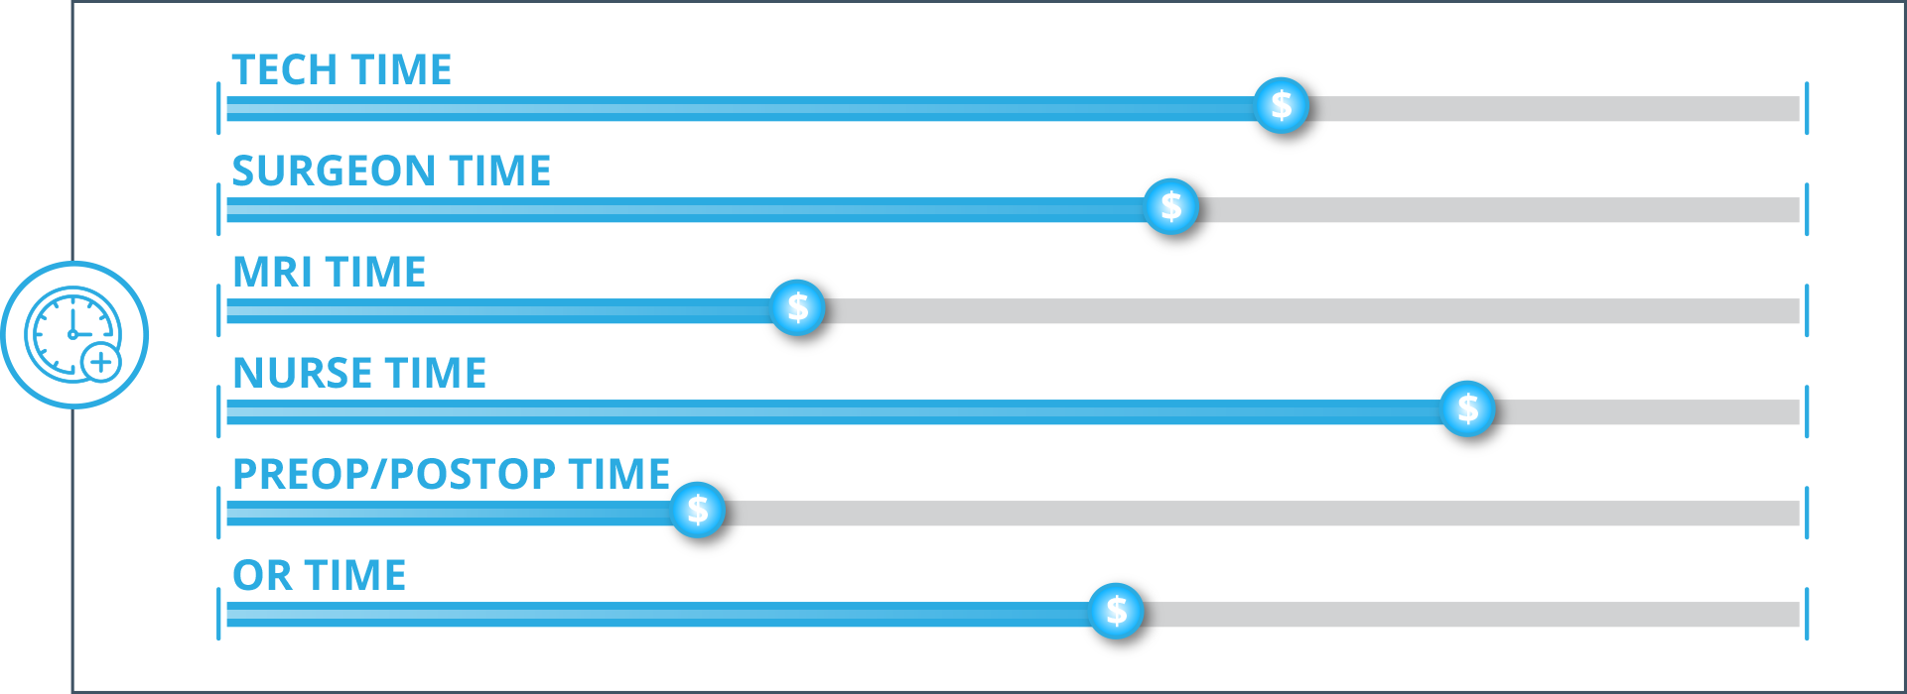
Activity-Based Costing
A paradigm shift affording greater visibility into the true costs of service delivery
44

Slide 45
Example: Strengthen Strategic Decision Support
Data showing that more expensive procedures to not always yield better outcomes
 |  | Laparoscopic | Vaginal | Robotic | Open | Total Hysterectomies
 | Cases | 870 | 250 | 330 | 280 | 1,730
Per Case | Revenue | $ 6,207 | $ 10,480 | $ 5,152 | $ 7,036 | $ 6,757
 | Direct & Indirect Expense | $ 5,397 | $ 4,400 | $ 6,803 | $ 7,893 | $ 5,925
 | Margin | $ 810 | $ 6,080 | $ (1,651) | $ (857) | $ 832
*Sample data for illustrative purposes.
Notes:
Here’s an example that shows how we can help you strengthen strategic decision-support:
A service line analyst wants to test the hypothesis of whether it’s better to use robots for surgery to understand if they should buy more.
The data on this slide shows that Robotic costs are higher than traditional Hysterectomy surgeries.
Because we can tap into clinical data (only we do that) integrated with cost data, we can help you uncover that outcomes for Robotic Hysterectomy were no better, and in some cases worse, than traditional methods.
Therefore, you can determine that buying another costly robot for surgery is not necessary.

Slide 46
Example: Empower Change with Trustworthy Data
Full Consumption Costing and Clinical Variation
Direct (54%)
Service Center (46%)
Consumption Driver
Avg. cost per procedure:
$3,530
20%
Surgical
Services
Surgical Services:
OR Case Minutes – Room-in to Room-out time, Staff Time
Supplies, Blood, and Drugs
Average cost per procedure:
$9,950
66%
161%
variation
Avg. cost per procedure:
$2,520
Nursing:
ADT Minutes – Time patient was in bed (NOT # of room charges)
14%
Nursing
53%
203%
variation
45%
162%
Avg. cost per procedure:
$710
Interventional Diagnostics:
Lab count, Imaging time (MRI), Imaging counts (X-ray)
4%
Interventional & Diagnostics
variation
35%
333%
variation
Avg. cost per procedure:
$1,510
8%
All Other
All others:
Varies by service
67%
155%
variation
$9,950
$8,270
=
$18,220
67%
155%
67%
184%
55%
155%
variation
variation
variation
Example of Lumbar Spinal Fusion (n=852)
Notes:
Here’s an example that shows how we can help you strengthen strategic decision-support:
A service line analyst wants to test the hypothesis of whether it’s better to use robots for surgery to understand if they should buy more.
The data on this slide shows that Robotic costs are higher than traditional Hysterectomy surgeries.
Because we can tap into clinical data (only we do that) integrated with cost data, we can help you uncover that outcomes for Robotic Hysterectomy were no better, and in some cases worse, than traditional methods.
Therefore, you can determine that buying another costly robot for surgery is not necessary.

Slide 47
Supply Variation Provider – Hip & Femur

Slide 48
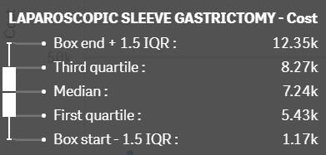
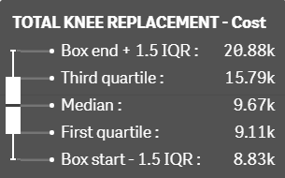
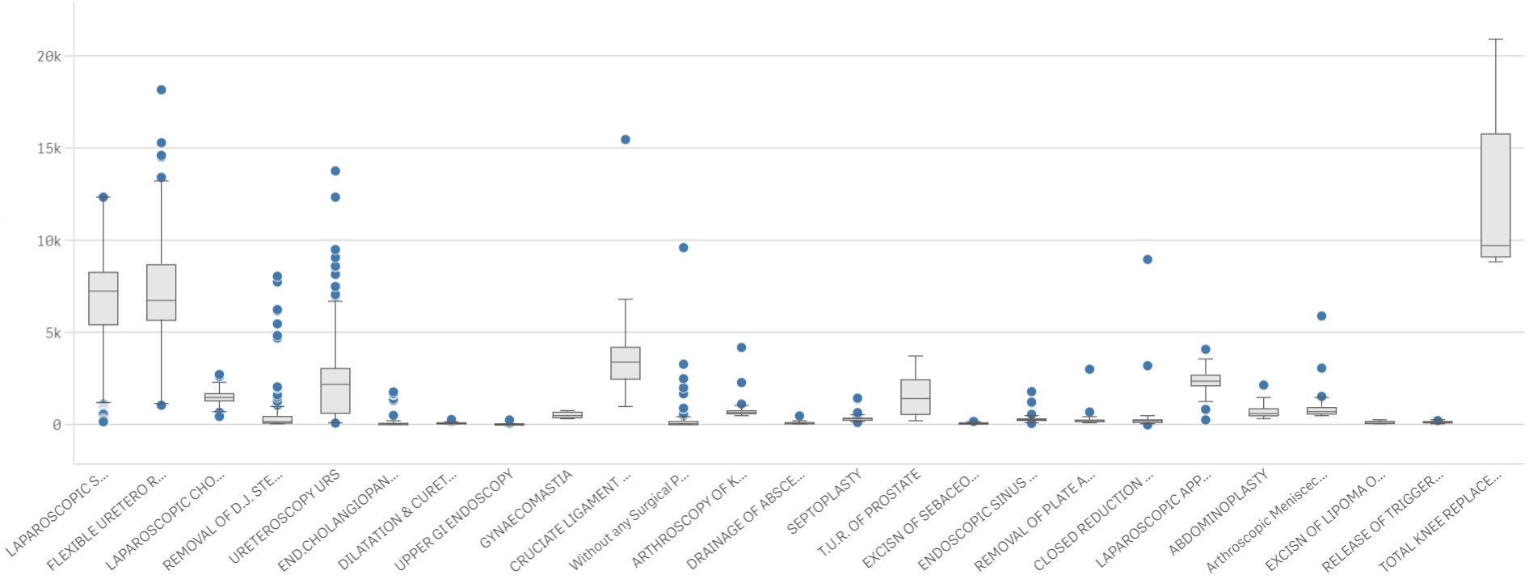
Supply Variation by Procedure
85 Procedures
$104,196 Opportunity
14 Procedures
$73,875 Opportunity
Laparoscopic Sleeve Gastrectomy:
median is $7.24 K with high variation around the center representing 16% to 171%
Total Knee Replacement:
median is $9.67 K with high variation above the center representing 91% to 216%
85 Procedures
14 Procedures
Supply Cost
25 Procedures

Slide 49
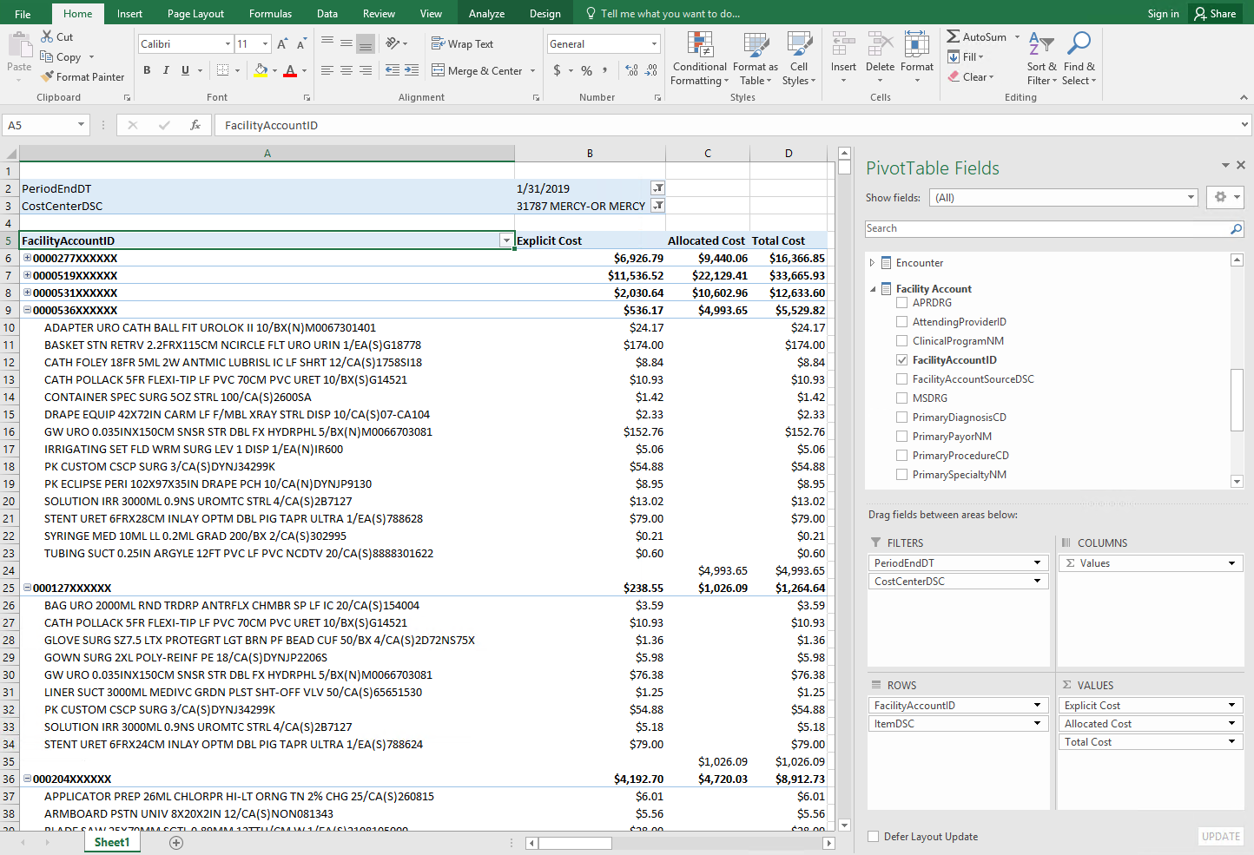
Supply Item Level Detail by Patient Account

Slide 50




Patient and Physician Level Costing
Catalyst for Change
Organization Level
Health System
Team Level
Hospital 1
Hospital 2
Hospital 3
Service Lines
Orthopedics
Cardiology
Neurosurgery
Primary Care
Oncology
Pediatrics
Behavioral Health
Leader or
Physician Level
The Triple Aim requires individual visibility and accountability.
Notes:
Set strategies at the highest level, implement at the leader or physician level.

Slide 51
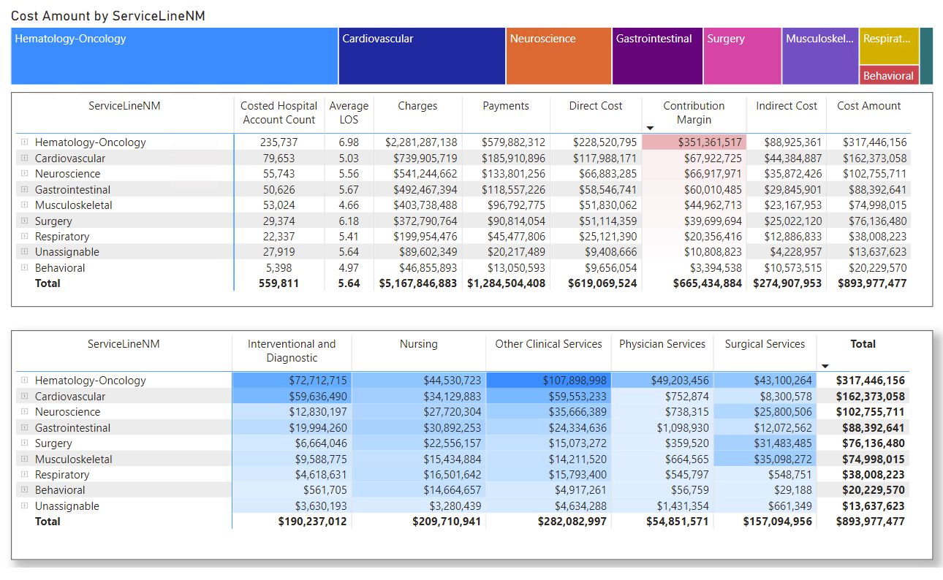
Patient and Physician Level Costing
Catalyst for Change
Profitability by Service Line:
Cost Consumption
Heat Map
Service Line (rows) by
Service Center (columns):
Notes:
Set strategies at the highest level, implement at the leader or physician level.

Slide 52
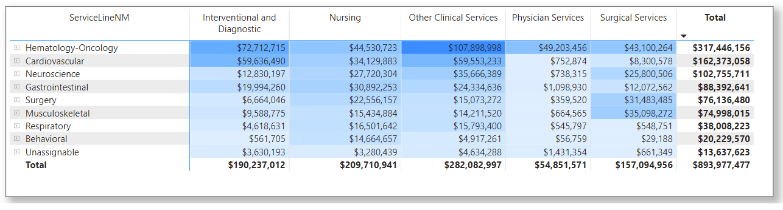
Patient and Physician Level Costing
Catalyst for Change
Cost Consumption Heat Map: Service Line (rows) by Service Center (columns):
Notes:
Set strategies at the highest level, implement at the leader or physician level.

Slide 53
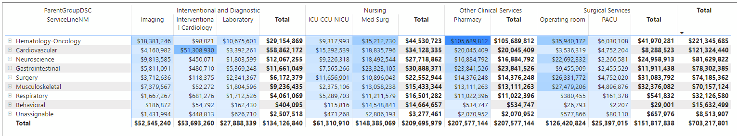
Patient and Physician Level Costing
Catalyst for Change
Cost Consumption Heat Map Service Line (rows) by Functional Group (columns):
Drilled Down to Key Functional Groups
Notes:
Set strategies at the highest level, implement at the leader or physician level.

Slide 54
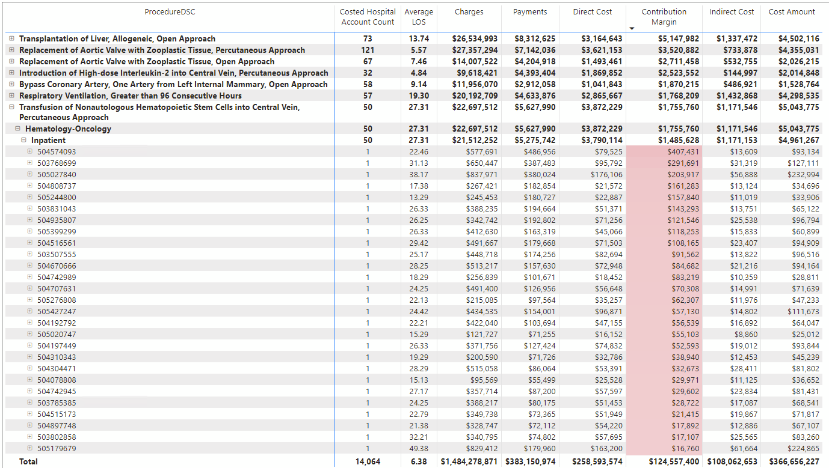
Focus on the Margin
Where am I supporting my bottom line?
Notes:
Set strategies at the highest level, implement at the leader or physician level.

Slide 55
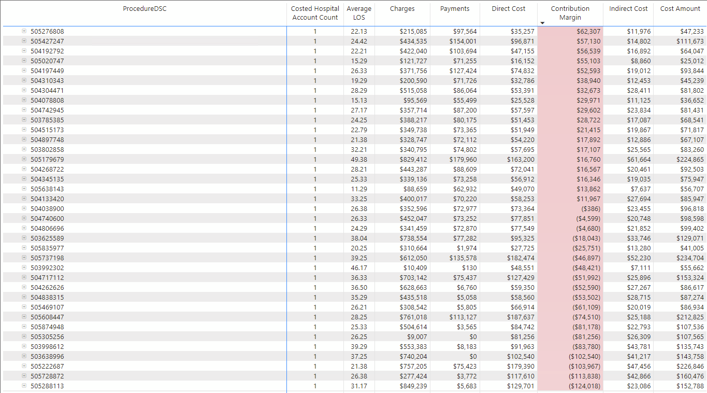
Focus on the Margin
Where am I supporting my bottom line?
Notes:
Set strategies at the highest level, implement at the leader or physician level.

Slide 56
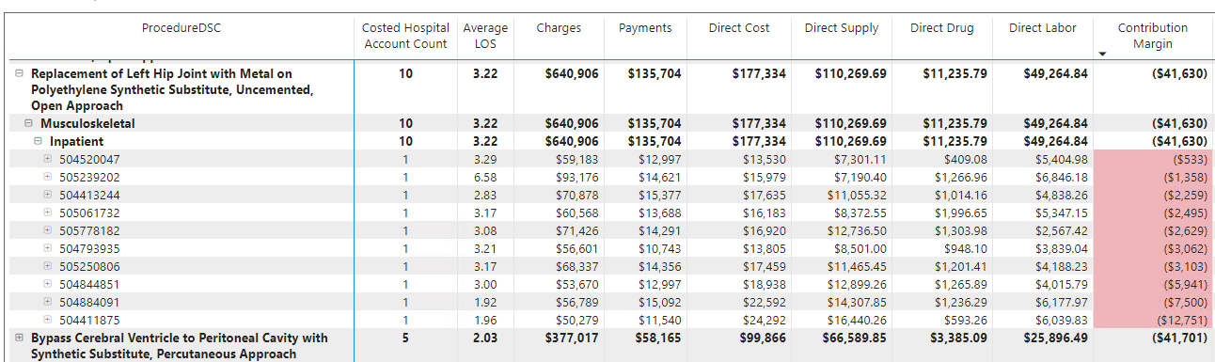
Focus on the Margin
Where am I supporting my bottom line?
Notes:
Set strategies at the highest level, implement at the leader or physician level.

Slide 57
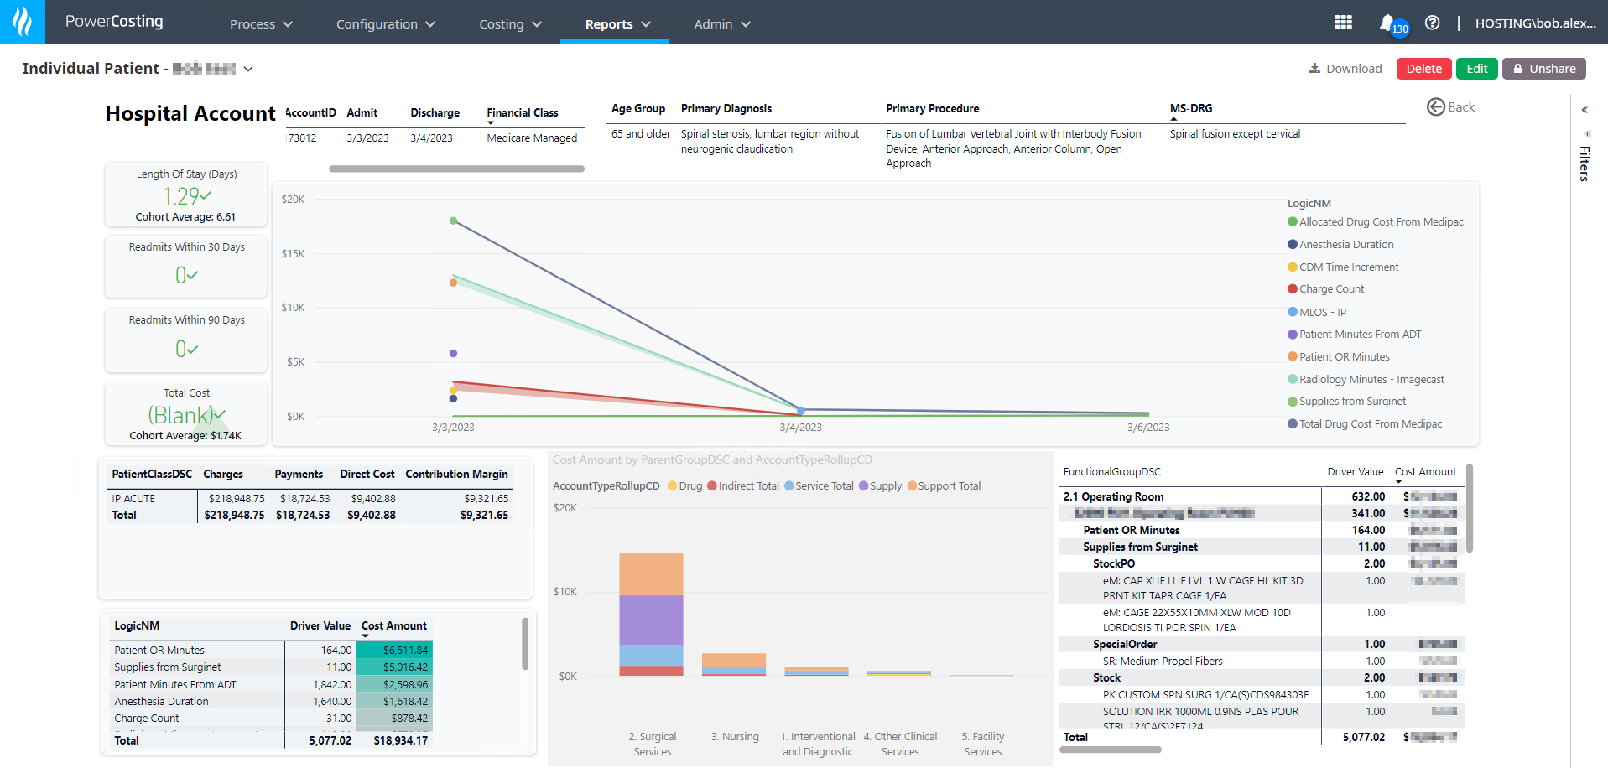
Example: Empower Change with Trustworthy Data
Individual Patient
Notes:
Here’s an example that shows how we can help you strengthen strategic decision-support:
A service line analyst wants to test the hypothesis of whether it’s better to use robots for surgery to understand if they should buy more.
The data on this slide shows that Robotic costs are higher than traditional Hysterectomy surgeries.
Because we can tap into clinical data (only we do that) integrated with cost data, we can help you uncover that outcomes for Robotic Hysterectomy were no better, and in some cases worse, than traditional methods.
Therefore, you can determine that buying another costly robot for surgery is not necessary.

Slide 58
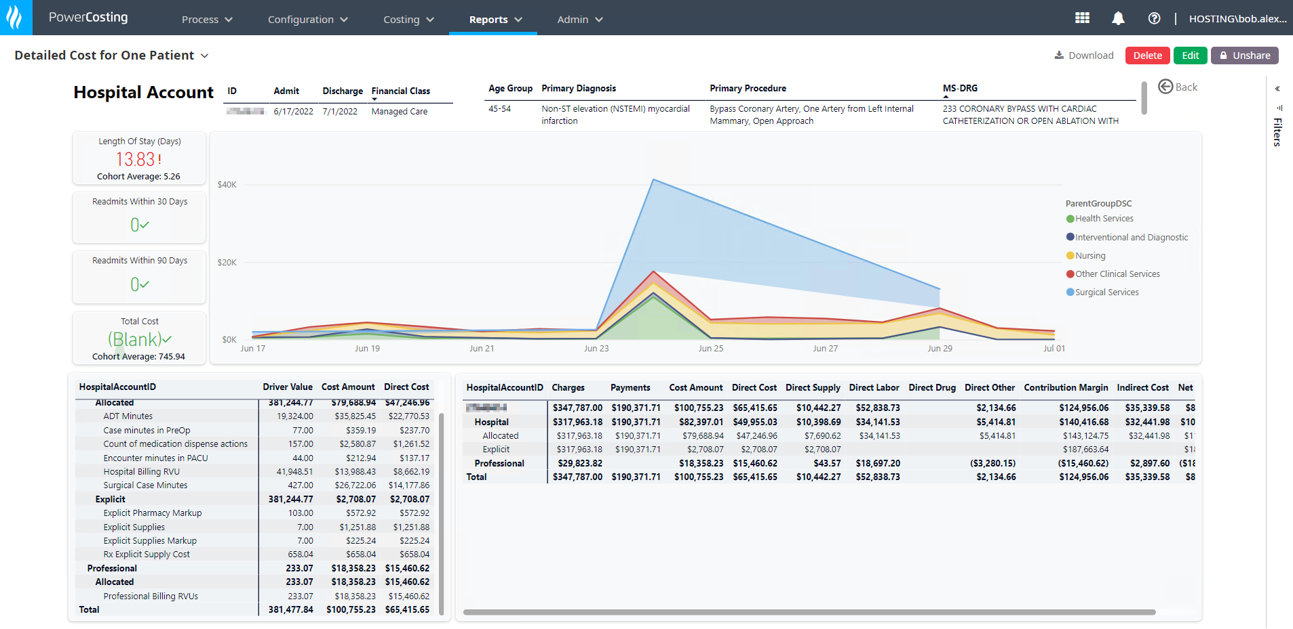
Example: Empower Change with Trustworthy Data
Individual Patient
Notes:
Here’s an example that shows how we can help you strengthen strategic decision-support:
A service line analyst wants to test the hypothesis of whether it’s better to use robots for surgery to understand if they should buy more.
The data on this slide shows that Robotic costs are higher than traditional Hysterectomy surgeries.
Because we can tap into clinical data (only we do that) integrated with cost data, we can help you uncover that outcomes for Robotic Hysterectomy were no better, and in some cases worse, than traditional methods.
Therefore, you can determine that buying another costly robot for surgery is not necessary.

Slide 59
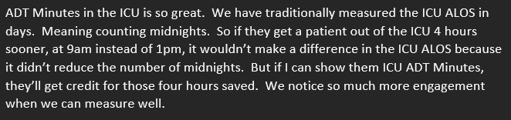
The Simple Answer – Better Data Speaks Volumes
Recent feedback from a Hospital CFO:
Notes:
Health Catalyst is the best solution on the market to support your organization:
Comprehensive and integrated, financial and clinical data*, for a holistic picture of your costs
We don’t limit the data points a client can compare cost to and on avg, our clients have 53K data points.
Strata dictates which data points can be used against costs and it’s 225
We offer automated access to in-depth clinical data
Strata claims to access clinical data, but it’s only with Epic’s EMR, it's not automated, and they charge an additional fee​.
All at great speed - up to 97% improvement in time to access data according to UPMC
Automated activity-based costing across 100% of clinical costs, with minimal effort
We accurately measure the costs of health care resources across supplies, drugs and labor, used as a patient moves along a care pathway resulting in an understanding of true costs
Strata uses RVUs for direct costs only (e.g., supplies and drugs), which is not the whole picture (e.g., missing labor)​
Frictionless, self-service reporting from the start
Our normalized data from multiple domains, including in-depth clinical, help our clients to address their unique reporting needs, without having to build the capability from the ground up and train staff, saving precious time
Strata’s 200+ canned reports don’t address a client’s unique needs, making costly custom-built reporting inevitable
Timely, robust and predictive, labor productivity management
We provide a comprehensive view of labor, including contract, premium, and overtime, etc., and predictive analytics for proactive labor productivity management
Other vendors don’t use cost, staffing and patient data:​
Kronos data does not include cost of staffing​
Strata uses RVUs and charges instead of granular EMR data to understand the volume of patients that drive staffing
*We harness data from (1) electronic health record, (2) financial and (3) patient report outcomes data with the (4) post-acute care claims and (5) proprietary benchmarks built upon a data registry of hundreds of thousands of patients.

Slide 60
Labor Impact:
Stay Tuned for a Whole Presentation on this Topic !

Slide 61
Bob Alexander and William Malm
hcwebinars@healthcatalyst.com

